Slide 1
SLUGTERRA
1. Slugterra is a videogame. When you shoot slugs they transforn
2. Eli is the main person with his slug burppy
3. There is slugs called ghouls
4. Ghouls are slugs but when they get exposed to stuf called dark watter they are ghouls

Slide 2
5
There are cats in slugterra.
8
There are spiders in slugterra
7
Eli's birthday is in january .
9
Most ghouls have red eyes
6
A group of slugs is called a flock.

Slide 3
1. Kord the member of the shane gang. He wears purple boxers with flowers on them. 2 Burpy is immortal.

Slide 4
These are the slugs.

Slide 5
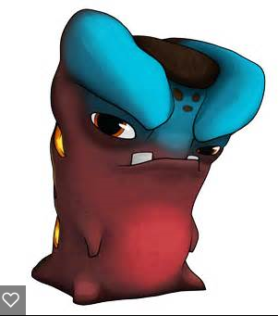
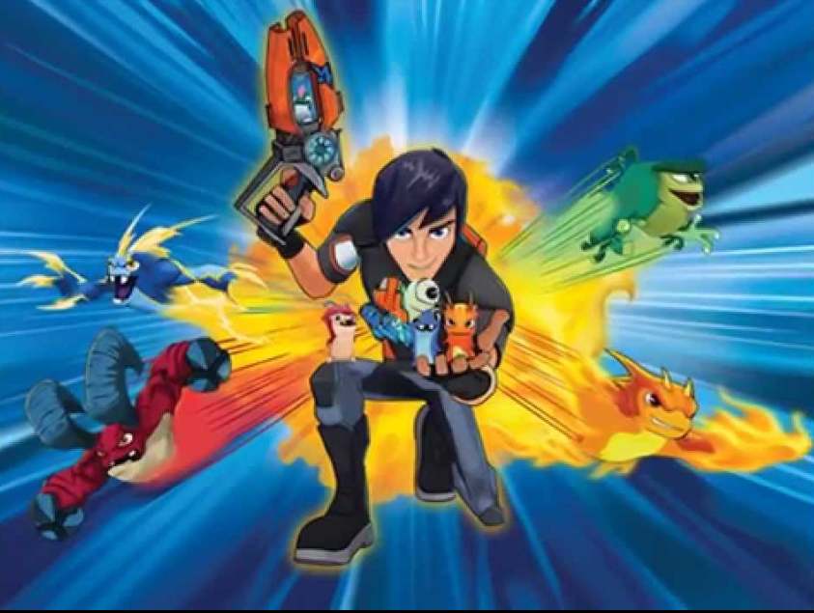
slugterra

