Slide 1
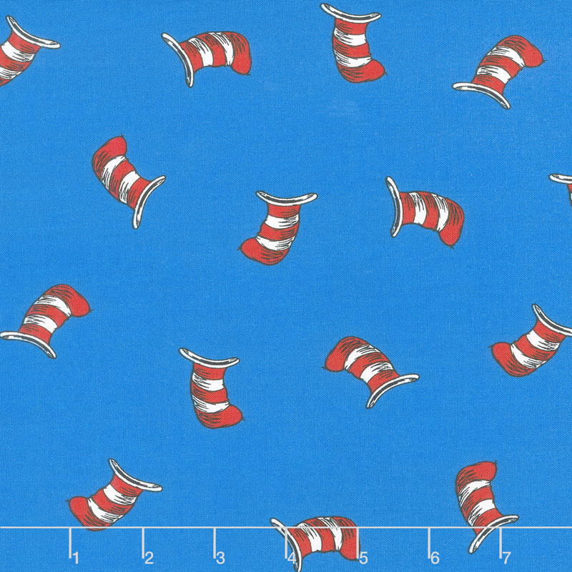

Welcome to the 1 Bransfield Virtual Classroom! Have fun exploring! For this week’s activities for Literacy and Numeracy, click on the Literacy and Numeracy tabs and check out the weekly message for each one!
If you have any questions, please email krista.bransfield@nbed.nb.ca

Slide 2


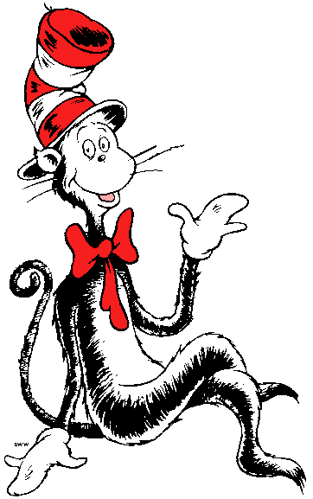






Slide 3






Slide 4



















Slide 5


















Slide 6






Slide 7

Literacy at Home with Ms. Bransfield – Week of January 17 - 21
Hi boys and girls! I miss you all! Here are your Literacy activities for this week.
Listen to Reading: Listen to a RAZ-Kids book or a Storyline Online book each day. Do a “Five-Finger Retell” for a grown-up (see handout in home learning packet ) after each book.
Read to Yourself: Once you’ve finished listening to your RAZ-Kids book each day, read it to yourself. Don’t forget to try the quiz when you’re done! Remember, no Robot Reading!
Read to Someone Else: Once you’ve finished practicing your RAZ-Kids book, read it to a grown-up each day!
Word Work:
Monday) Go to Spelling City and click on the –est words (best, nest, rest, test, west). These are your words for this week. Try some games! Practice spelling them.
Tuesday) Syllables https://www.youtube.com/watch?v=HKxAjCqc3wU
Wednesday) Have fun playing Squiggle Park!
Thursday) Show your grownups how neatly you can print by practicing writing your spelling words (see sheet in home packet).
Friday) Nouns and verbs (videos)
Nouns https://www.youtube.com/watch?v=9cu7C07pNbA
Verbs https://www.youtube.com/watch?v=j3EYciNco58
Work on Writing: Each day you will have a writing assignment (see the booklet in home packet). Use the word wall in your home packet. Try to include at least five details. Don’t forget your end punctuation and capital letters.

Slide 8



Slide 9


Slide 10
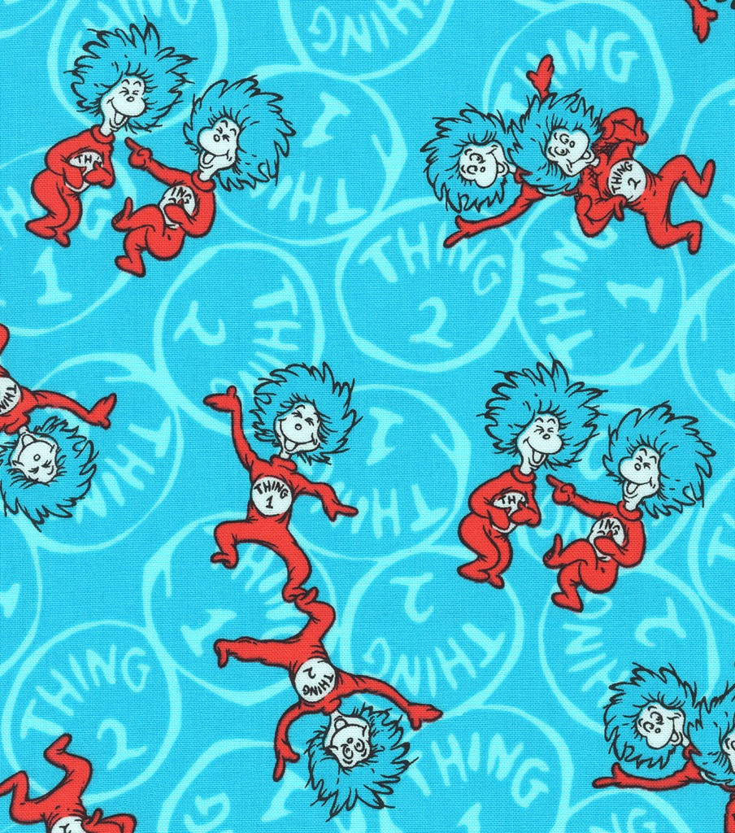


Slide 11

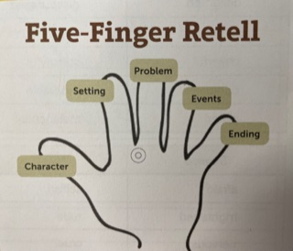

Slide 12











Slide 14

a
and
are
as
at
be
for
from
had
he
his
I
In
is
it
of
on
or
that
the
they
to
was
with
you

Slide 15
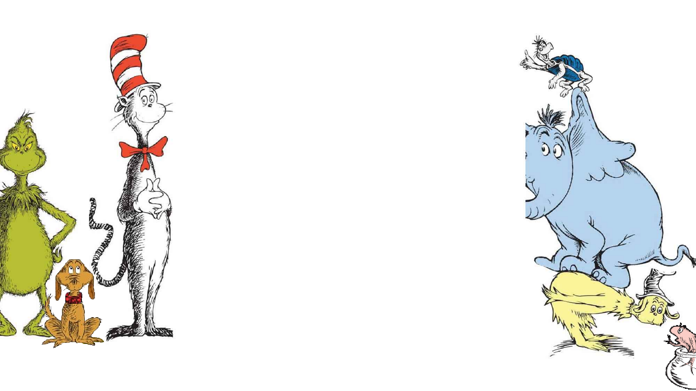




Slide 16





Slide 17

Monday | Tuesday | Wednesday | Thursday | Friday
*10-Pin Bowling (see attached sheet) *Look at the combinations of 10 on the worksheet. On the back of your sheet, write out all of the friends of 10. For example, 1 + 10 and 10 + 1) *DreamBox | *I have a machine that adds 5 to every number I put in. If I put in 4, what comes out? If I put in 16, what comes out? If I put in 12, what comes out? If I put in 25, what comes out? If I put in 54, what comes out? Try a few more and record all of your answers. *Dinasaur Addition Story (see attached sheet) *DreamBox | *More Addition Stories (see attached sheet) *DreamBox *Play a card game with someone you love. | *Act Out Addition Stories (see attached sheet). *Play a dice game with someone you love. *DreamBox | *Winter Addition (see attached sheet). *DreamBox *Play a card game with someone you love.

Slide 18
Math Card Games to play: (most of these games were found on https://thatfunteacher.com and I was given permission to share)
Go Fish – This is an old favorite of mine. Each player gets 5 cards and the remaining cards are placed in the middle of the table, all messed up. Before play starts, players look for pairs in their hand and place them in a pile. Players ask, “do you have a __”. If the other player has the card asked, he/she gives it up. If the other player does not have the card asked, the other player says, “go fish” and then he/she picks a card from the pile. If a player runs out of cards, then they pick up 5 more from the pile.
Go Fish for 10 – In this game, you need to remove the kings and jacks from the deck. The ace = 1 and the queen = 0. Each player get 4 cards. It’s pretty much the same as ‘go fish’ but with this game, you are looking for combinations of 10, not matches.
Go for 10 – For this game, you need to remove all of the face cards. Then lay out 20 cards on the table, face up. Each player takes turns removing 2 cards that add up to 10. Try to remove as many cards as you can.
Sum War – For this game, you need to remove the kings and jacks from the deck. The ace =1 and the queen = 0. Split the deck equally among players. Each player will turn over 2 cards and say the sum of the two numbers. The person with the greater sum wins and takes all of the cards. Play until all the cards are gone. The person who has the most cards in the end, wins. This can also be played using subtraction.
25 – For this game, you need to remove all of the face cards and then spli25 – For this game, you need to remove all of the face cards and then split the cards equally among players. Each player will turn over a card and add it to the previous number. So, in the first round, you are only turning over a card. You will then keep adding cards until you get to 25. If you get a card that would bring you over 25, you will then subtract the number. When someone reaches 25 first, they win.
Uno – If you have this game at home, it is another fun one to play. Follow the directions on the package.
7 Up – This is a 2 player game where each players gets 7 cards. Line cards up in a straight line, face down. The remaining cards are placed in a pile, face down. The first player will draw a card from the deck and if it is a number from 1-7, they would place it in that spot in the line. For example, if I got a 2, I would place it in the second spot and see what the next card is. If that number is also from 1-7, I would continue placing my cards until all 7 cards are revealed.

Slide 19

Math Dice Games to play: (games are from www.whatdowedoallday.com) If you visit this website, there are videos that show you a visual on how to play the games. I did not post all of them but feel free to play more.
Passage – You will need 2 dice and 2 or more players. The objective of this dice game is to be the first player to get 11. To begin, each player rolls a die. The player with the highest number will go first. The player who rolled the lowest number will roll again and that number will become the “point number.” Beginning with the first player, players will take turns rolling 2 dice. If he/she rolls the point number, he/she gets one point. If he/she rolls doubles of the point number, he/she gets 2 points. Each player gets only one roll per turn. First player to get 11 points will be the winner.
Fifty – You will need 2 dice and 2 or more players. The objective of this dice game is to be the first player to reach 50. Taking turns, each player will roll 2 dice. If you do not roll doubles, you do not get a score for that round. This is how doubles are scored: Double 1’s, 2’s, 4’s, 5’s = 5 points, Double 6’s = 25 points. If a player rolls Double 3’s, their score up to that point is wiped out and they restart.
Three or More – For this game, you will need 5 dice and 2 or more players. The objective of this game is to get the highest score after rounds. It is suggested to play 10 rounds but you can modify that. To play, players take turns rolling all 5 dice. The goal is to roll a 3 of a kind. The following will happen in each turn: (1) If the roll contains no matches, the score is 0 and the turn is over. (2) If the roll contains 3 or more of a kind, the score is recorded and dice are passed to next player. (3) If the roll contains 2 of a kind, the player may re-roll the remaining 3 dice. If after the second roll, there is not at least a 3 of a kind, the score is 0. If the roll has 3, 4, 5 of a kind, record the score.

Slide 20
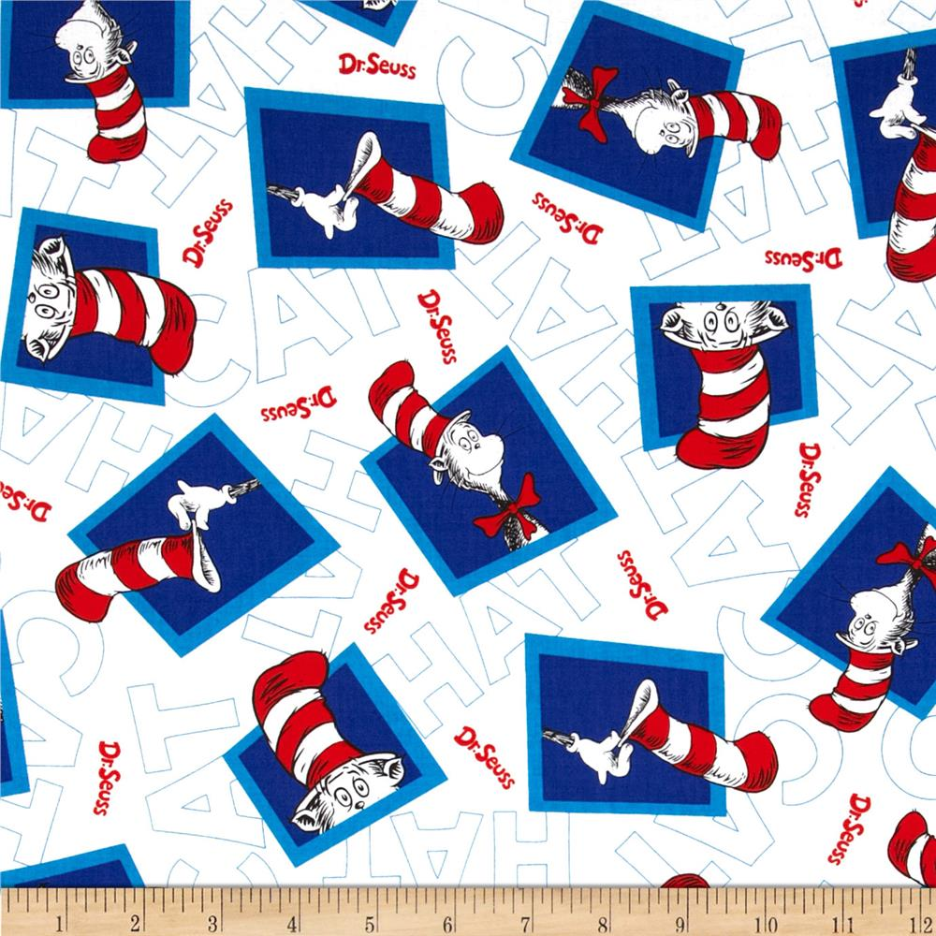





Slide 21



