Slide 1

REMEMBRANCE DAY 2012
GRETNA GREEN ELEMENTARY

Slide 2
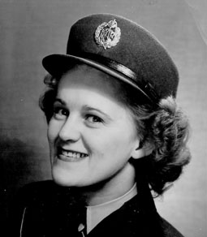
Marion Savage
Mrs. Morehouse’s Great Aunt

Slide 3
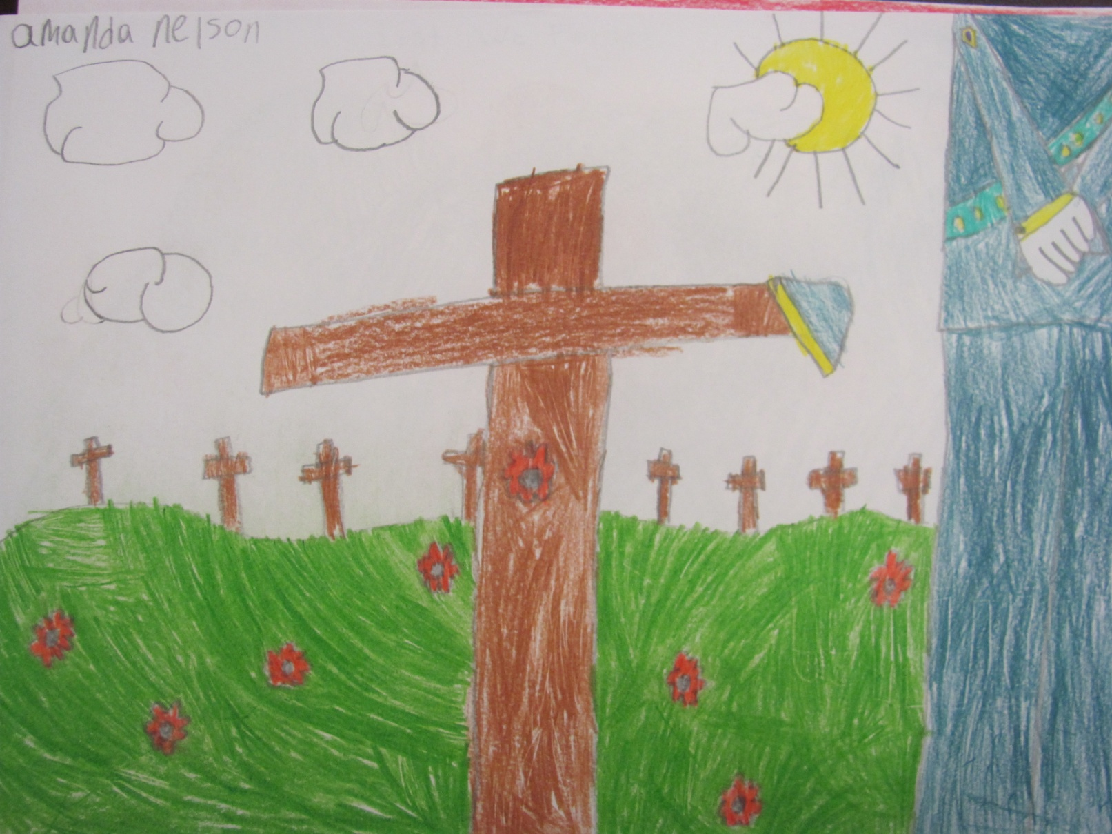
Every year we remember… may you rest in peace… enemies have been defeated… may you have gone to a better place.
Patrick MacDonald, 5G

Slide 4
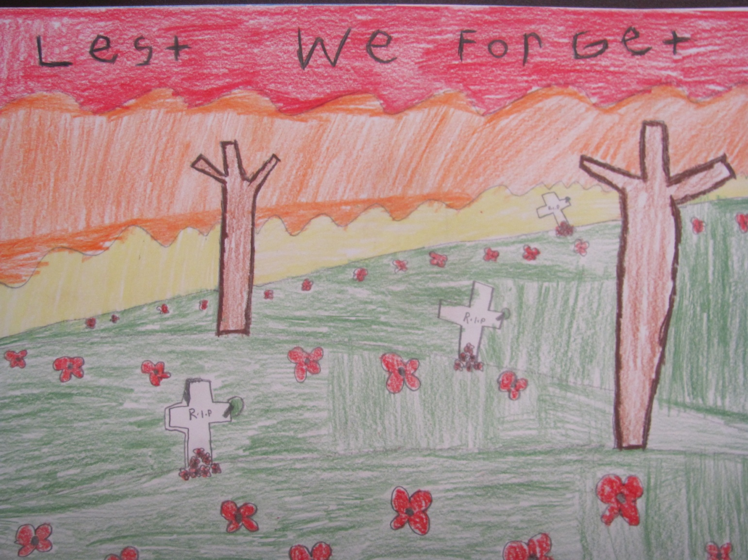
Remember the veterans.
Ellie Newman, 5G

Slide 5
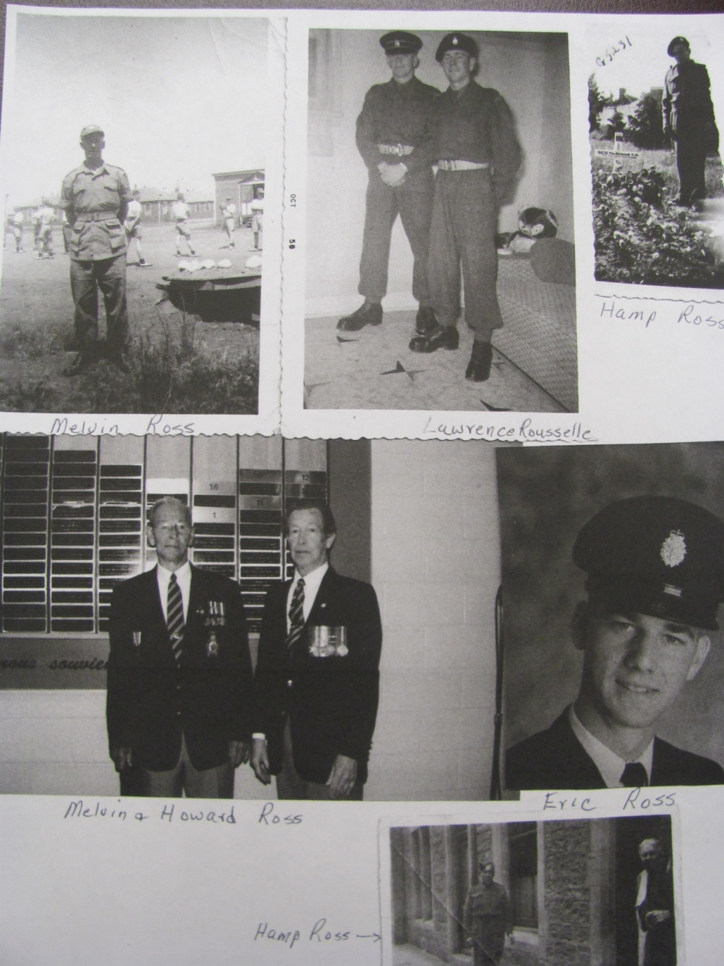
MEMBERS OF WALSH FAMILY
Related to Brianna and Kevin Walsh

Slide 6
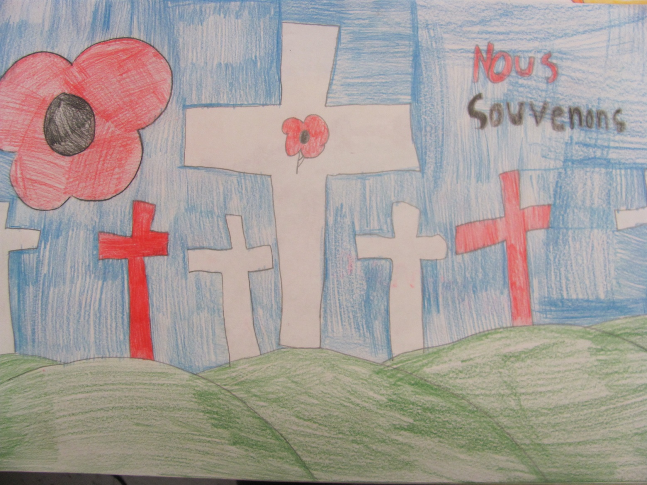
Remember why the poppies grow, beside the soldiers’ crosses.
Sarah King, 5G

Slide 7
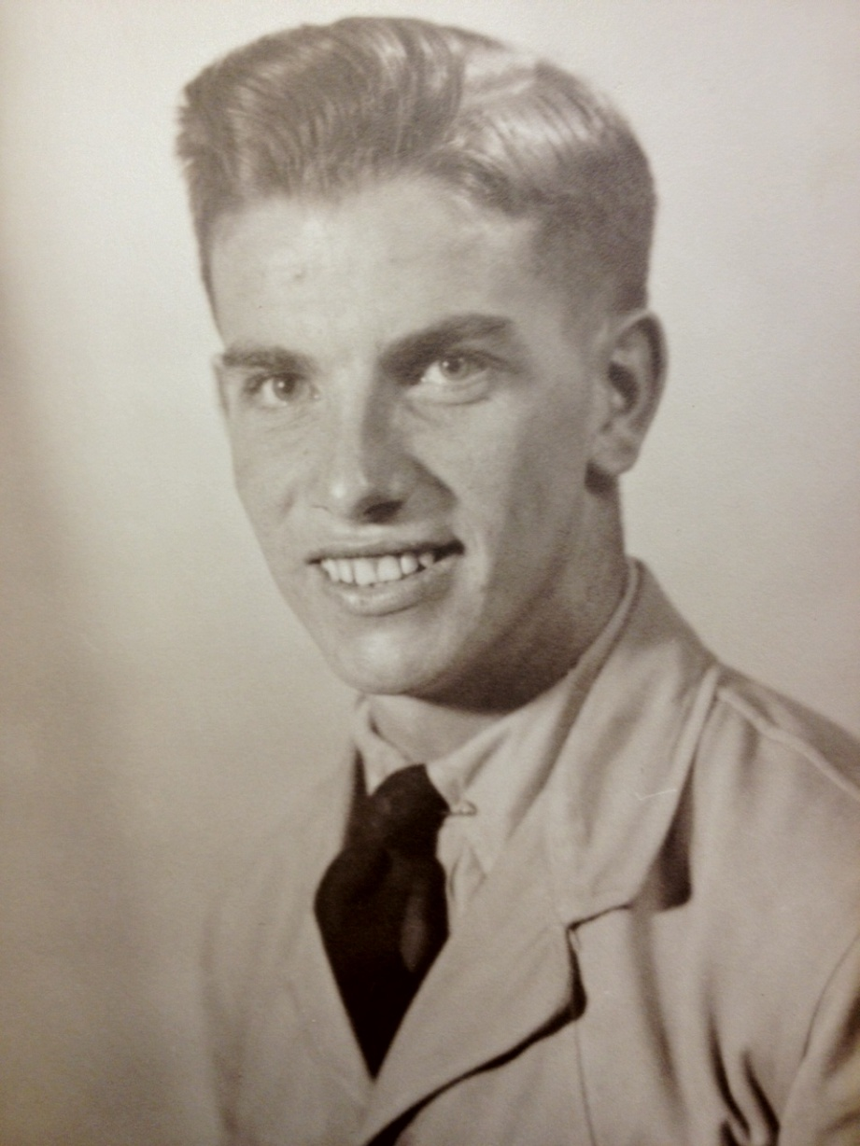
Gerald Pickard
Mr. Comeau’s Father in Law.

Slide 8
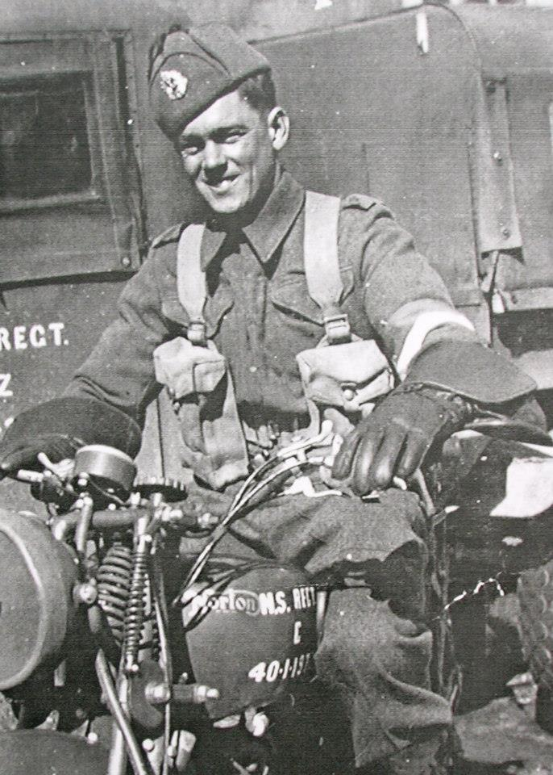
Billy Savage
Mrs. Morehouse’s Great Uncle

Slide 9
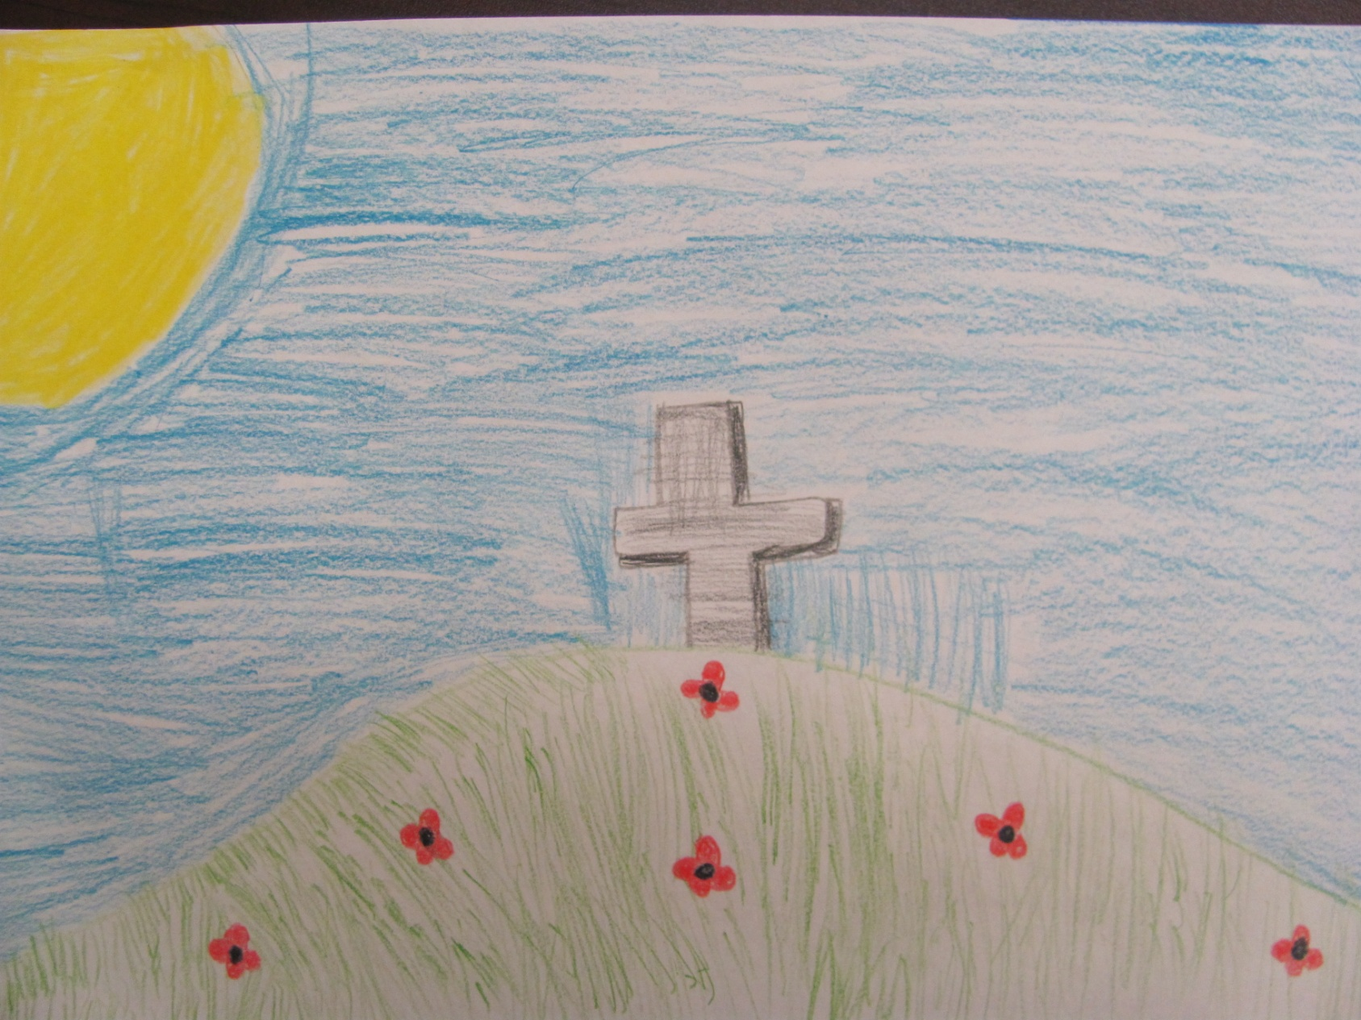
We are thankful for the soldiers who fought for the freedom we have today.
Octavia Tucker, 5G

Slide 10
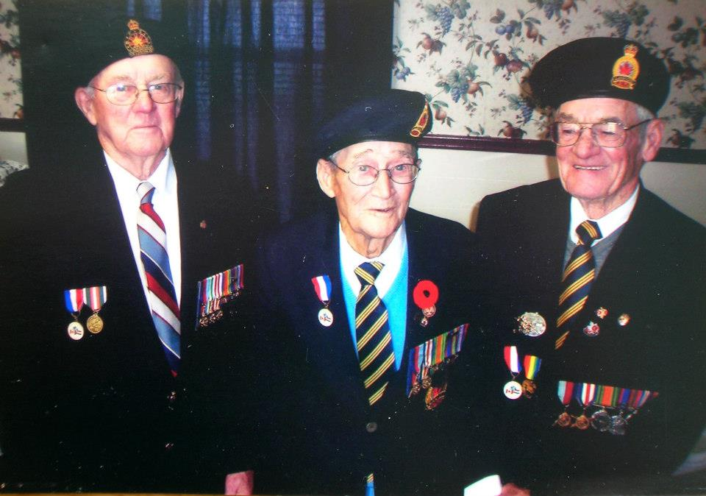
Mrs. Morehouse’s Great Uncles
Bryon Savage, Percy Savage, Billy Savage

Slide 11
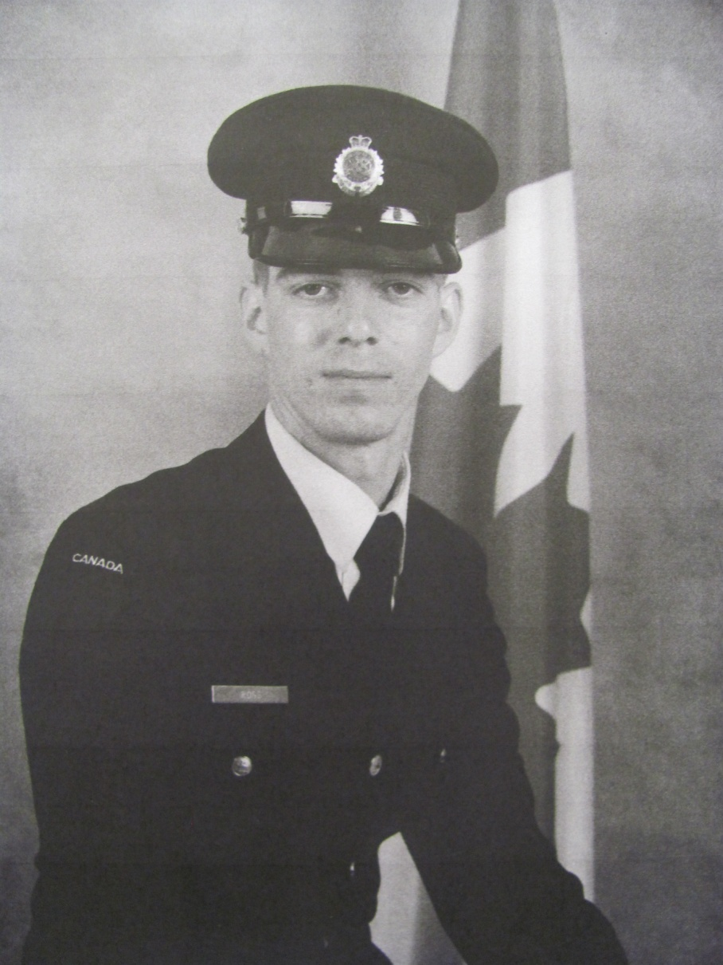
BRIAN ROSS
Great Uncle to Brianna and Kevin Walsh

Slide 12
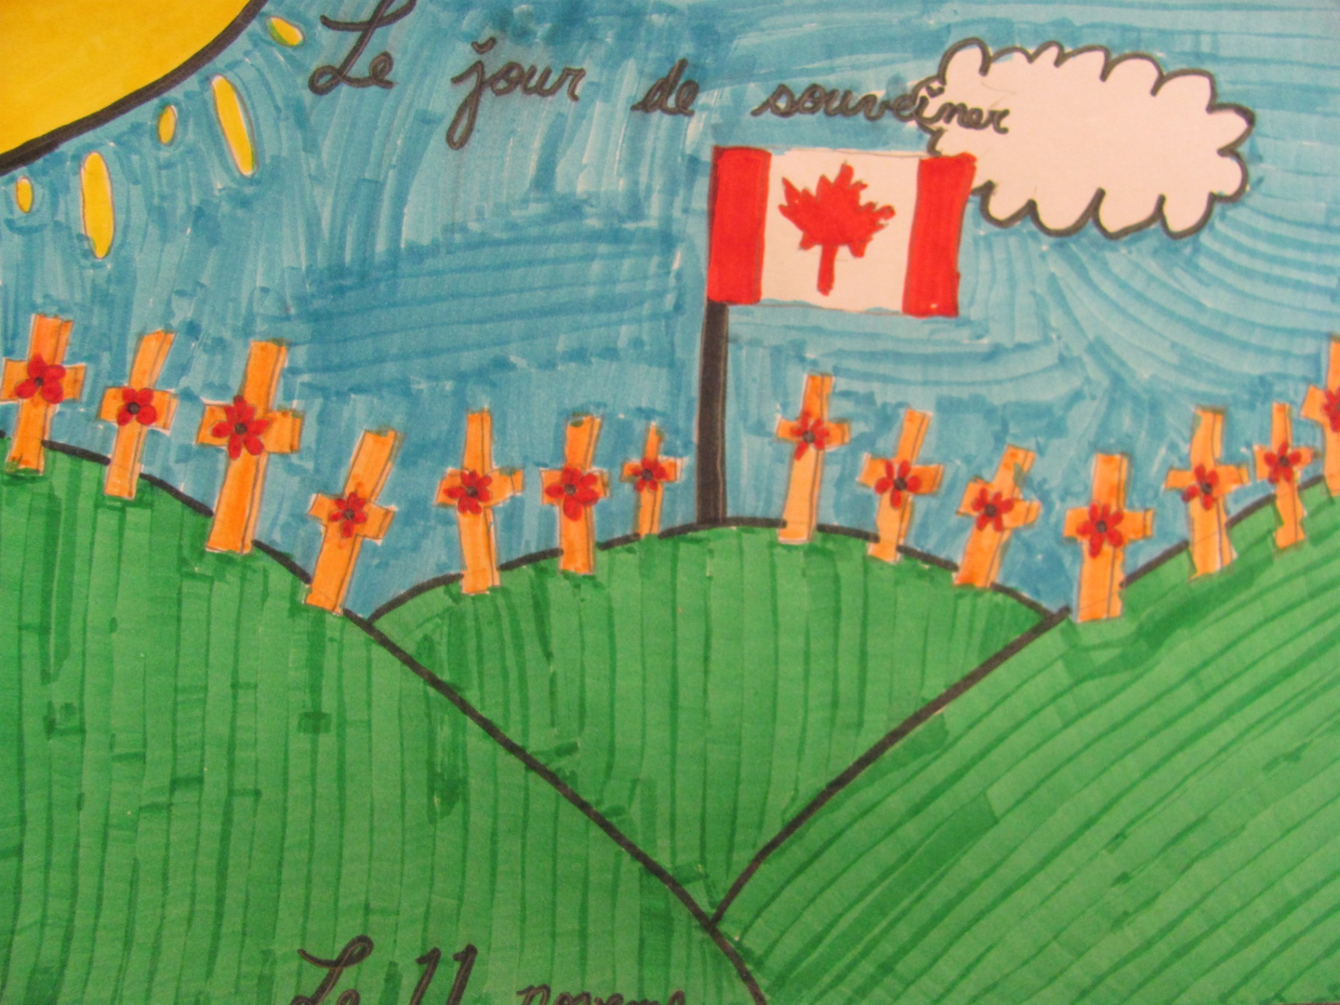
On dit merci pour tout ce que tu as fait dans la guerre.
Matthew Binedell, 5G

Slide 13
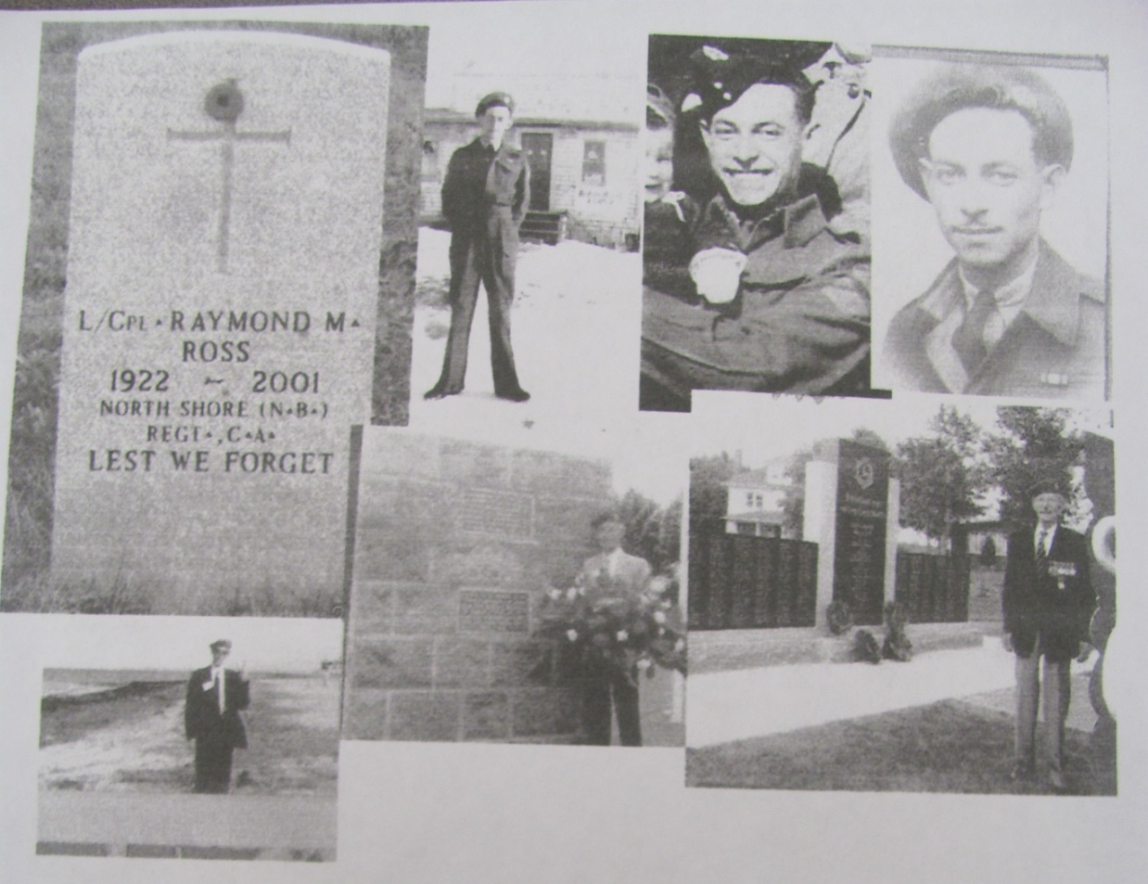
RAYMOND ROSS
Great Great Uncle to Brianna
and Kevin Walsh

Slide 14
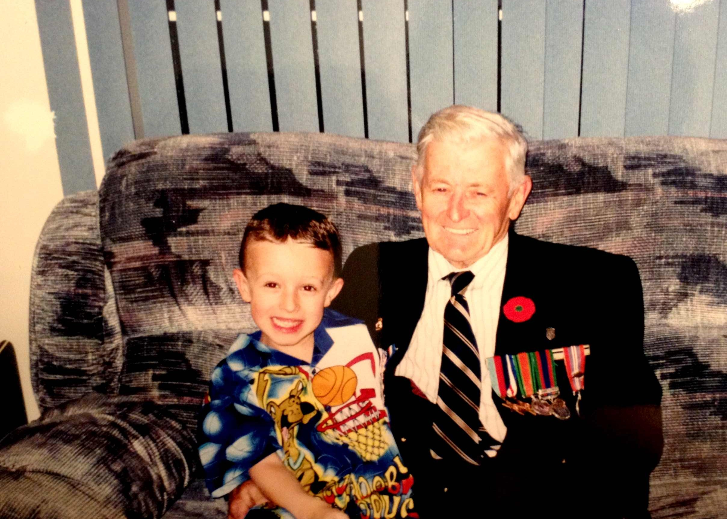

Ray Gallant
Isabella Gallant’s Grand Father

Slide 15
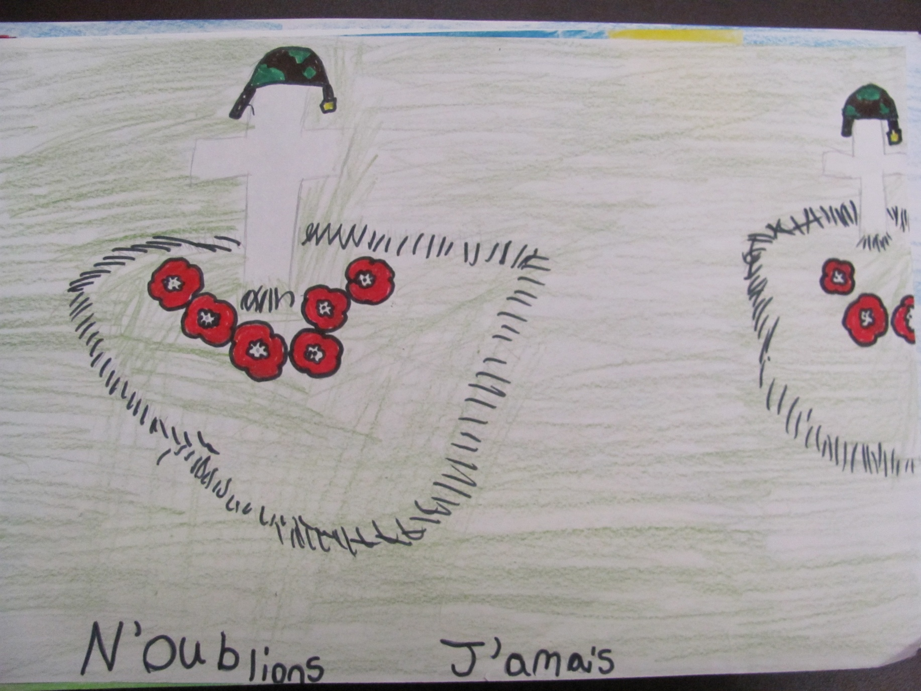
Remember the people who died, standing side by side.
Brooke Blackmore, 5G

Slide 16
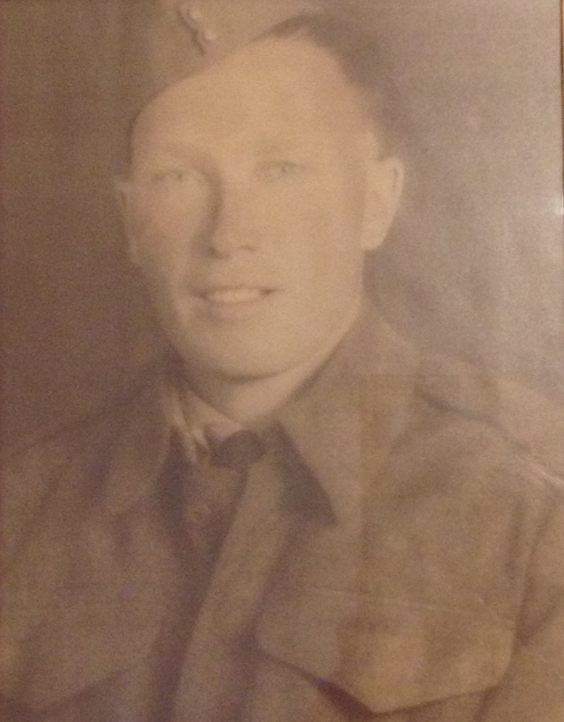
William Sturgeon
Ben Sturgeon’s Great Grand Father

Slide 17
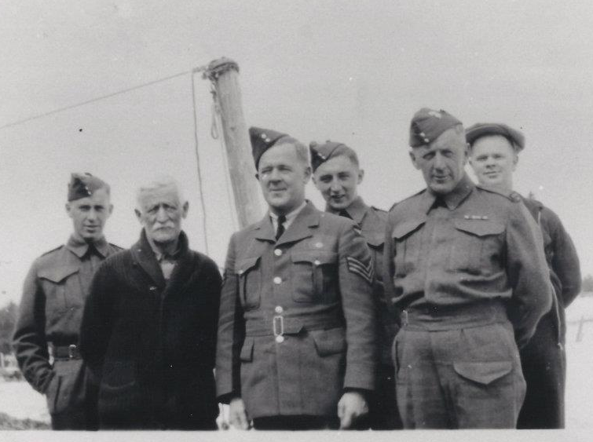
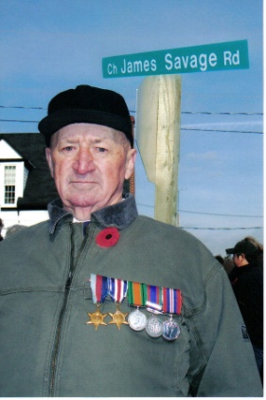
Clark Family
Maggie Clark’s Great Grand Father

Slide 18
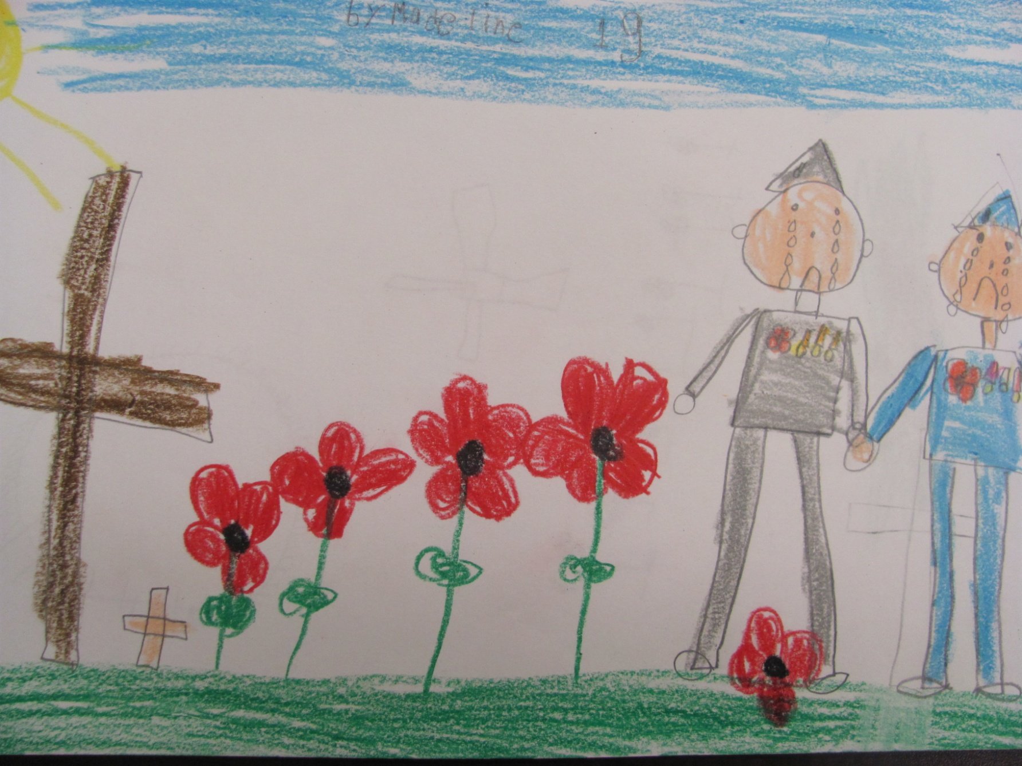
I’m glad you protect us.
Cassidy Savoie, 5G

Slide 19
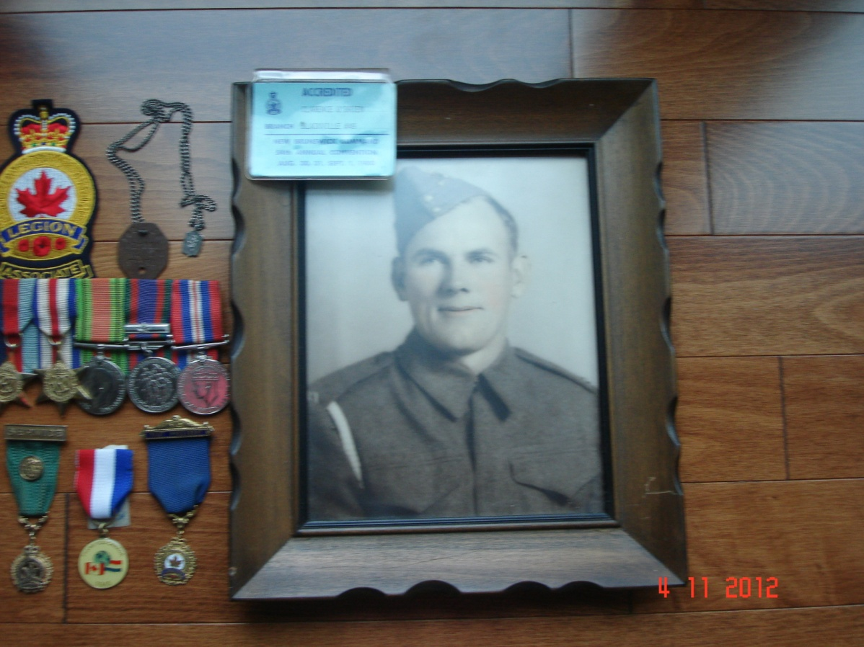
Clarence O’Brien
Great- Great Uncle of Drayden and Alea Sweeney

Slide 20
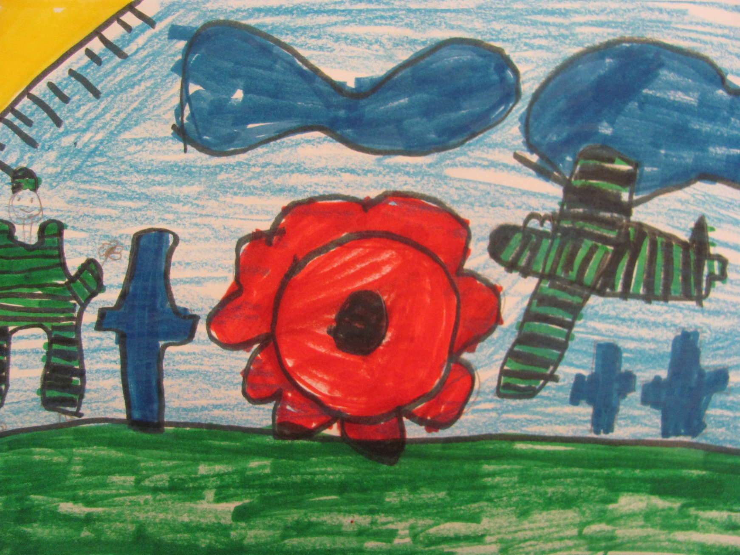
Rest in peace.
Amanda Nelson, 5G

Slide 21
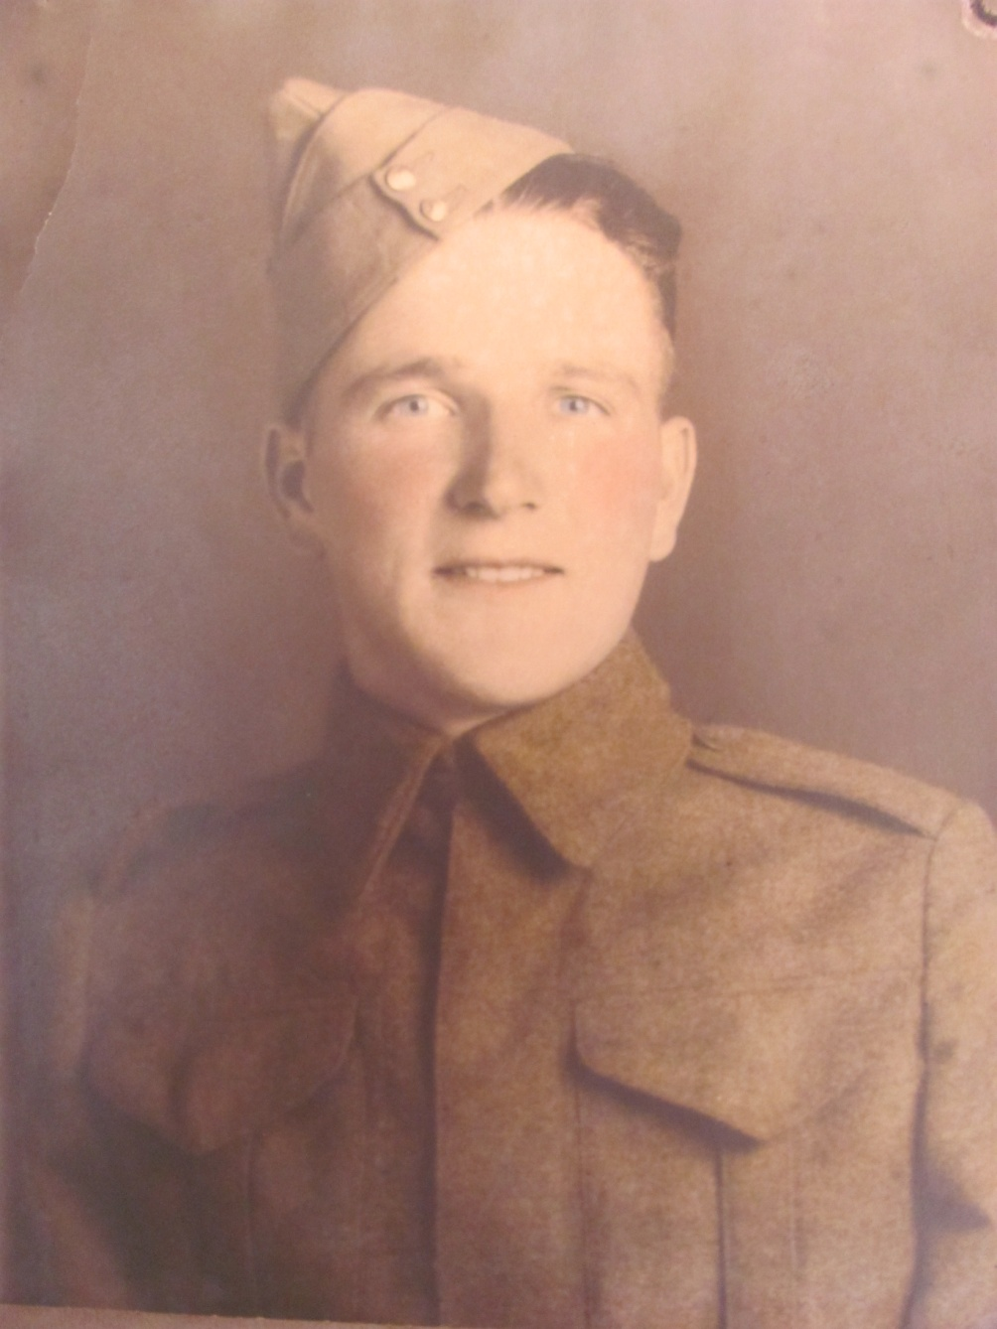
Omer Matchett
Maggie Clark’s Great Grandfather

Slide 22
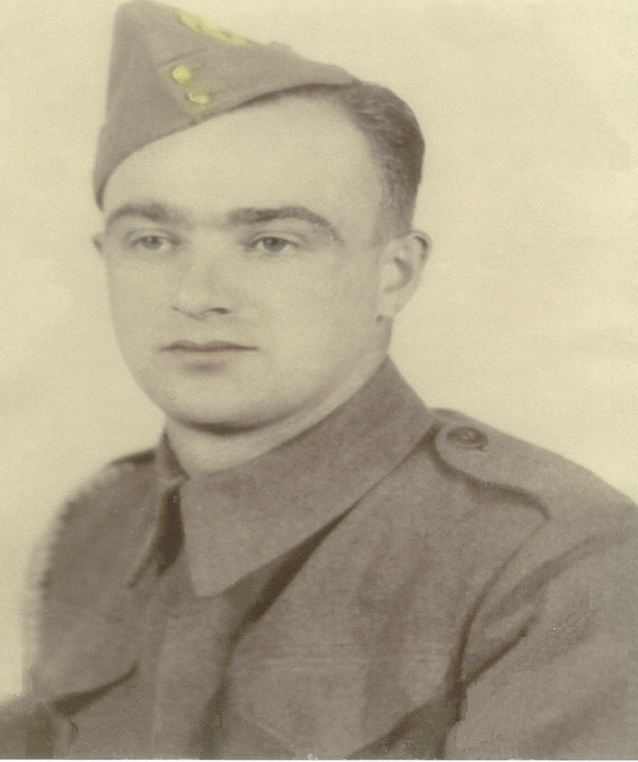
James Manuel
Kayla Matchett’s
Great Grandfather

Slide 23
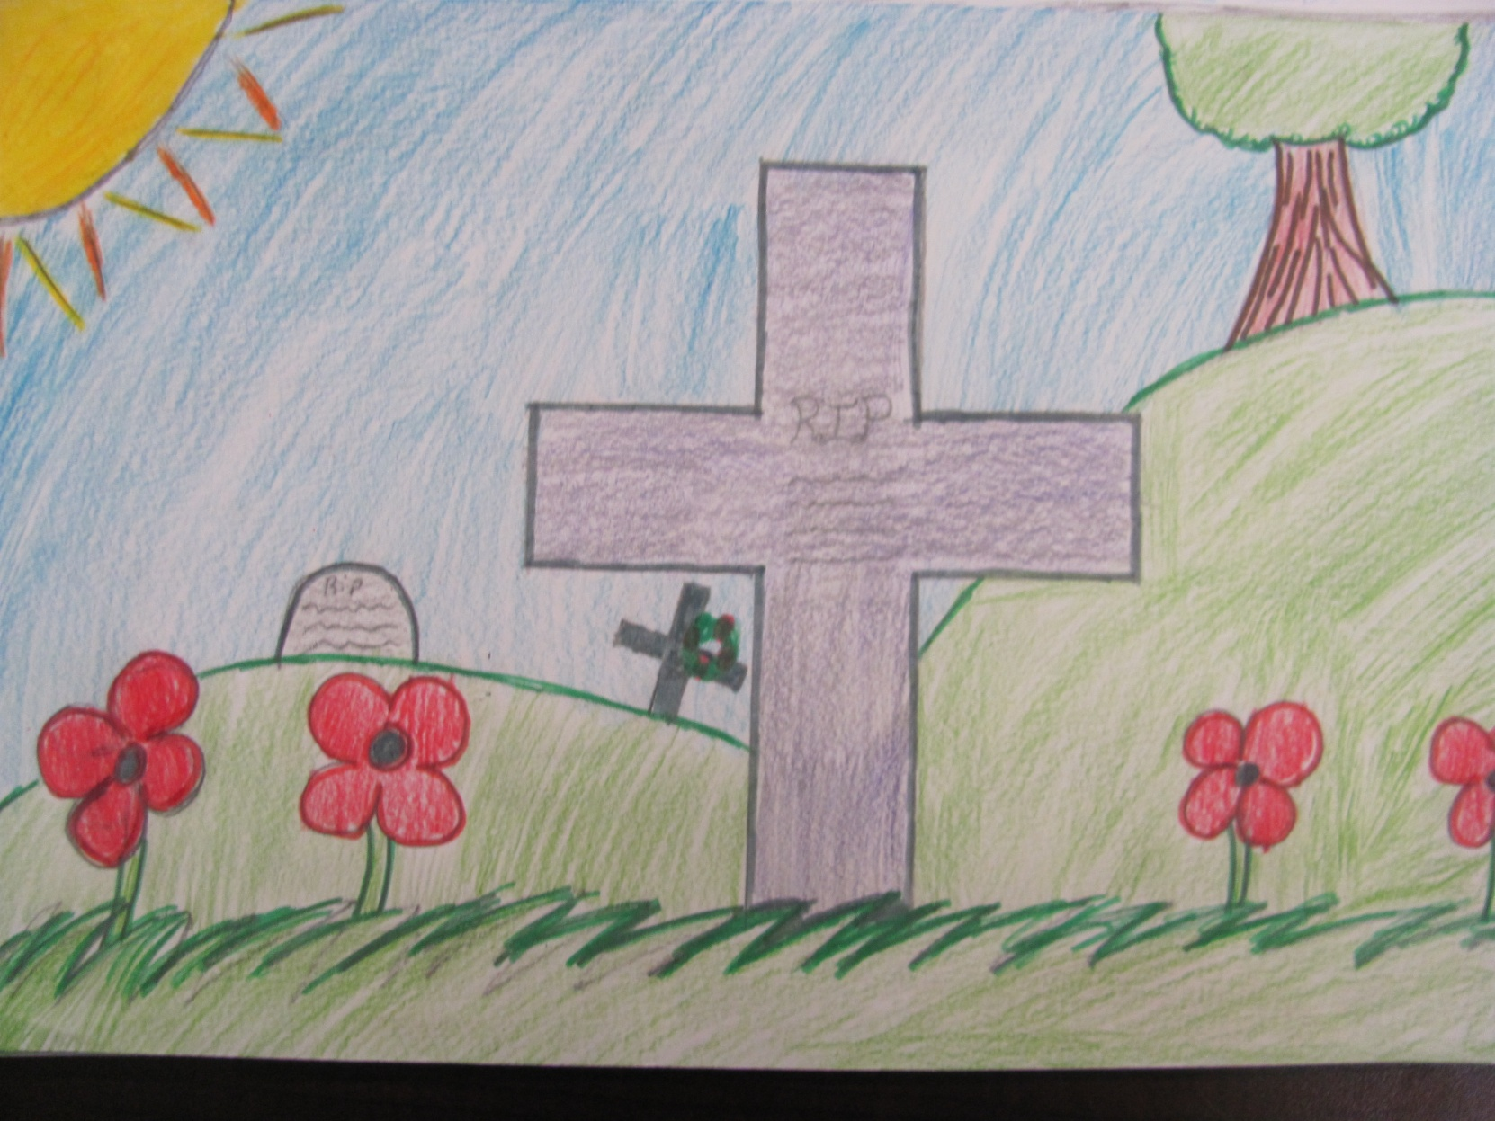
May the poppies grow where the soldiers rest in peace.
Grace Sobey, 5G

Slide 24
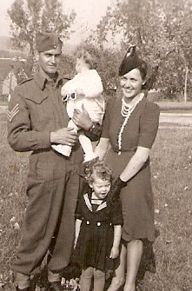
Raymond Fletcher
Mrs. Simmons’ and Ms. Matheson’s Grand Father

Slide 25
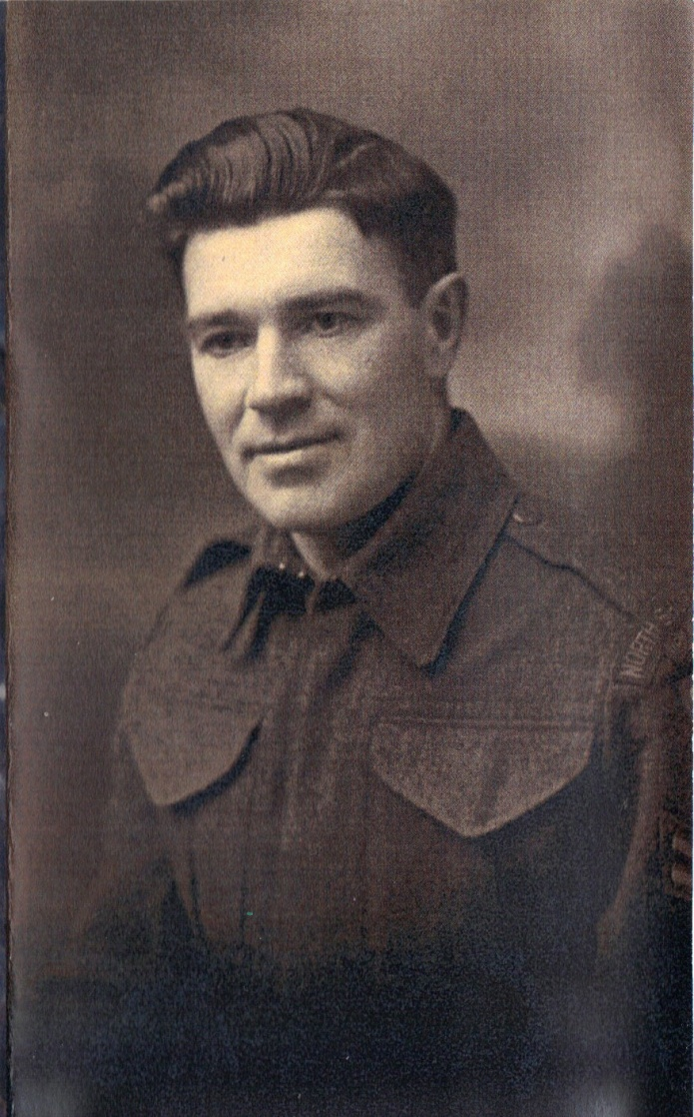
Bob Currie
Ellie Newman’s Great Grand Father

Slide 26
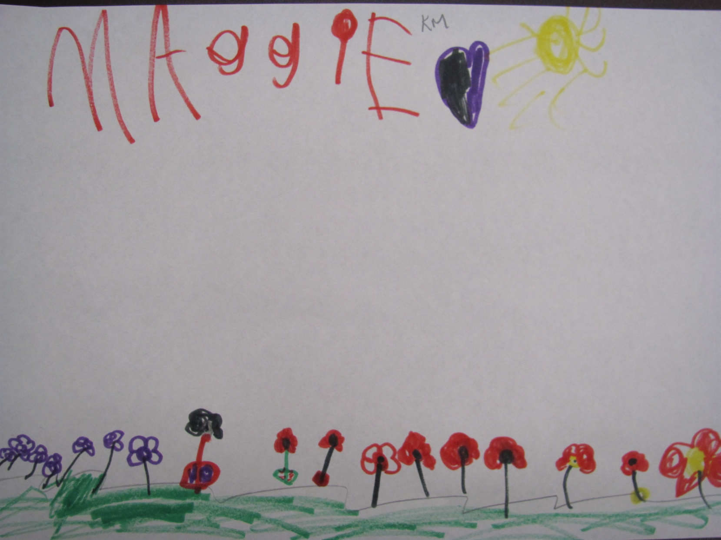
Remember the veterans that fought in the war.
Anna Smith, 5G

Slide 27
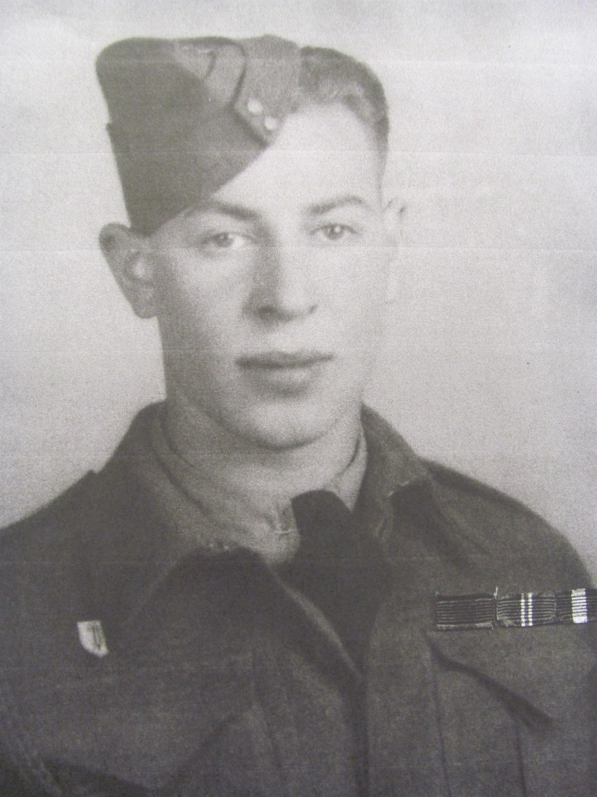
MELVIN ROSS
Great Grandfather of Brianna and Kevin Walsh

Slide 28
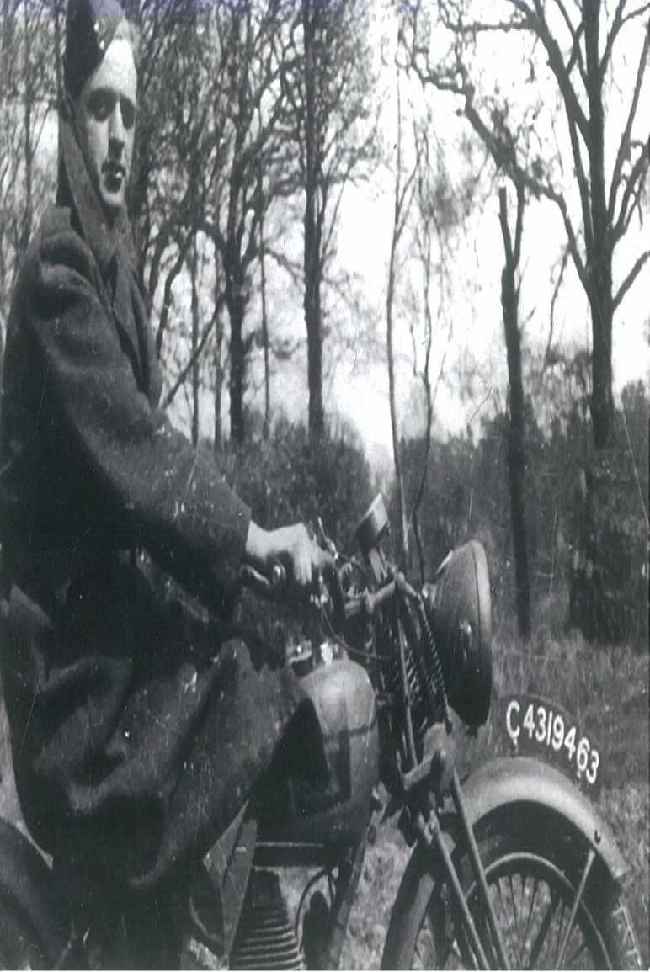
Raymond Morrison
Kayla Matchett’s Great Grand Father

Slide 29
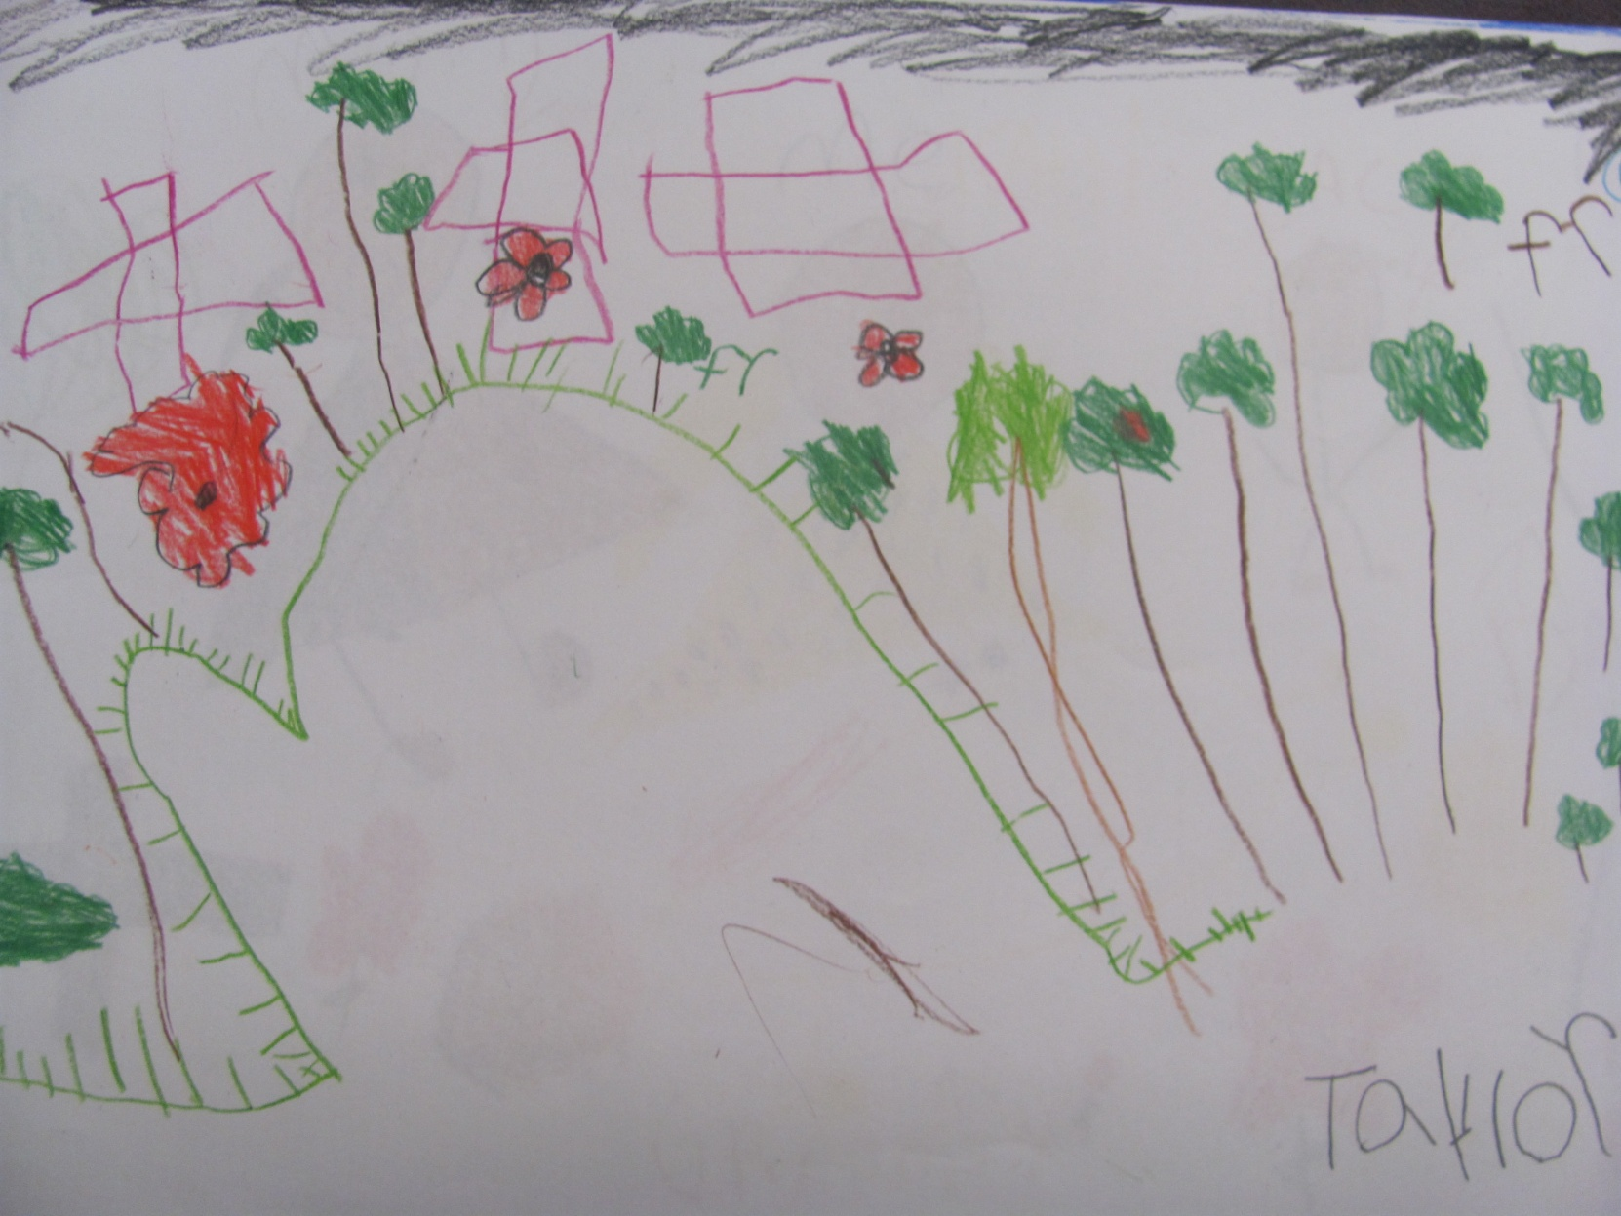
Everyone fought for our freedom… remember.
Colby Smith, 5G

Slide 30
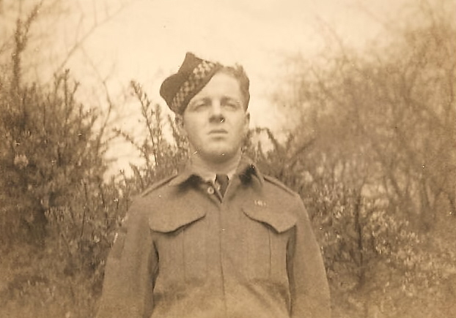
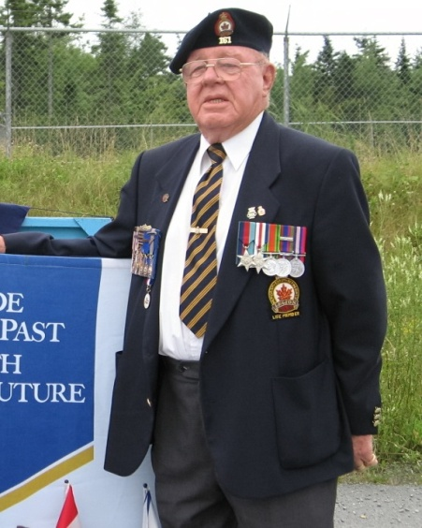
Arthur Humphreys
Jaden and Tyra Humphreys Grand Father

Slide 31
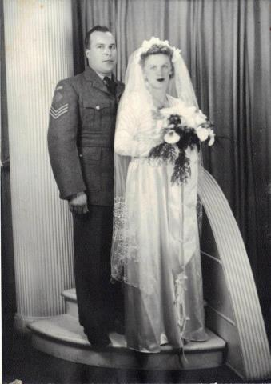
Harold Punkari
and Martha
Great Great Grandparents of Bryan and
Emily Comeau

Slide 32
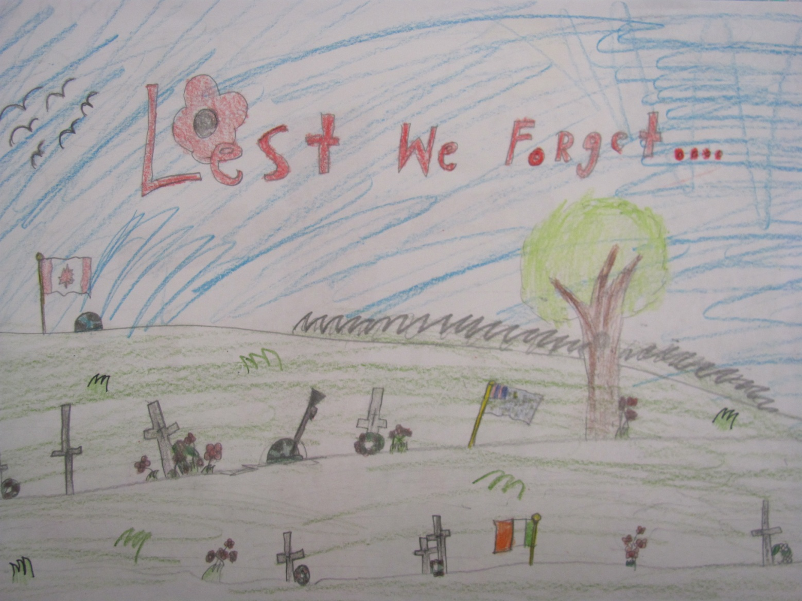
Many people risked their lives for us; be thankful they risked their lives.
Jenna Augustine, 5G

Slide 33
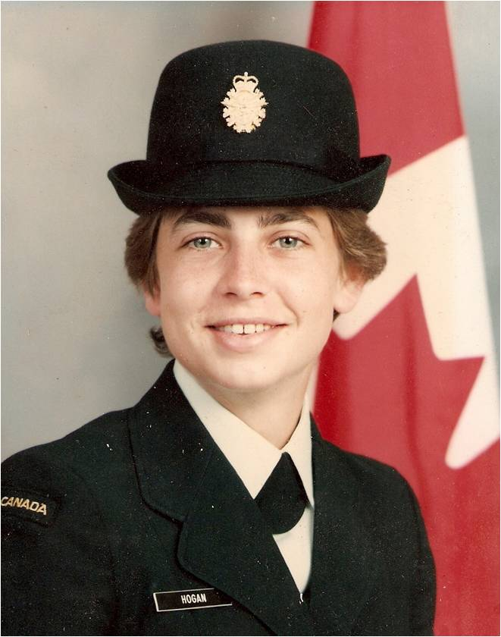
HEATHER HOGAN
MRS SIMMONS’ SISTER

Slide 34
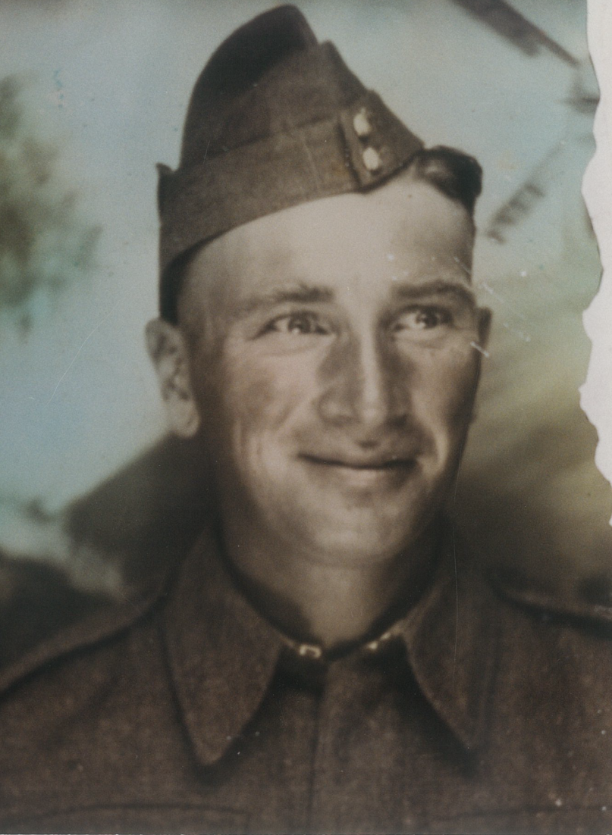
EDMUND BREAU
KAYLA MATCHETT’S
Great Grandfather

Slide 35
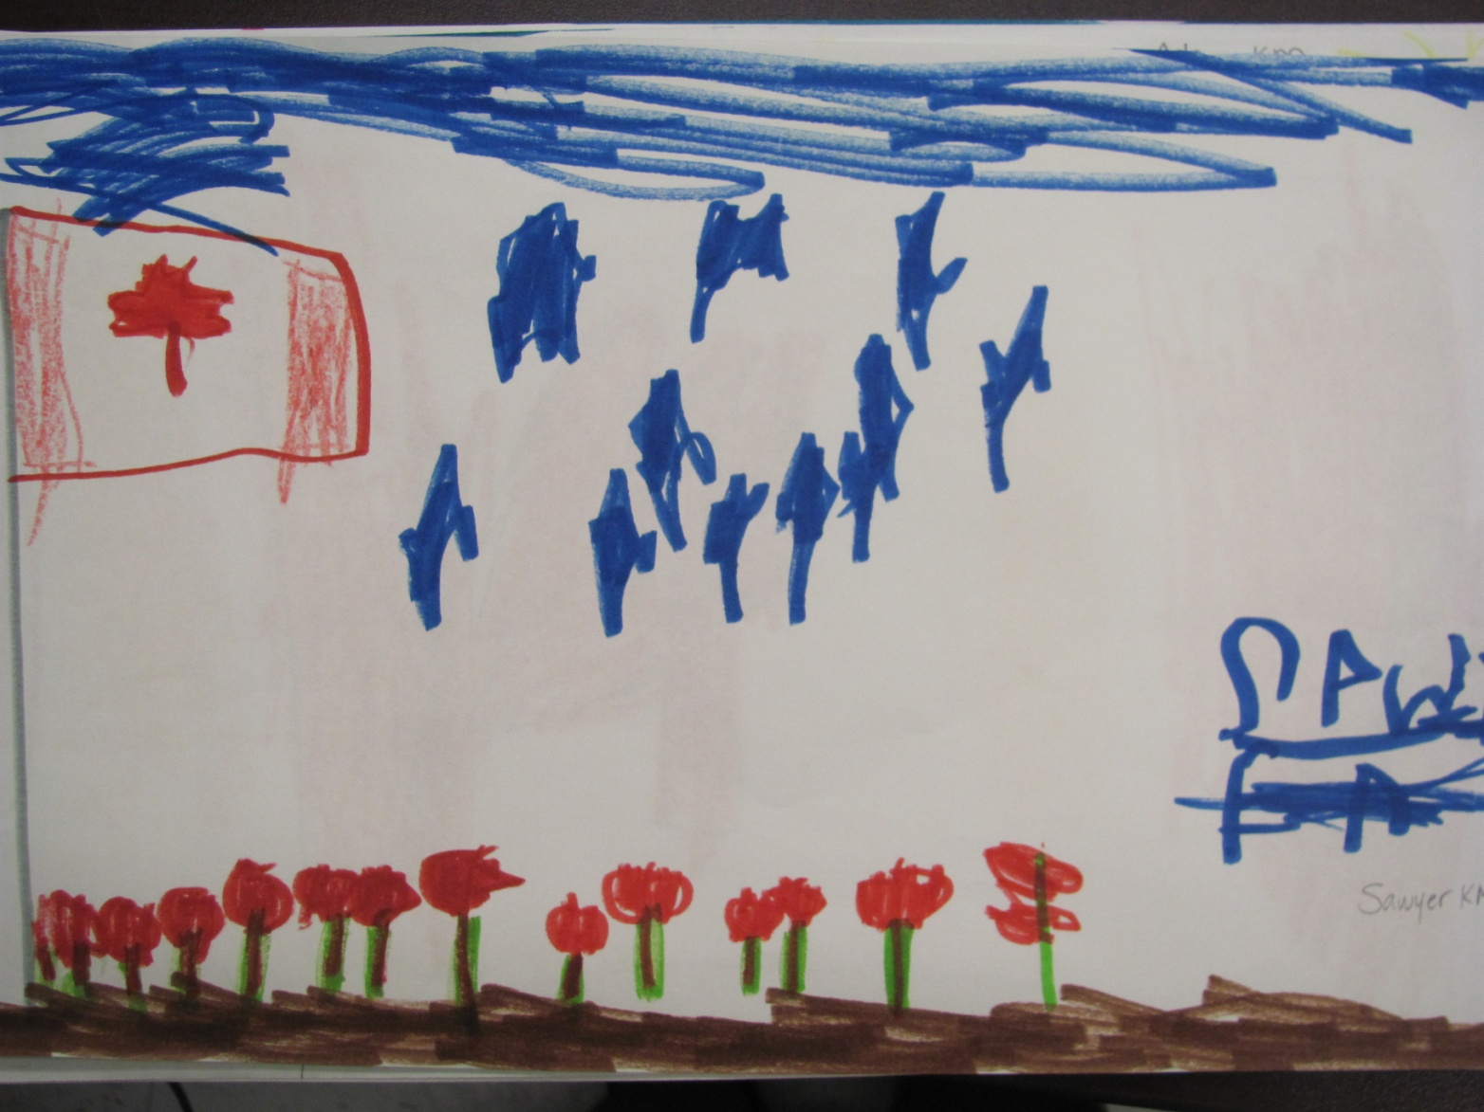

Slide 36
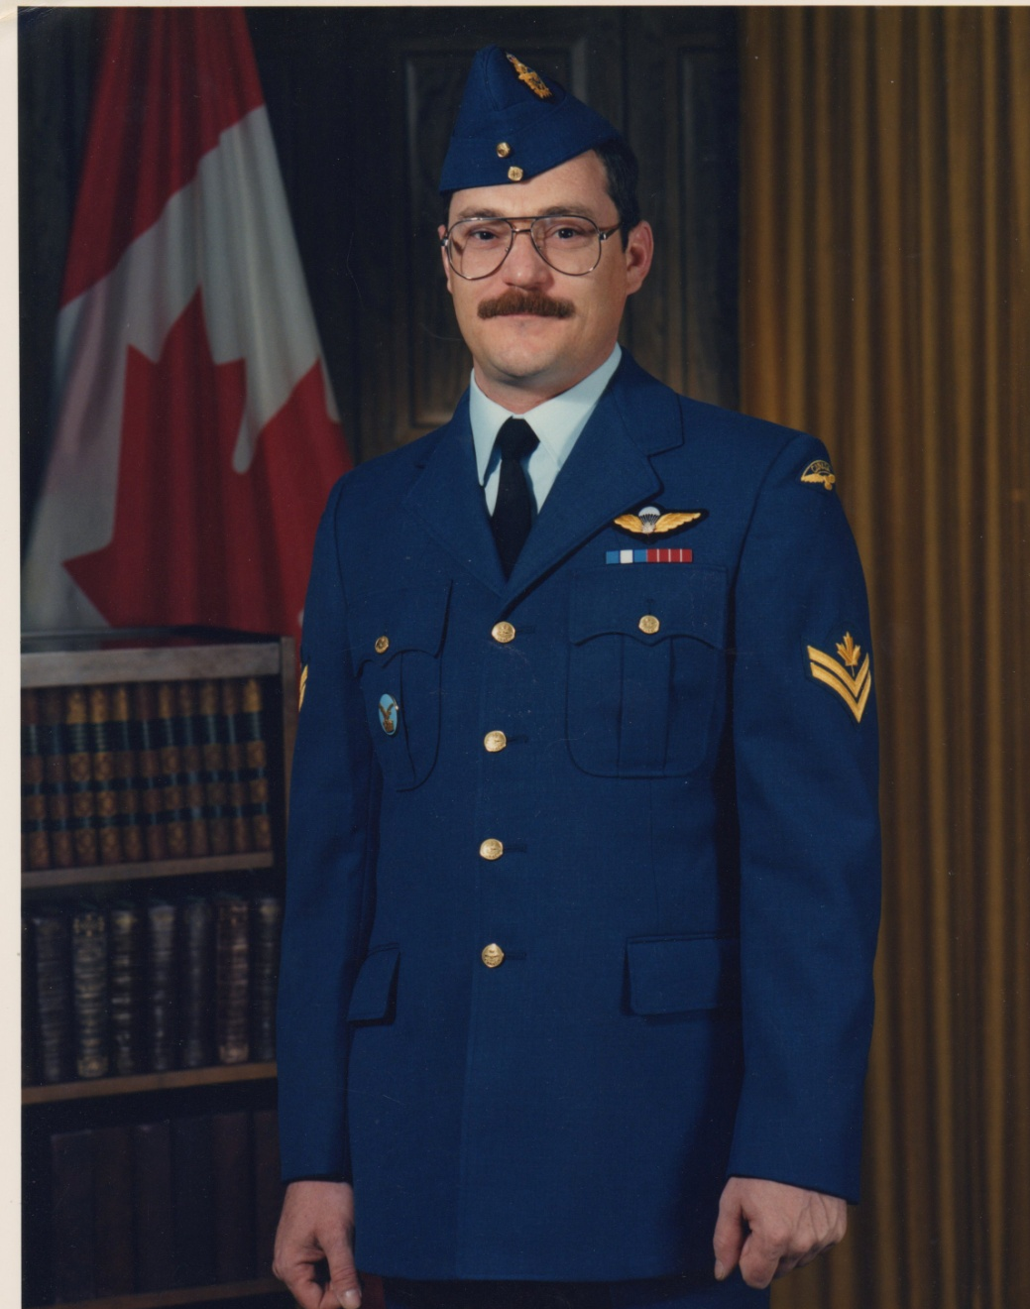
Carlo Dorais
Uncle of Gillian, Jenna & Katie Kennedy

Slide 37
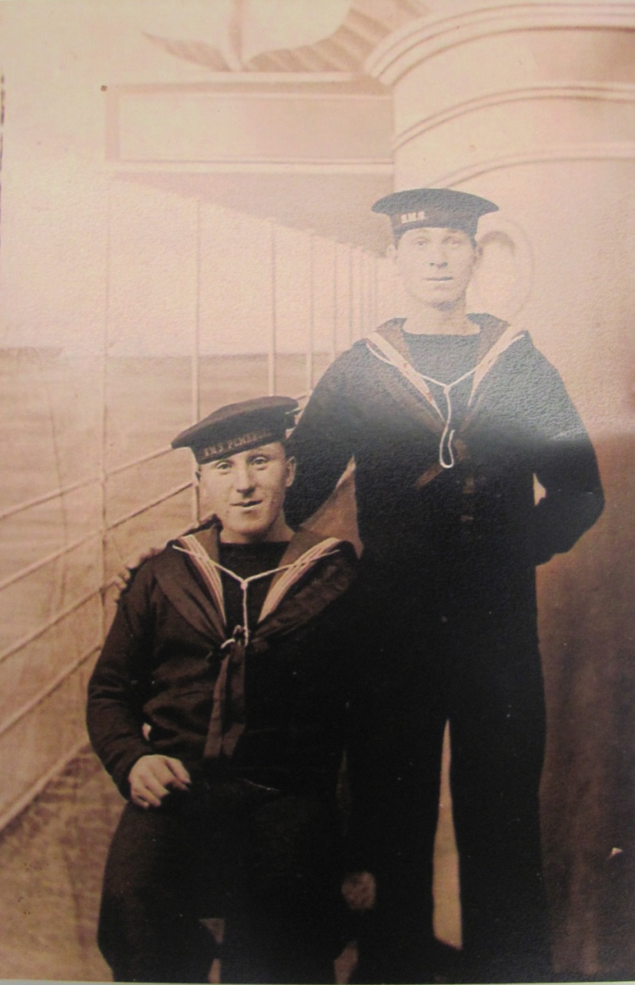
BRAVERY & COURAGE

Slide 38
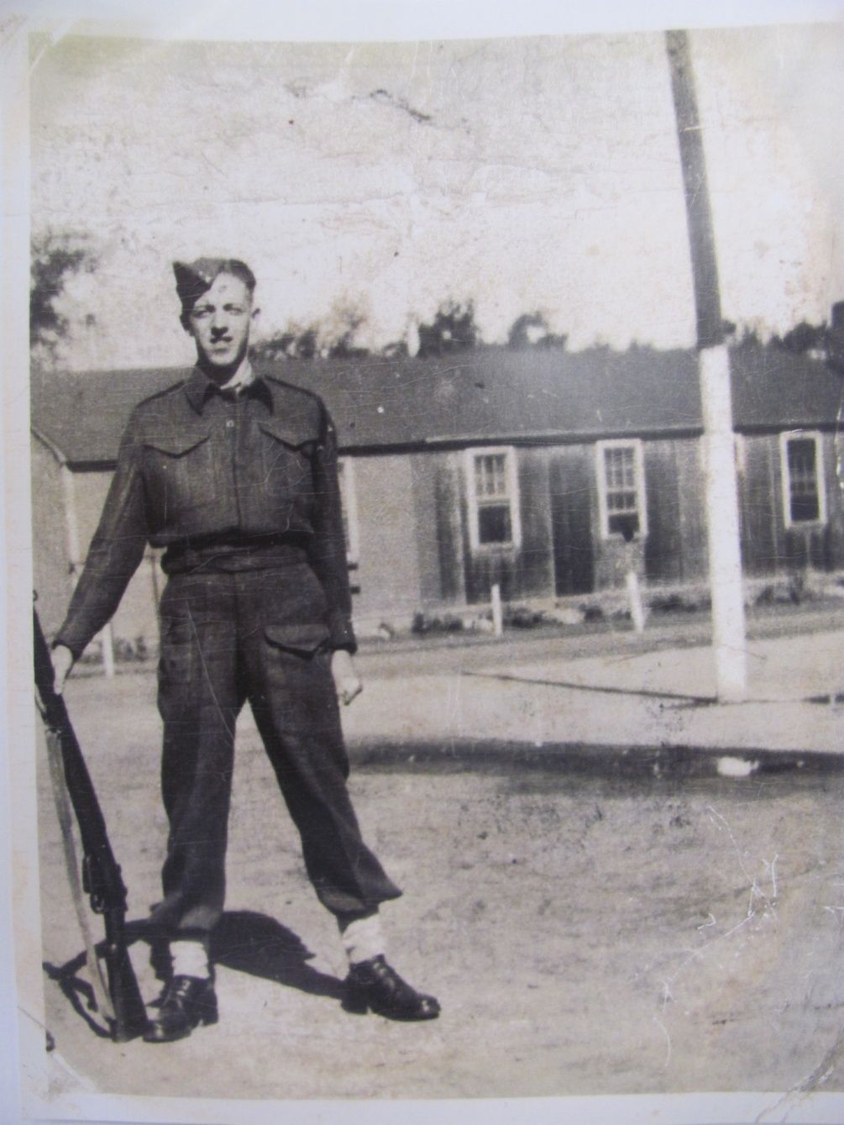
BILL RUSSELL
Great Grandfather of Erica and Jadyn Mah

Slide 39
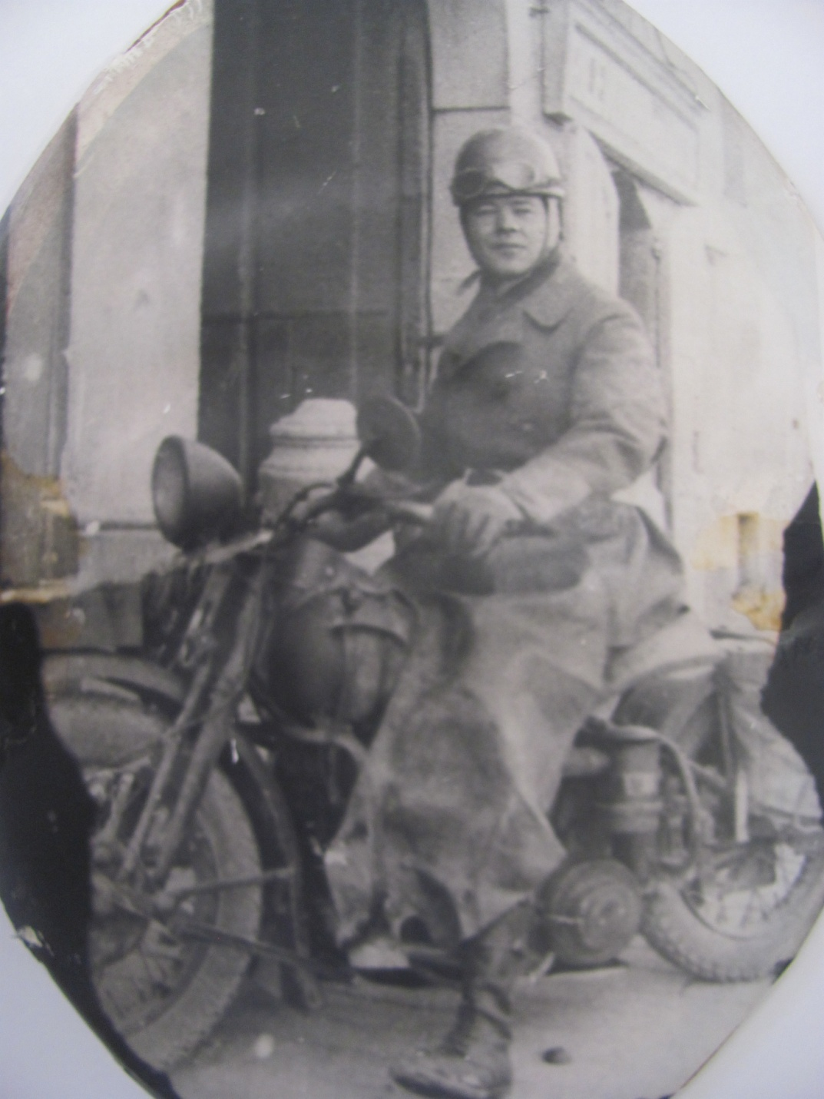
HONOUR OUR VETERANS

Slide 40
