Slide 1
Some of my Favorite Things
By Mrs. Allison

Slide 2
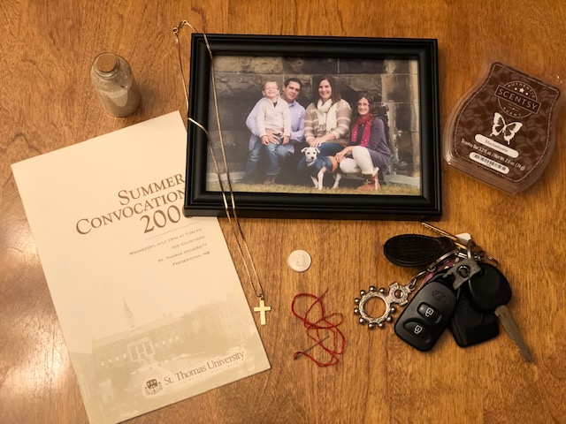

Slide 3
When I sat down and thought about what to include in this assignment, I really had to think hard because I have so many things that are very special to me. Sit back and listen and you’ll get to know a little more about me.
First, I included a picture of my chain and cross. For my sixteenth birthday, my Dad gave me a gold chain. I loved it and wore it all the time. As I got older and dressed up more and more for work, I didn’t wear it all of the time. My Dad asked if I still had it and I told him yes. My Dad became very ill and on my last birthday before he died, he gave me a cross for my chain. He always told me to stay true to my faith and the cross is a reminder of that.

Slide 4
My family is very important to me. I have been married to my husband Kyle for 17 years and we have two beautiful children. This is an old picture of us but still one of my favorites. Avery is 16 years old and loves to play ringette and hockey. She is an avid reader and loves to do well in school. She wants to be a physiotherapist when she grows up. Ryan is 10 years old and loves hockey, baseball, and soccer. He is a whiz in Math and loves to make people laugh. He wants to be a pro hockey or baseball player when he grows up or a photographer.
After my Dad died, my sister told me that our loved ones always send us messages from Heaven and one of those signs are dimes. Every time I find a dime out of the blue, it makes me smile and I pick it up. I have found 36 dimes since my Dad died and I keep them all in a jar on my dresser, labeled ‘Dimes from Heaven’.

Slide 5
The bottle with beach sand in it represents my love for the beach. Our first trip to the Dominican Republic was so much fun because we went with a lot of our closest friends. The sand was so warm and white I decided to bring some home to remind me of our fun times down south.
The Summer Convocation 2006 program is from Saint Thomas University when I graduated with a Bachelor of Education. In 2005, I graduated with a Bachelor of Arts. Going back to school for me as an adult was a bit overwhelming for me but I did it. My husband and I moved to Fredericton for four years as I pursued my studies to become a teacher. While in school, Avery was born but I continued on with my studies. I graduated as a teacher on Avery’s third birthday and I was even offered a full time job. It was a pretty exciting day!

Slide 6
The needle and thread symbolize my love to cross stitch. When I was young, my mother, who is very skilled with a needle and thread and knitting needles always wanted me to learn how to sew. I had no interest until I was a bit older. My mother taught me how to cross stitch and I am so glad that she did. I just wish I had more time to sit and do it today.
I included my keys because when I was 16, I got my driver’s license. I love the freedom of being behind the wheel of a vehicle. Nothing could hold me back. When I was 24, I bought myself a brand new Toyota Corolla. I loved that car and sometimes, I wish I still had it.

Slide 7
Finally, I included a Scentsy bar. I absolutely love Scentsy and how it makes my house smell so good. My favorite scents are Mochadoodle and Very Merry Cranberry. When I enter my house and smell either one of these, it makes me happy. It’s a comfort thing for me…the glow of my burners, along with savory scent coming from them.

