Slide 1
REMEMBRANCE DAY 2020
GRETNA GREEN FAMILY VETERANS

Slide 2
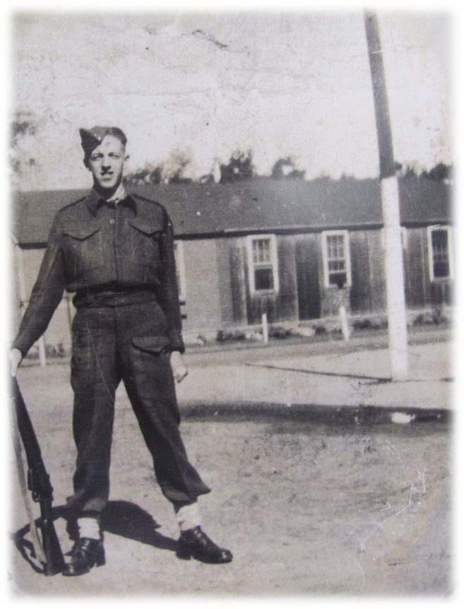
William Russell
Great Grandfather of Drew & Samantha Tweedie, Kaden Buggie, Amaly Russell

Slide 3
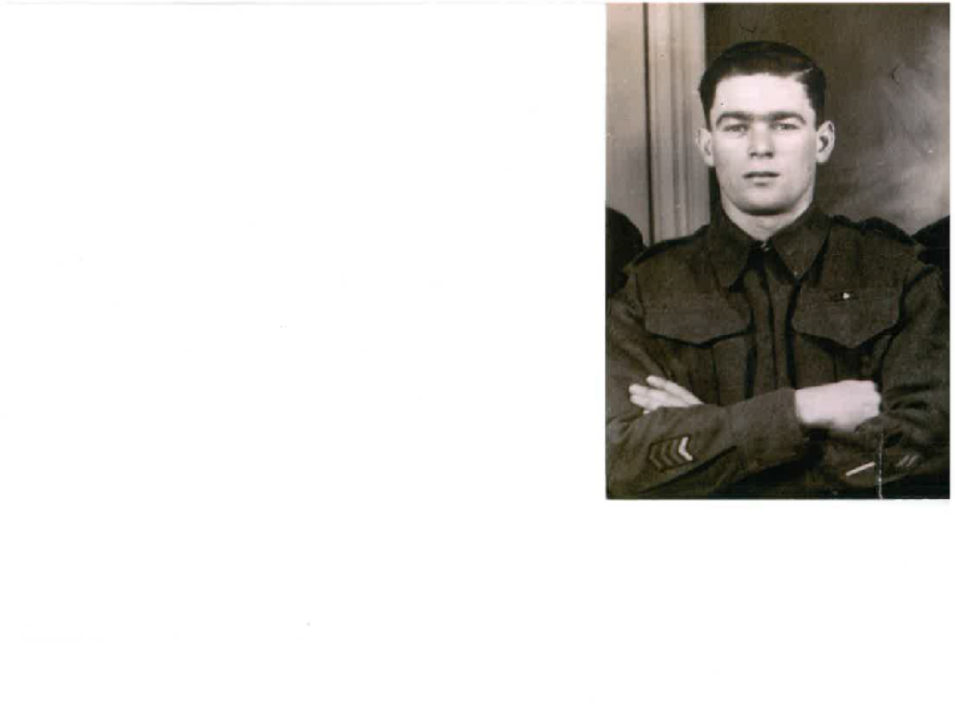
WILLIAM SAVAGE
Lauren & Elena’s Great - Great Grandfather

Slide 4
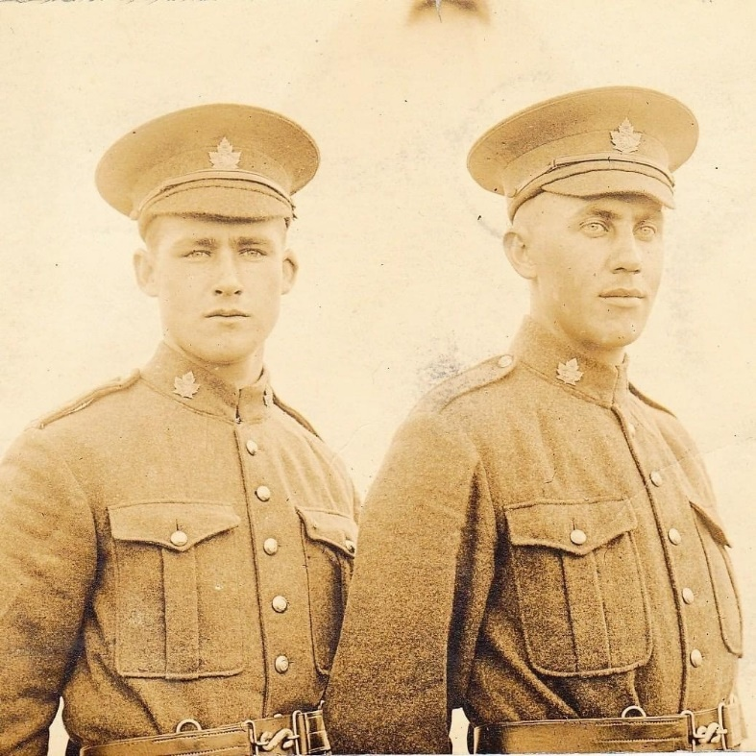
HENRY PERCY ANDERSON
(ON THE RIGHT)
Nash Lannan-McLeod’s Great Great grandfather

Slide 5
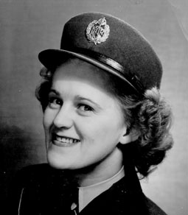

MARION SAVAGE
Mrs. Morehouse’s Great Aunt
Great Great Aunt to Lauren,Elena,Nealah
Savage & Charlie
Sullivan

Slide 6
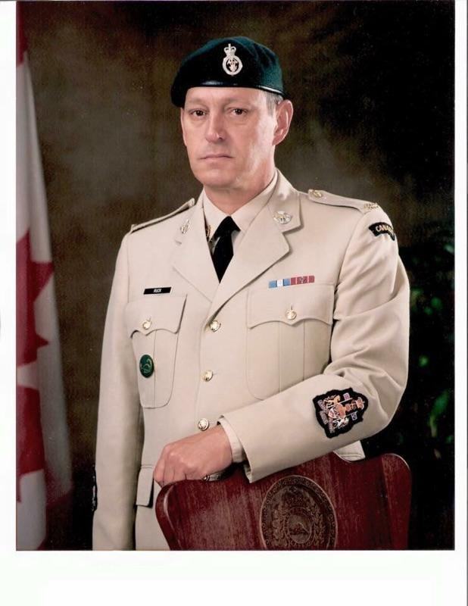
THEODORE RUCK
Jaida Gillespie’s Grandfather

Slide 7
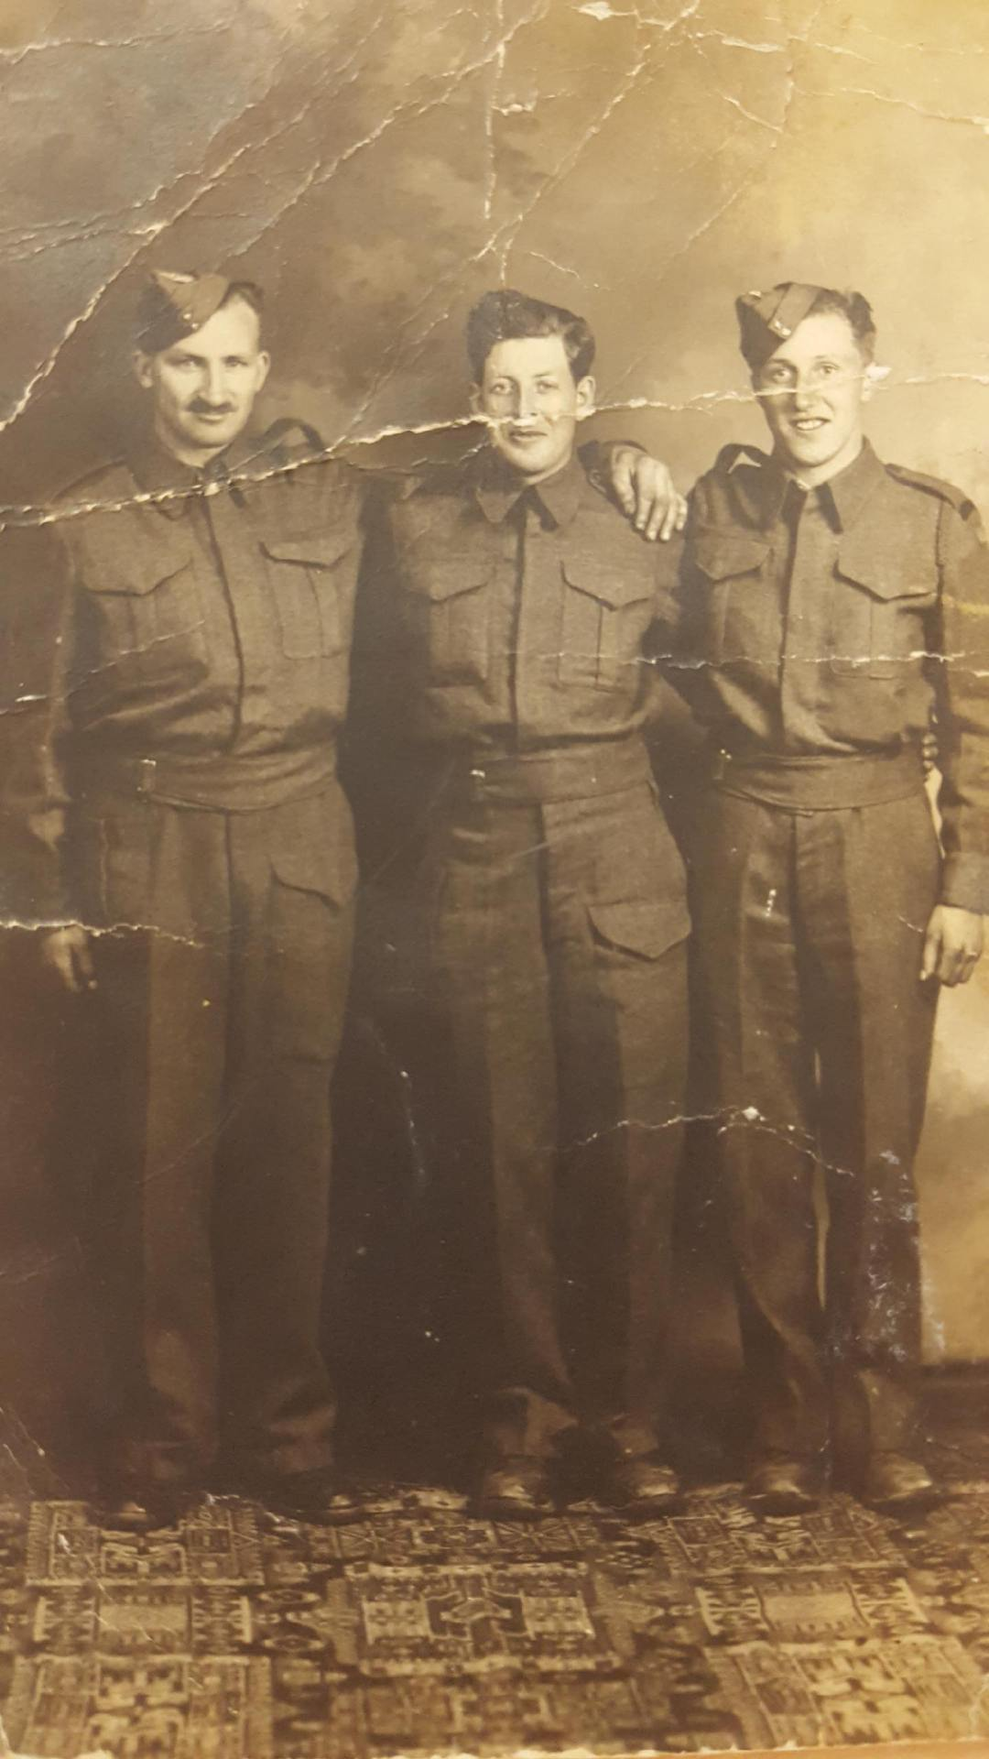
MARVIN JARDINE
Great Grandfather to Hilary Tucker

Slide 8
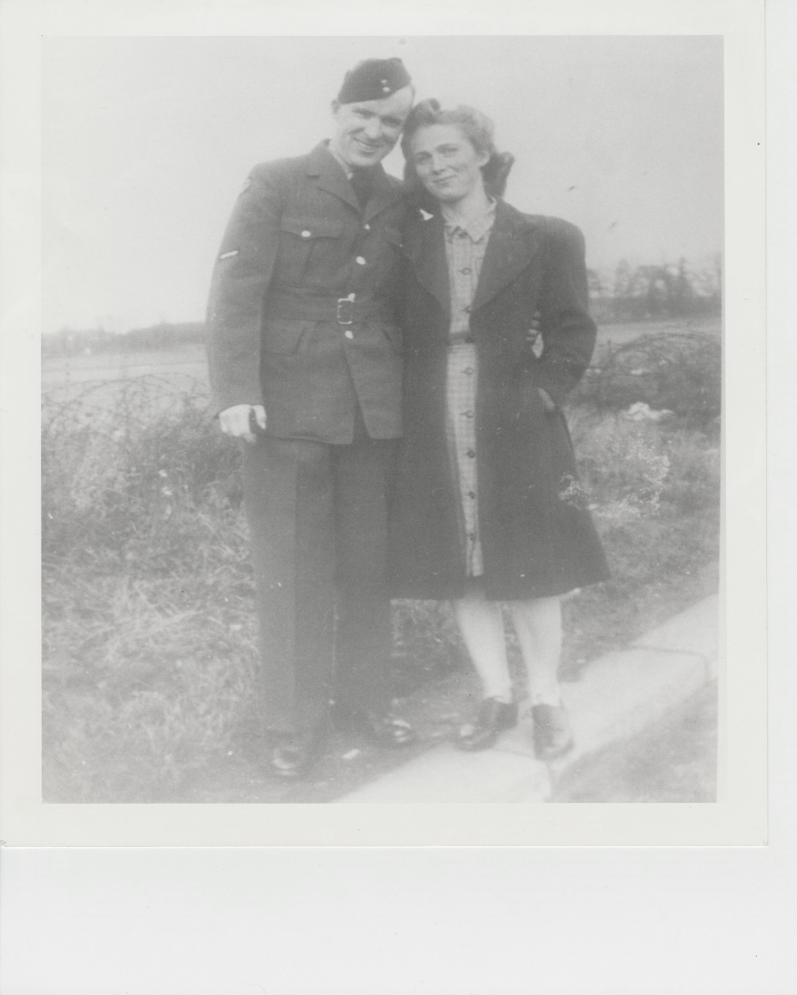
GEORGE & LILIAN DUNCAN
Logan & Lucas Mahabir’s
Great Great Grandparents

Slide 9
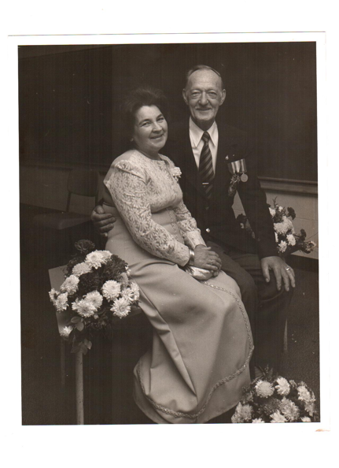
FREDERICK
ROGERS
Daniel Squire’s
Great Great Grandfather

Slide 10
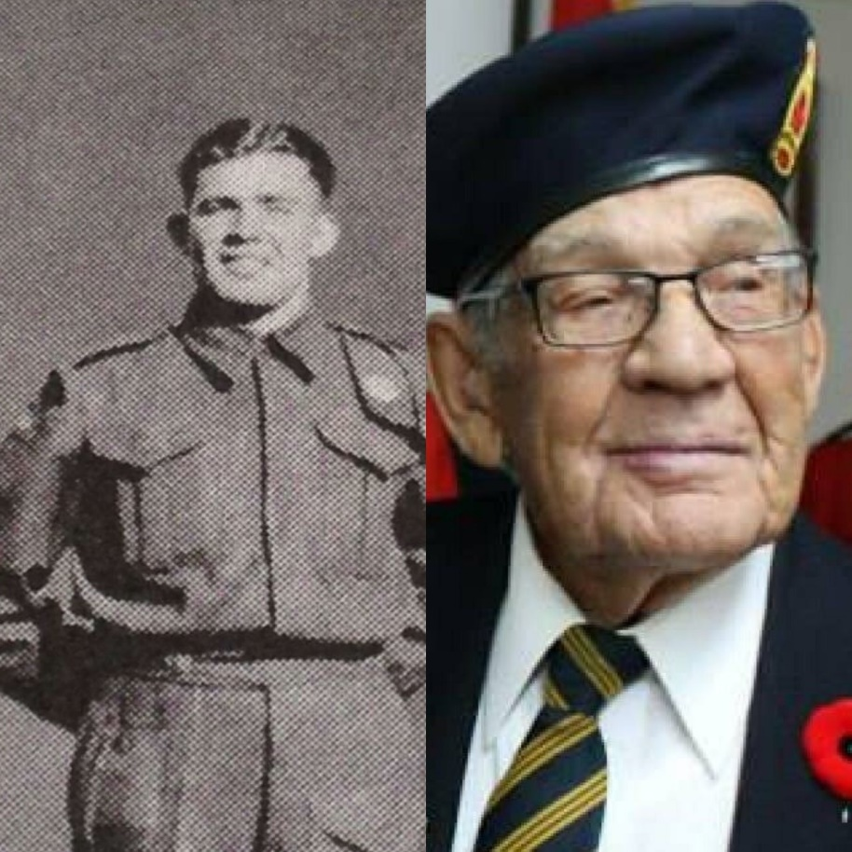
MARVIN HARDING WWII
Jackson Lavoie’s Great Grand Father

Slide 11
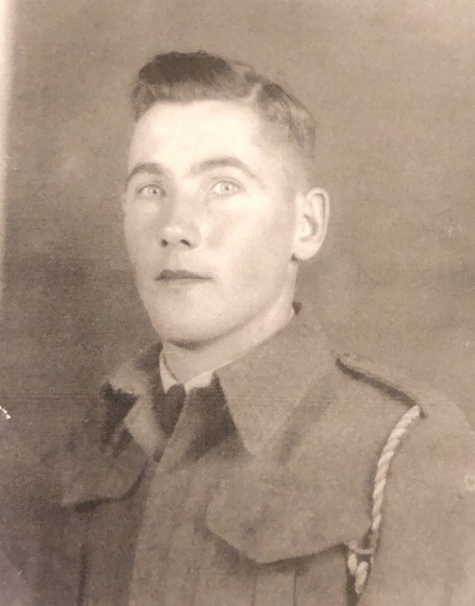
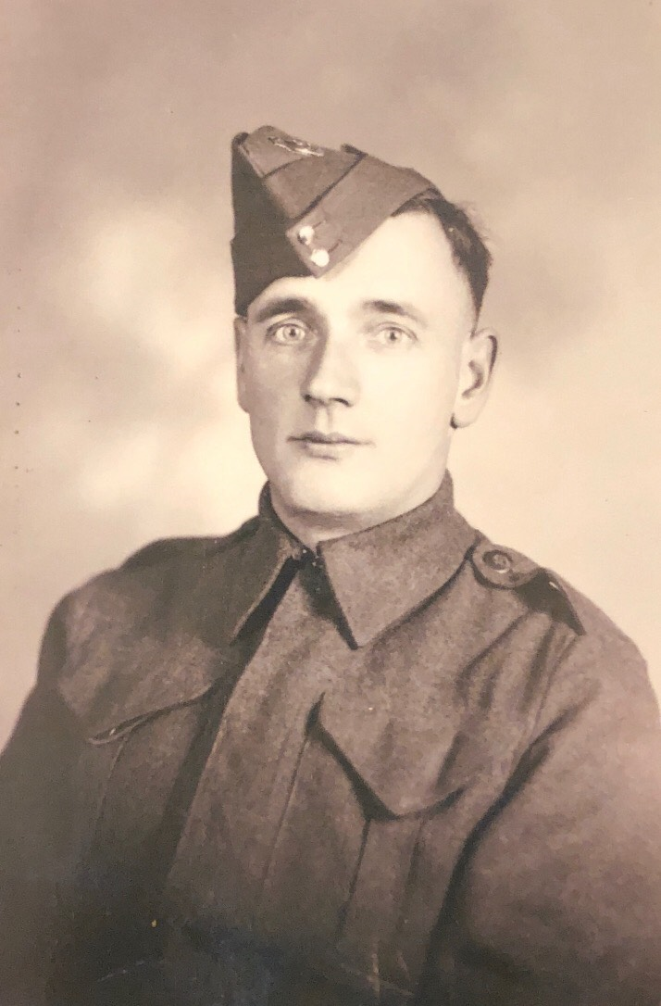
James Simpson &
Leonard MacCallum
Sky Stewart’s
Great Grand Fathers

Slide 12
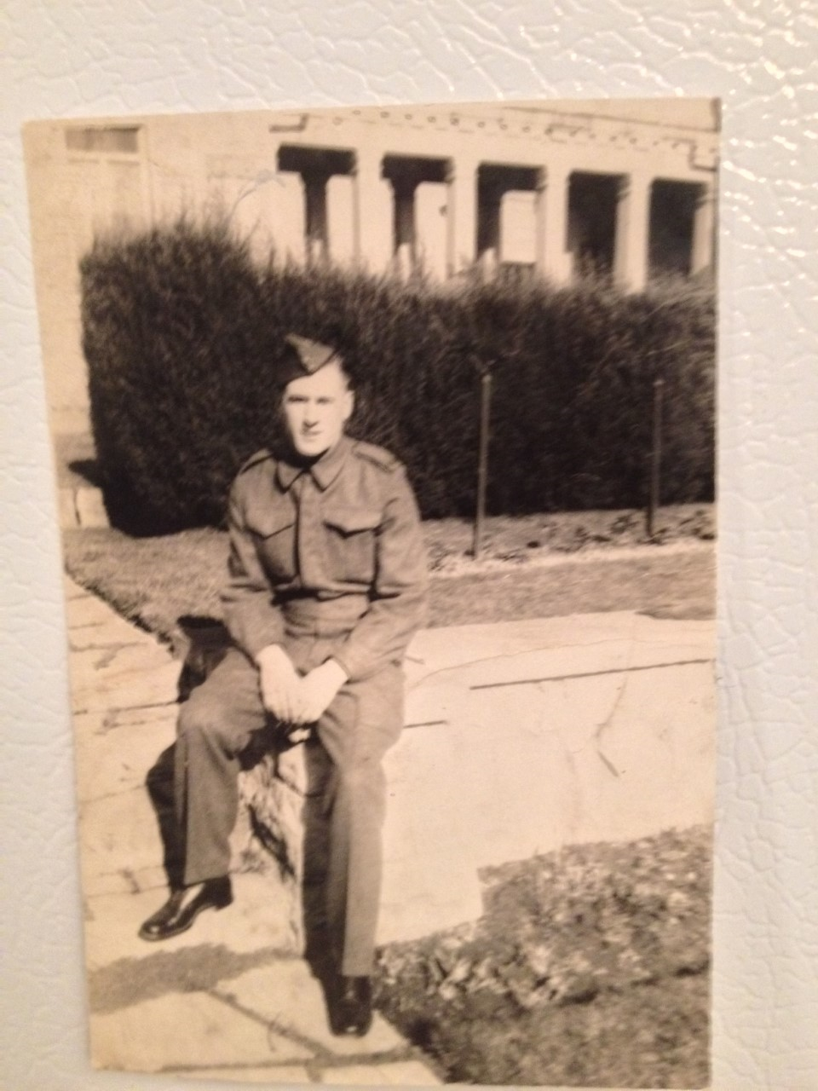
LEWIS
COPELAND
Hope’s
Great Uncle

Slide 13
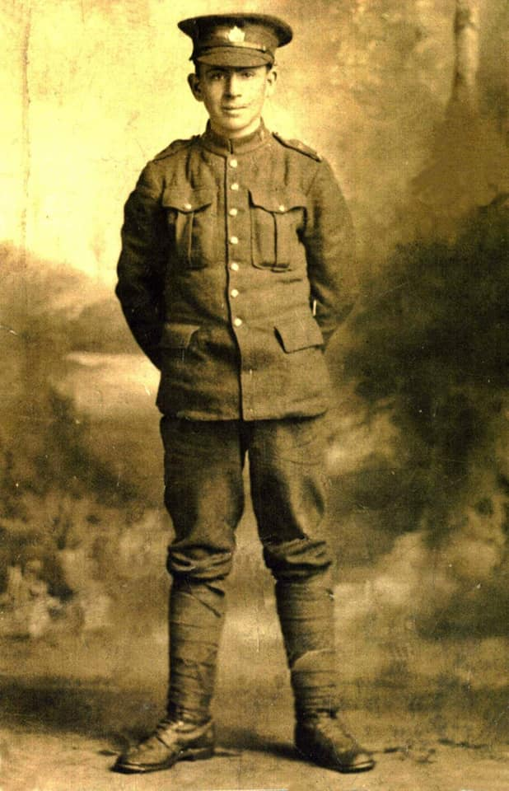
Aminah, Evan, Sam & Grace Gallant’s-- Great Great Uncle
Arthur Gallant

Slide 14
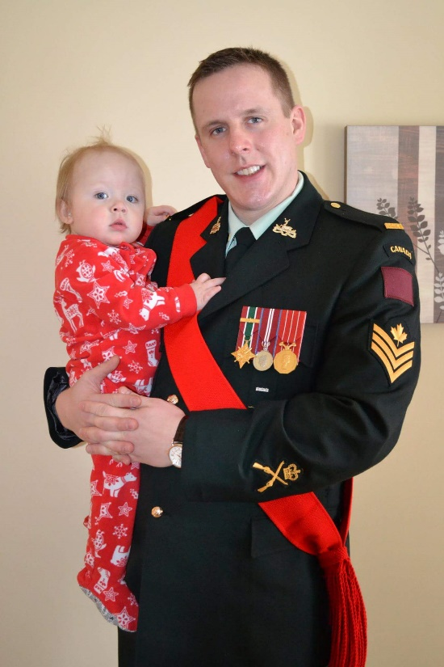
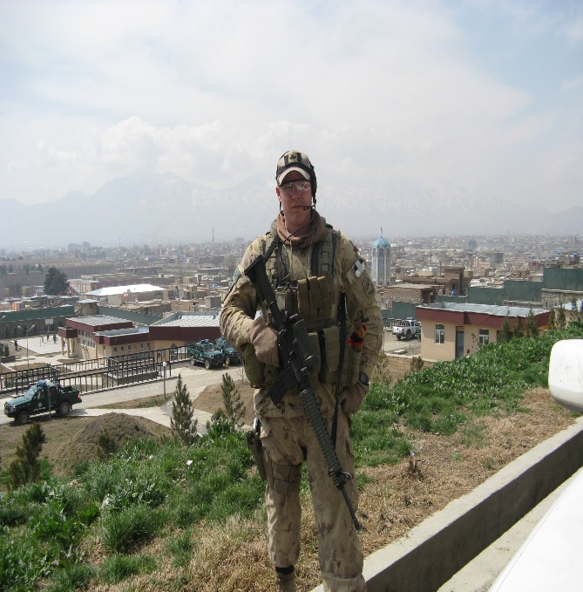
SERGEANT
CALEB DICKIE
Colten’s Father

Slide 15
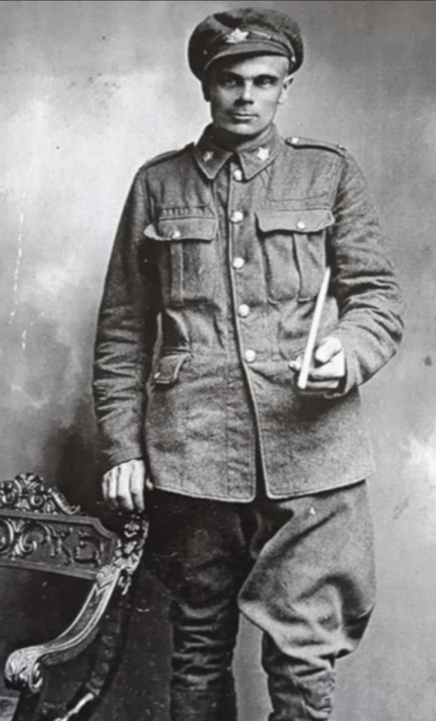
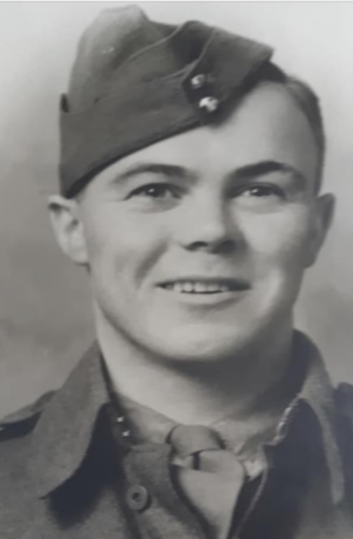
Great Great Grandfather William Savage (WWI) & son William Savage (WWII)
Emmily’s Great Great Grandfathers

Slide 16
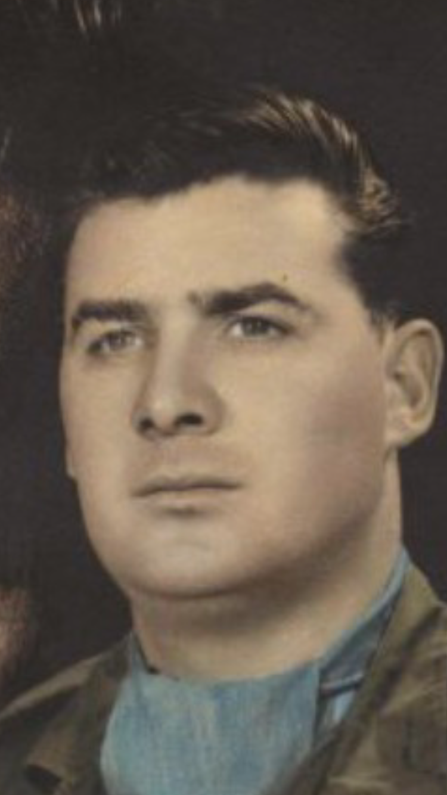
TRACEY ROBINSON
Lorynn Gallant’s
Grandfather

Slide 17
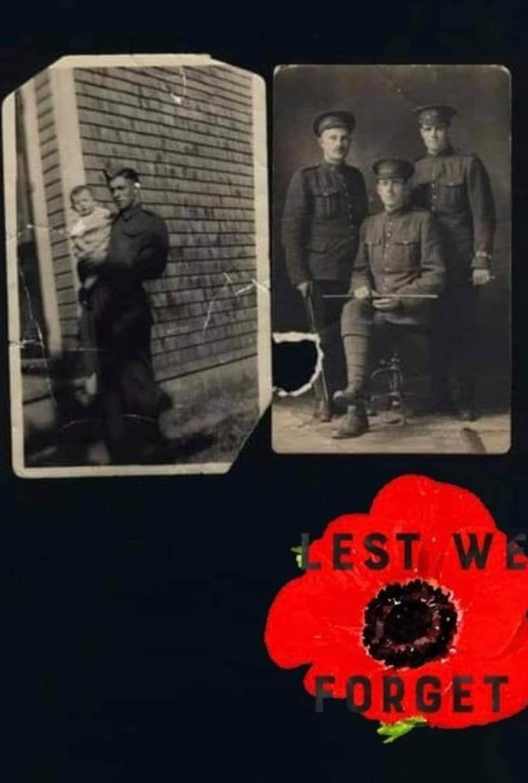
PETER
THOMPSON
Mykayla & Shyan’s
Great Great Grandfather

Slide 18
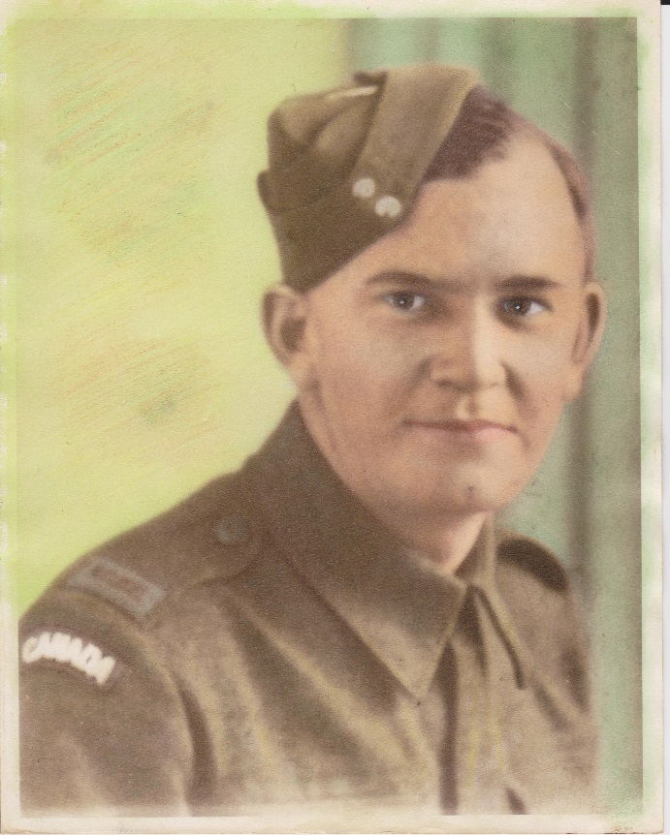
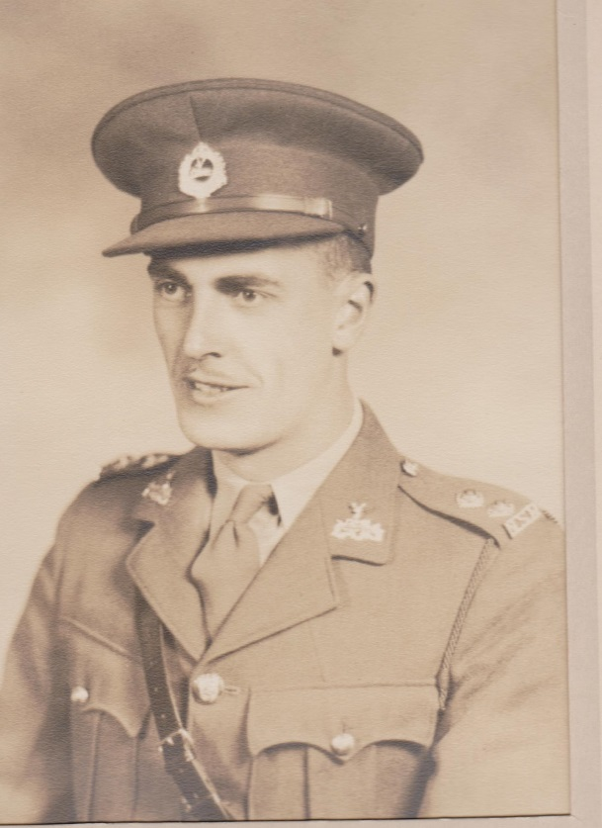
HUBERT BARNABY & BENEDICT DEWOLFE
Nicholas Treadwell’s
Great Great Grandfathers

Slide 19
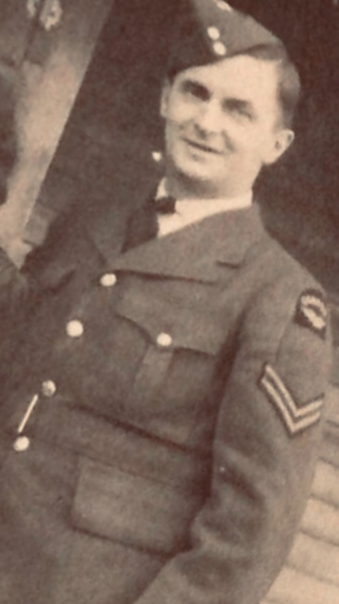
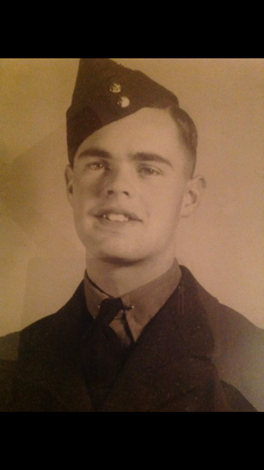
ROBERT & CAMPBELL WORRELL
Jack’s
Great Great Grandfathers

Slide 20
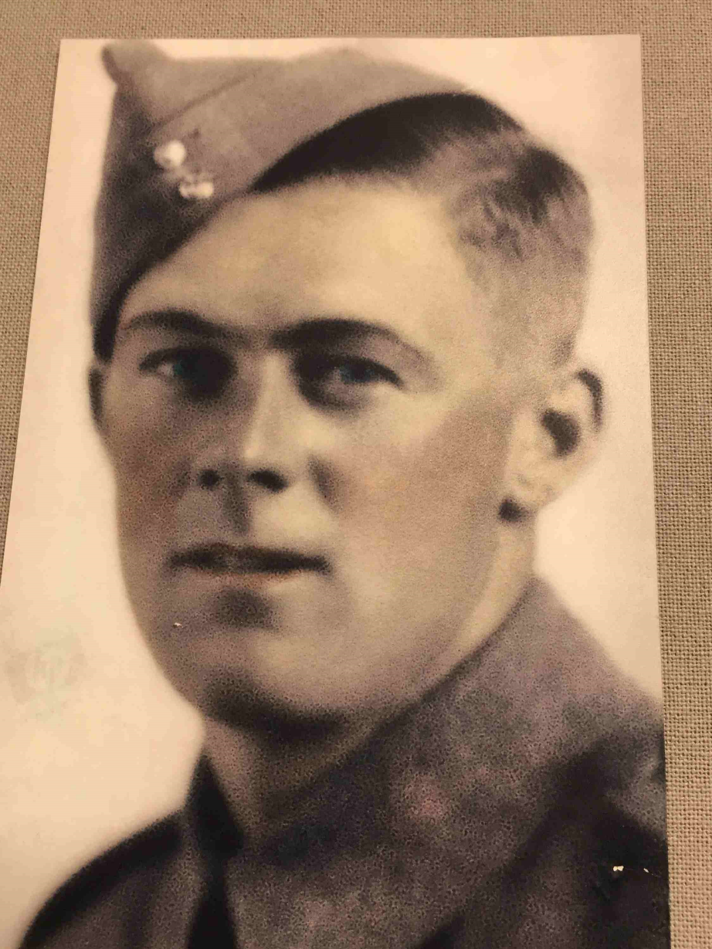
Byron Savage
Nealah Savage’s
Great Great
Grandfather

Slide 21
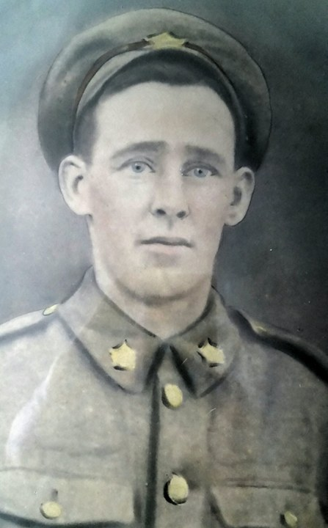
Ronald MacDonald
Trent Power’s
Great Great
Grandfather

Slide 22
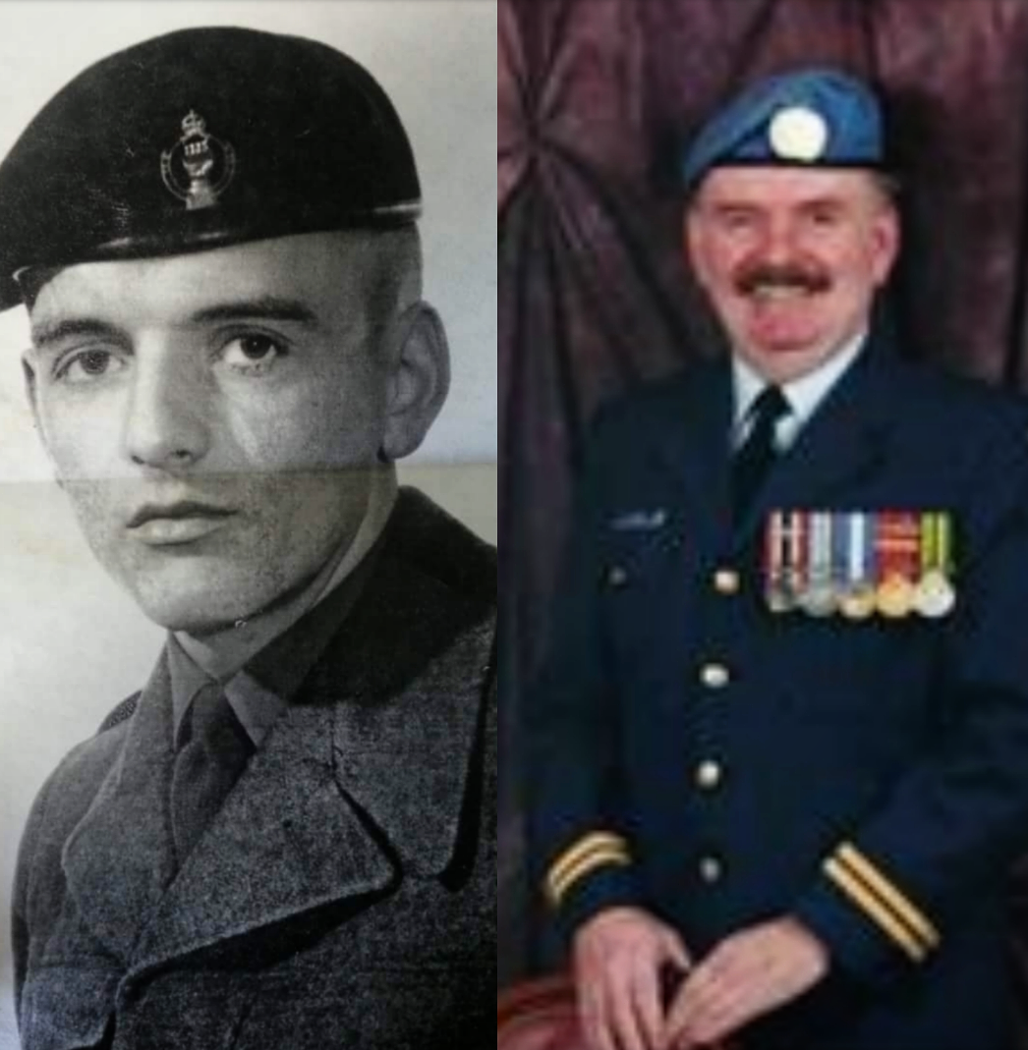
EARL WEIR
Lexen Guimond’s
Great Great
Grandfather

Slide 23
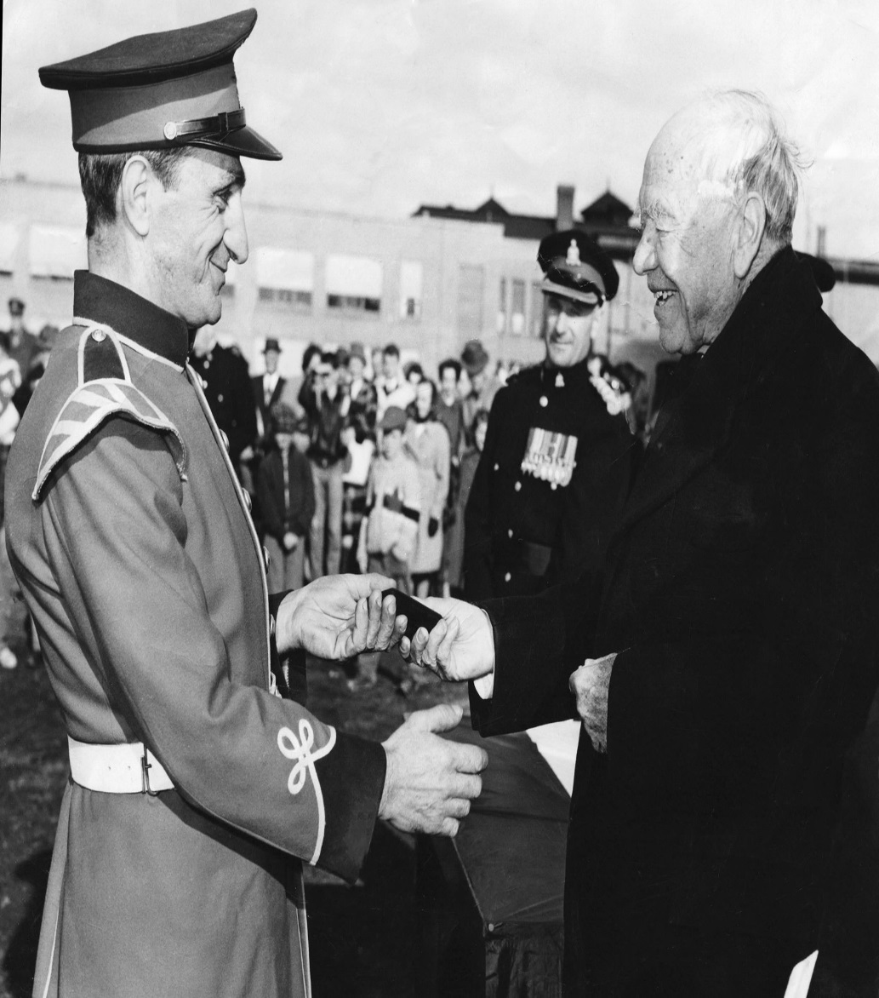
WILLIE FARRAH
Ella & Stone Breau’s
Great Great
Grandfather

Slide 24
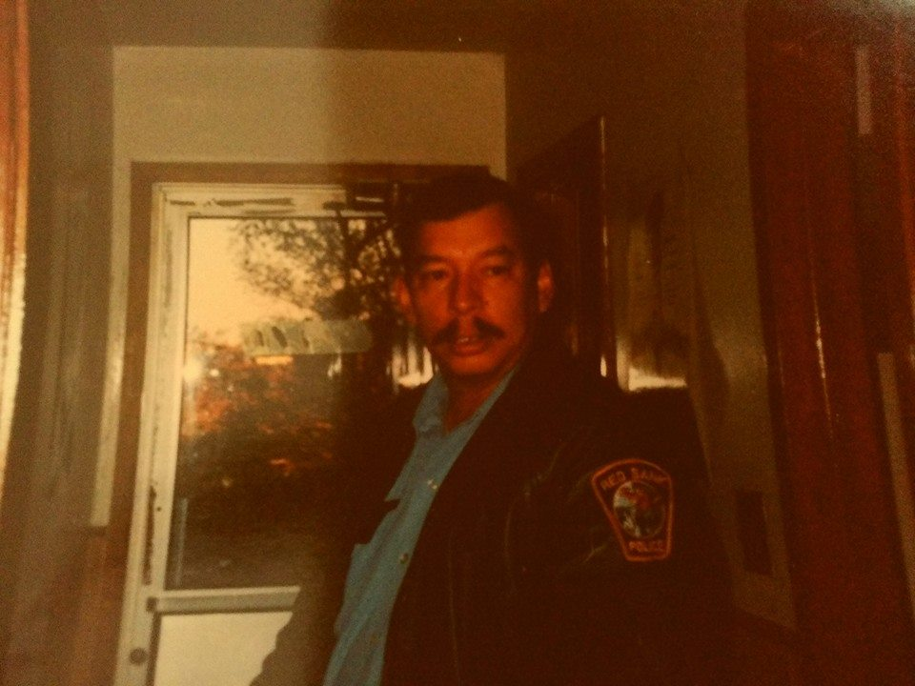
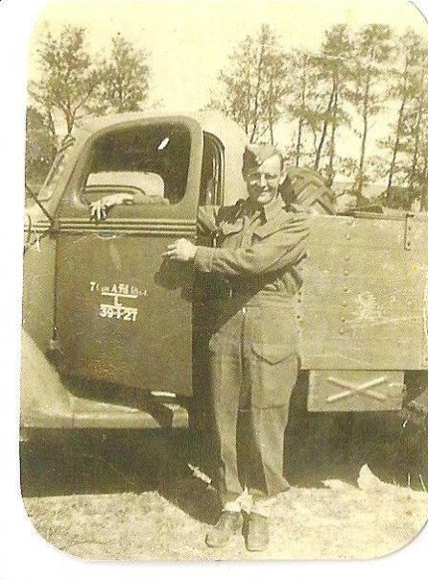
Wilfred LeGresley & Frank Sewell.
Sage Augustine Connell's Great Grand Fathers

Slide 25
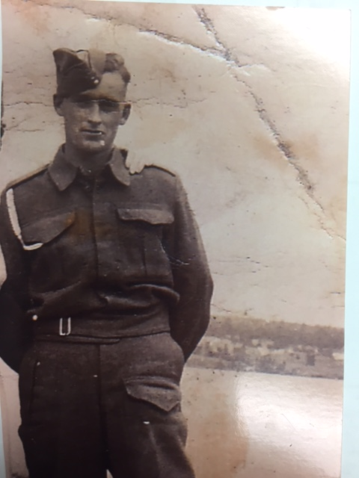
DEALY LANDRY
Great Grandfather to Lauren, Gabriel Landry & David Pickford and Asher Kane

Slide 26
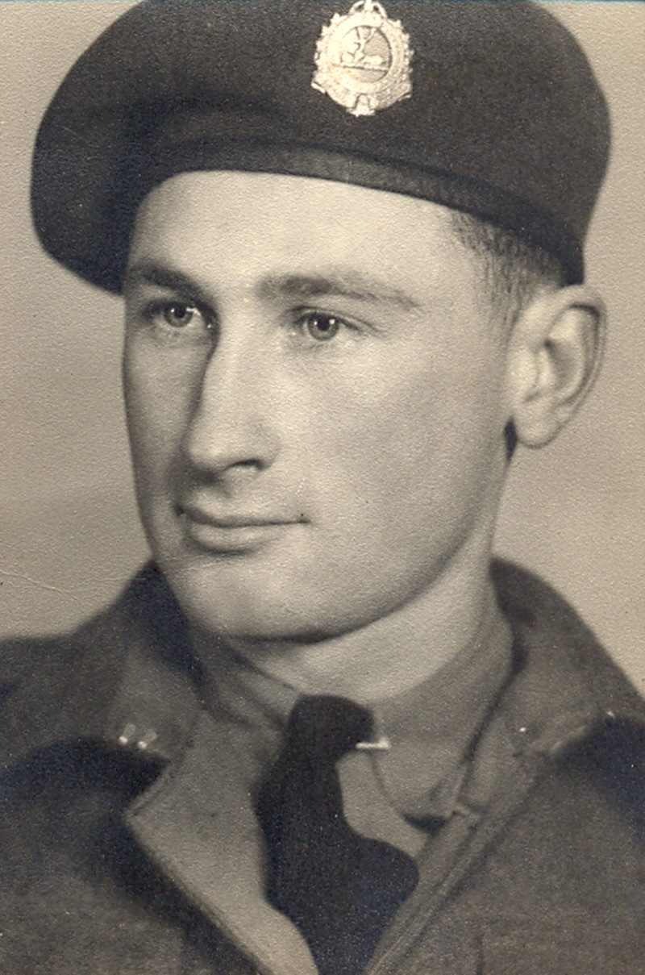
FREDERICK H.
PAYNE
Great grandfather to
Wynston, Huxley, Everett Foran

Slide 27
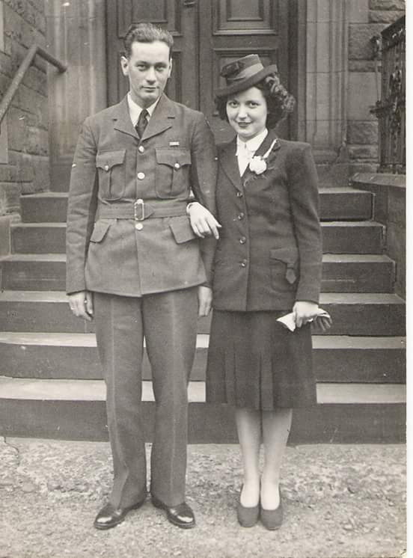
REG SAUNDERS
Great grandfather to
Luke and Charlotte
Saunders

Slide 28
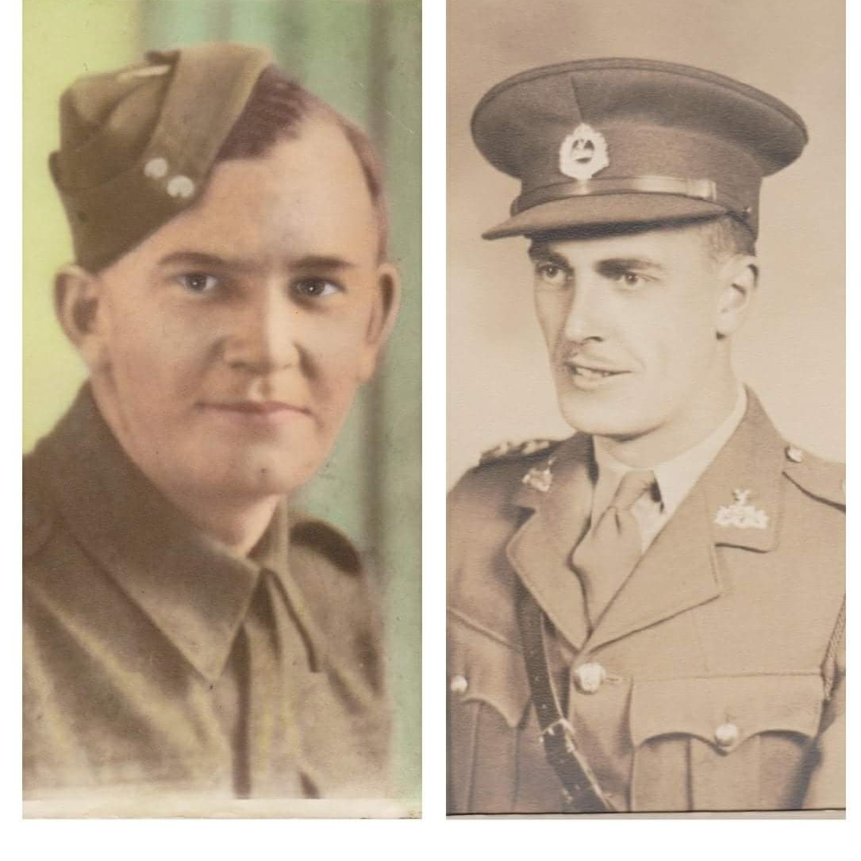
Hubert Barnaby
&
Benedict DeWolfe
Great Grandfathers to Nicholas Treadwell

Slide 29
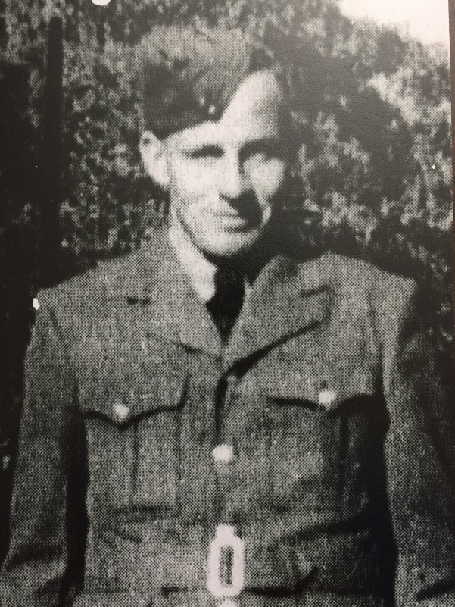
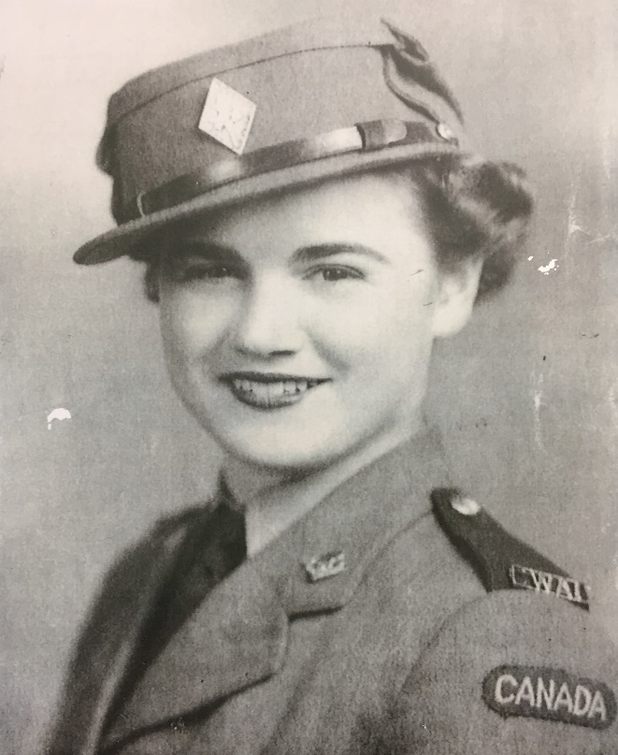
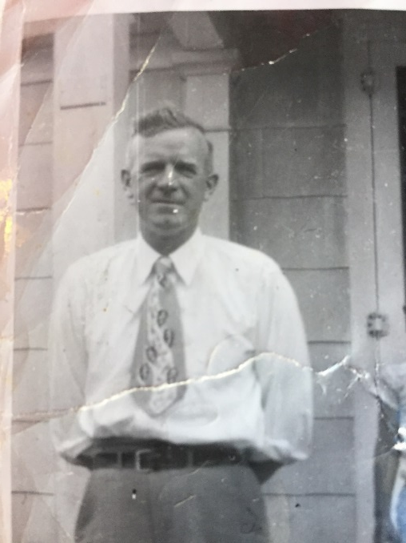
ROY & ANNA SAUNDERS
Great Great Grandparents to
Caroline
MacMillan
TOM MACMILLAN

Slide 30
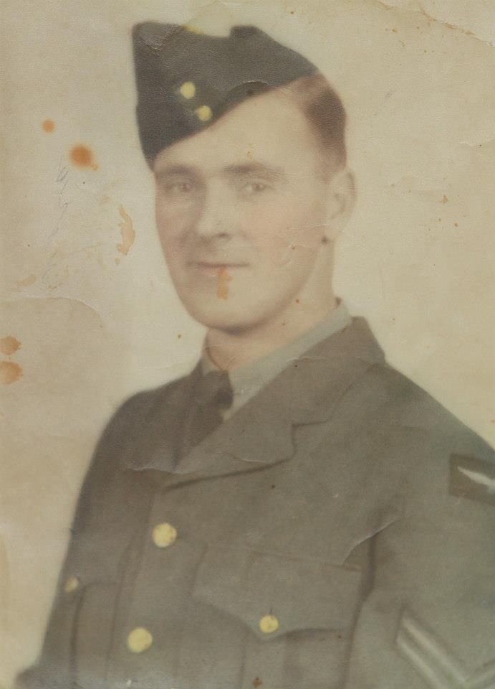
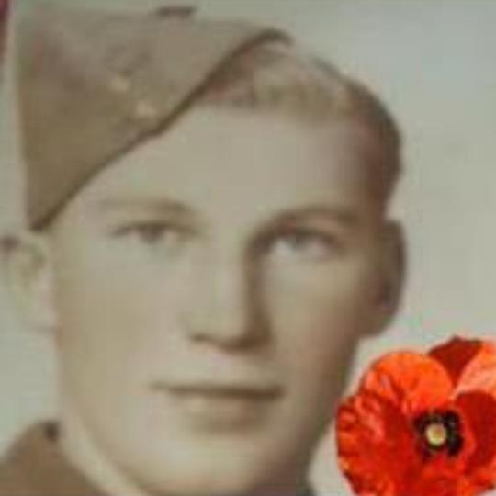
George Fraser & Windsor Kingston
Great Great Grandfather to
Keira Fraser

Slide 31
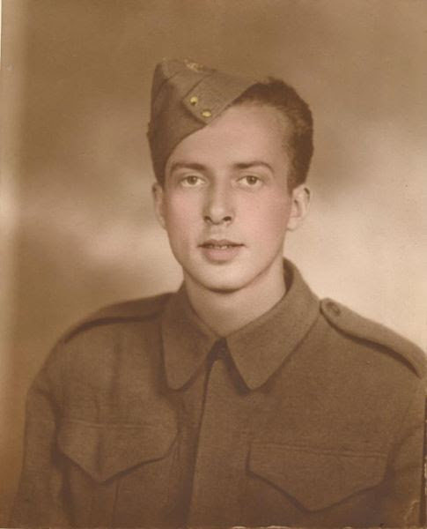
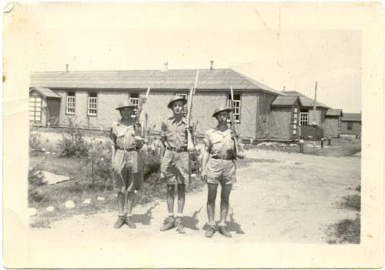
HAYWARD GRANT
Great- Great Grandfather to Molly Groundwater

Slide 32
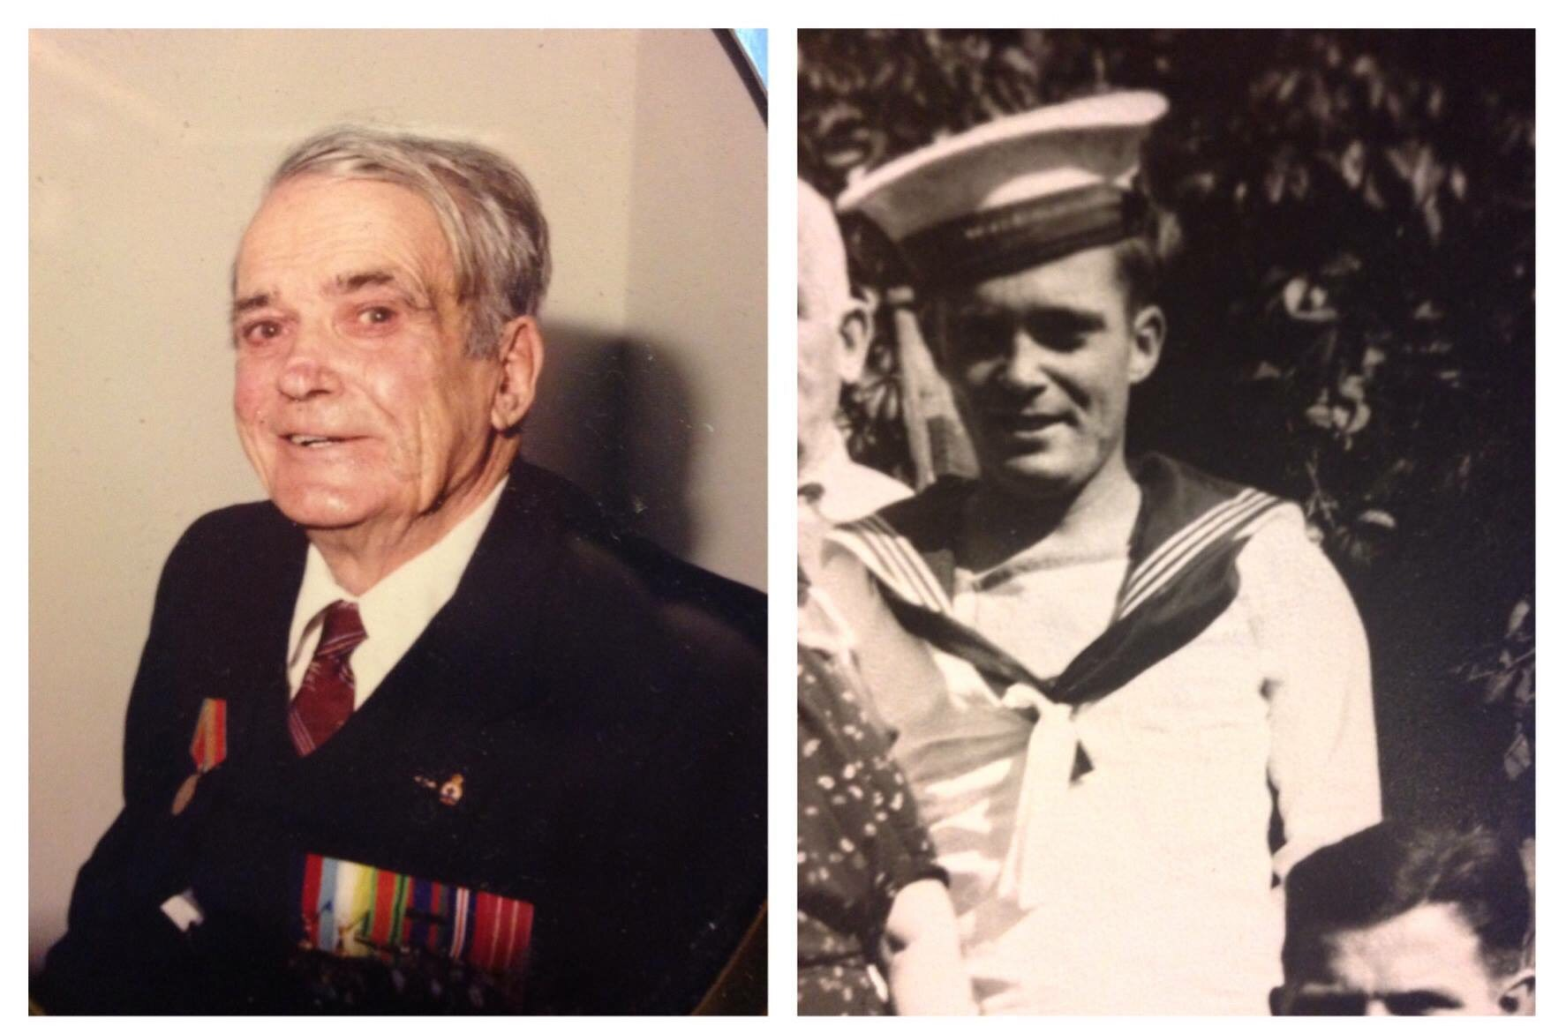
RAYMOND MOAR
Great Great Grandfather to Maycey Moar

Slide 33
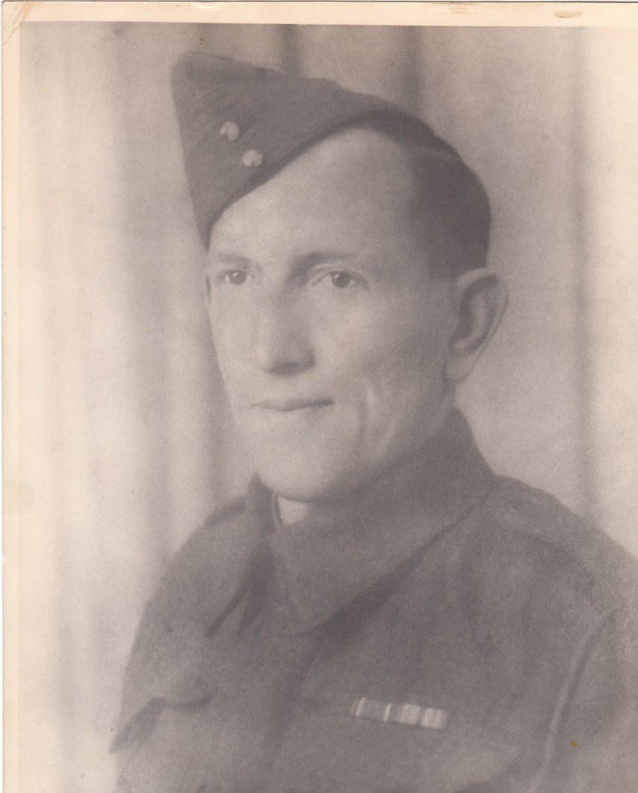
FREDERICK ARNOLD FOREST
Brady MacPherson's Great Great Grandfather

Slide 34
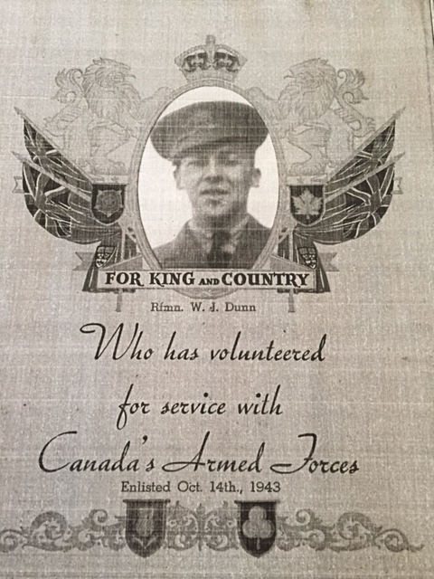
Rfmn. W.J. DUNN
Mrs. Dewolfe’s father

Slide 35
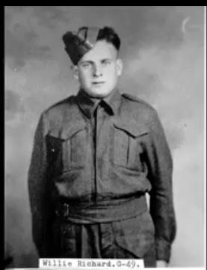
WILLIE RICHARD
Mme Lockerbie’s
Grandfather

Slide 36
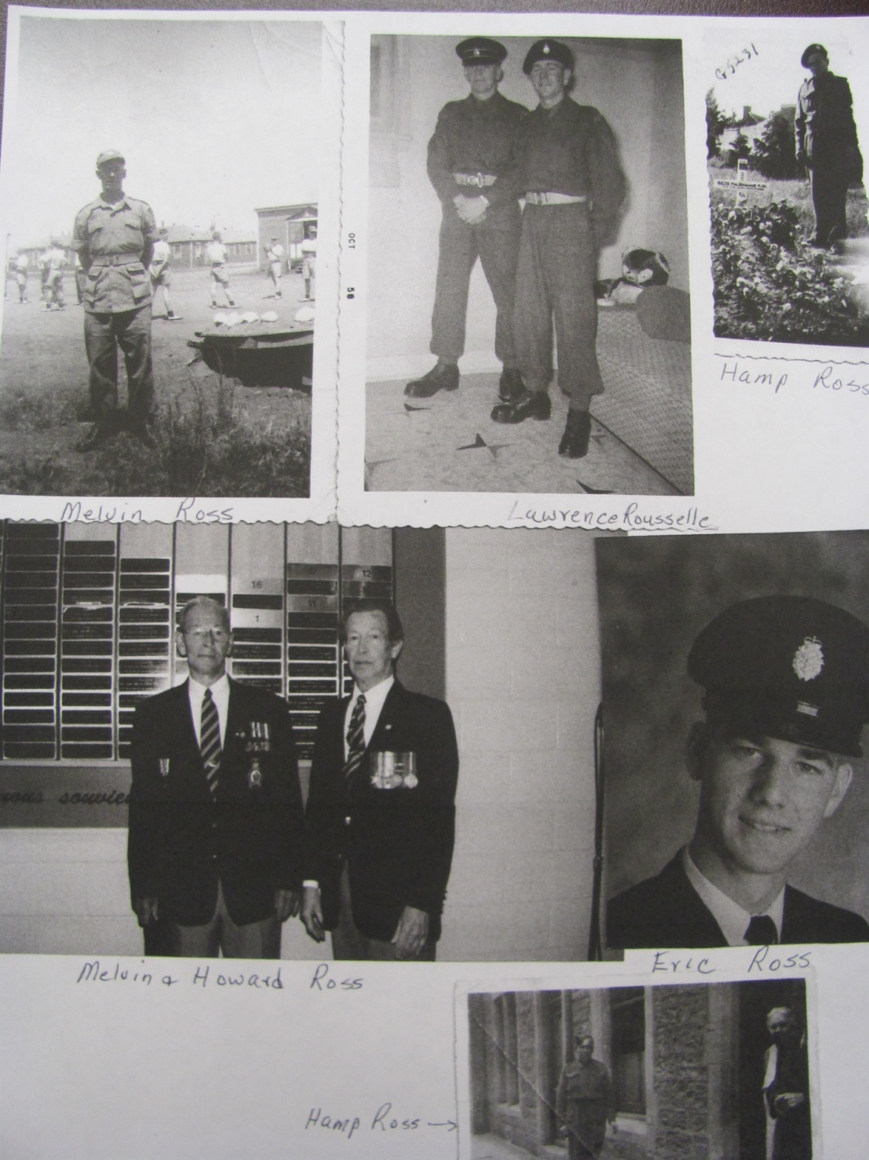
MEMBERS OF WALSH FAMILY
Related to Brianna Walsh & Tyler
Anderson

Slide 37
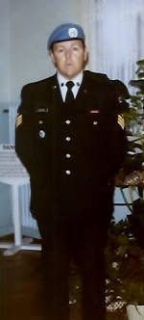
ALLAN MCKENZIE
Mrs. Morehouse’s Father & Charlie Sullivan’s Grandfather

Slide 38
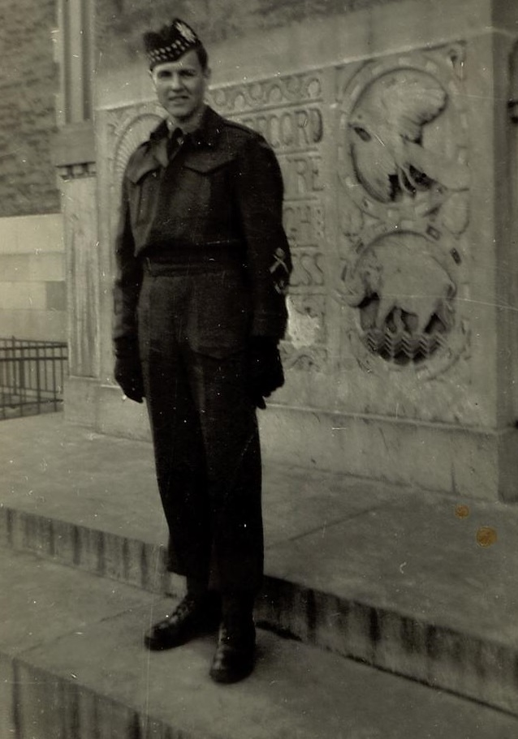
STERLING BELL
Great-Great Grandfather to Samuel
& Henry MacLean

Slide 39
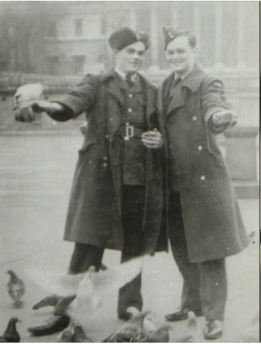
JACK O’REILLY
Ms. O’Reilly’s Grandfather (on the right)

Slide 40
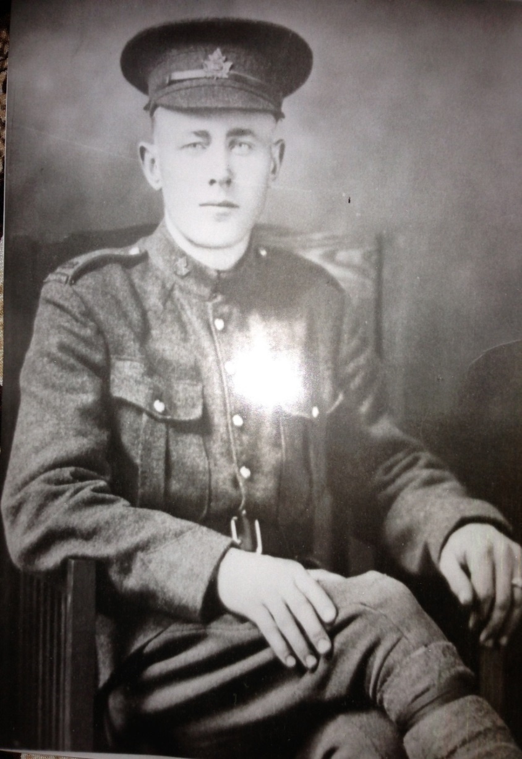
WILLIAM
BRANSFIELD
Great-grandfather of Ms. Bransfield
Great-great-grandfather of Madison Bransfield , George Cooper, Samuel & Henry MacLean

Slide 41
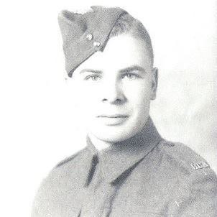

CHARLES COOLEN
&
WILLIAM CLANCY
Kate, Max & Charlie Gallant’s Great Grandfathers

Slide 42



REID & BURTON WISHART
Ava Mitchell’s
Great Grandfathers

Slide 43

BILLY SAVAGE
Mrs. Morehouse’s Great Uncle
Great Great Uncle to Nealah Savage & Charlie Sullivan
Great Grandfather to Lauren & Elena
Savage

Slide 44

ROBERT BRANSFIELD Sr.
Grandfather of Ms. Bransfield
Great-grandfather of
Madison Bransfield,George Cooper,
Samuel & Henry
MacLean

Slide 45

JEANNE O’REILLY
Ms. O’Reilly’s Grandmother (on the right)

Slide 46

Mrs. Morehouse’s Great Uncles
Bryon Savage, Percy Savage, Billy Savage- Great Grandfathers
to Lauren, Elena & Nealah Savage
Great Great Uncle to Charlie
Sullivan

Slide 47

GINNY CORKUM
Great Aunt to Roman Matchett

Slide 48

LOUIS HAROLD YOUNG
Great Grandfather to Adrienne &
Bentley Shaddick

Slide 49

WO Stuart Louis Young
Grandfather to Adrienne &
Bentley Shaddick

Slide 50


ISSAC SHEASGREEN’S
GREAT GRAND
FATHER

Slide 51

WILLIAM
STURGEON
Graham & William Sturgeon’s Great Grand Father

Slide 52


Clark Family
Maggie Clark’s Great Grandfather

Slide 53

OMER MATCHETT
Maggie Clark’s Great Grandfather

Slide 54

EDMUND BREAU
Emma Matchett’s
Great Grandfather

Slide 55

PATRICK DESMOND LYONS
Great Uncle to Quinn, Dylan, Nora, Jacob, Mirinda, Alexander, Rebecca, Matthew

Slide 56


Charles Arsenault &
Elmer Prosser
Conall & Luke’s Great Grandfathers

Slide 57

RAYMOND FLETCHER
Ms. Matheson’s
Grandfather

Slide 58

HOWARD WHITE
Great Grandfather to
Mason White

Slide 59


Holden Bowie &
Samuel Aube
Great Grandfathers to
Mrs. Allison

Slide 60


JACK IRVING & brothers ANDREW and JOSEPH
Great Grandfather to
Colin & Kale Murray

Slide 61

MELVIN ROSS
Great Grandfather to Brianna Walsh & Tyler Anderson

Slide 62


RUBY SOMERS &
EARL BLAKELY
Great Great
Grandparents to
Sophie Burns

Slide 63

GREGORY JAMAEL
Great Grandfather to Aidan Forbes

Slide 64


KEN & JIMMY COOPER
Uncles of George Cooper

Slide 65

Monsignor RAYMOND HICKEY
Ophelia & Adrian Rosengren’s distant cousin

Slide 66


JOSEPH POIRIER &
GEORGE COOPER
Great Grandfather &
Grandfather to George Cooper

Slide 67

WILFRED COMEAU
Great Great Uncle to Ophelia & Adrian Rosengren

Slide 68

Sgt DAVID B. RAMEY
Grandfather to
Alexis, Nicole &
Allen

Slide 69

FRANK MAHONEY
Great Grandfather to Evan McFarlene

Slide 70

HEATHER HOGAN
SOPHIE’S
AUNT

Slide 71

HAROLD PUNKARI
& MARTHA
Great Great Grandparents of Emily Comeau

Slide 72


JAMES MANUEL &
RAYMOND MORRISON
Emma Matchett’s
Great Grandfathers

Slide 73

RYAN MURPHY
Mrs. Gardiner’s Father

Slide 74


KEITH HUTT
Dylan & Ella’s Grandparents

Slide 75

CHARLES MCEVOY
Great Grandfather to Catherine and Liam Walsh

Slide 76


WILFRED
ROBICHAUD
Great Grandfather to Lincoln Basque &
Autumn, Dallas and Delilah McEvoy

Slide 77


JAMES URQUHART & JOHN TURNBULL
Great Grandfathers to Charlotte Allison

Slide 78

HARRY DALEY
(Far Left)
Mrs. Girouard’s Grandfather

Slide 79


KATHERINE BRANSFIELD
Samuel & Henry McLean, Madison, George’s Great-Great Grandmother

Slide 80


Slide 81

Wendell Perley
Uncle to Tayla Larocque

Slide 82


OUR SCHOOL VETERAN – SIR JOHN FORBES – WW II

Slide 83
FROM ALL OF US AT GRETNA GREEN SCHOOL
THANK YOU!

