Slide 1
REMEMBRANCE DAY 2022
GRETNA GREEN FAMILY VETERANS

Slide 2
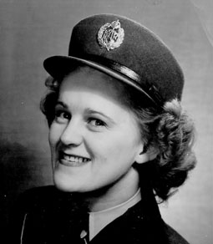

MARION SAVAGE
Great Great Aunt to Lauren,Elena,Nealah
Savage & Charlie, Jack, James Sullivan &
London & Lleyton
Savage

Slide 3
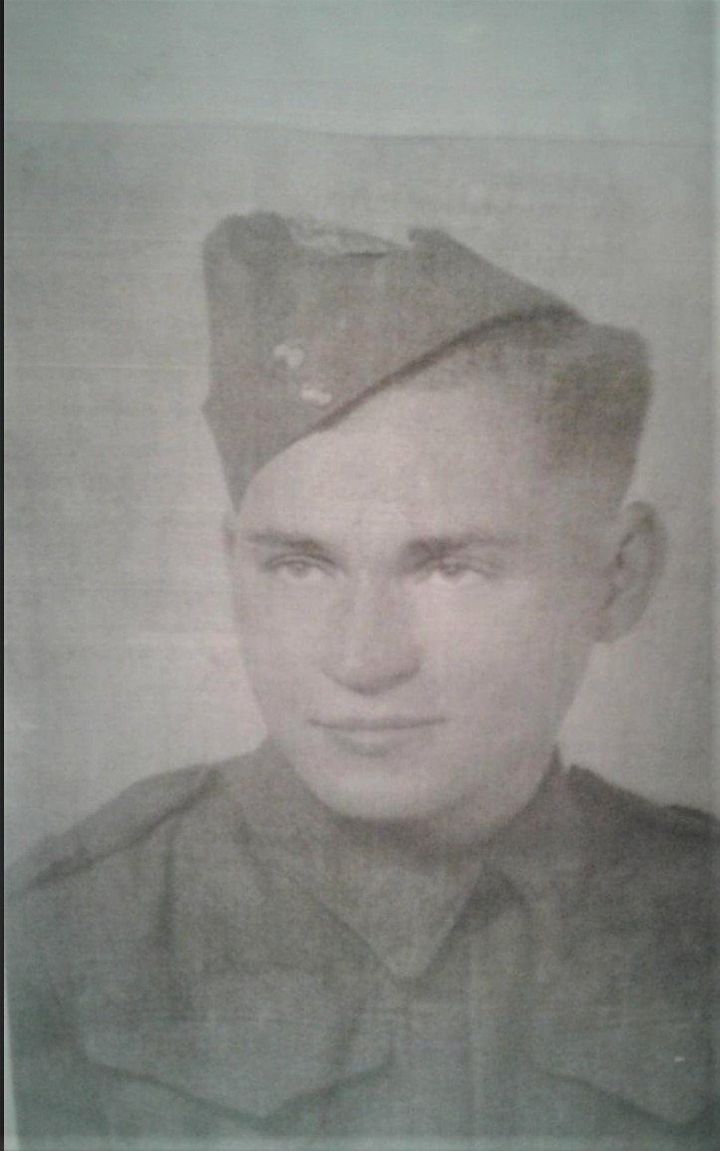
Marcel Beaulieu
Great Grandfather to
Ethan Sutherland

Slide 4
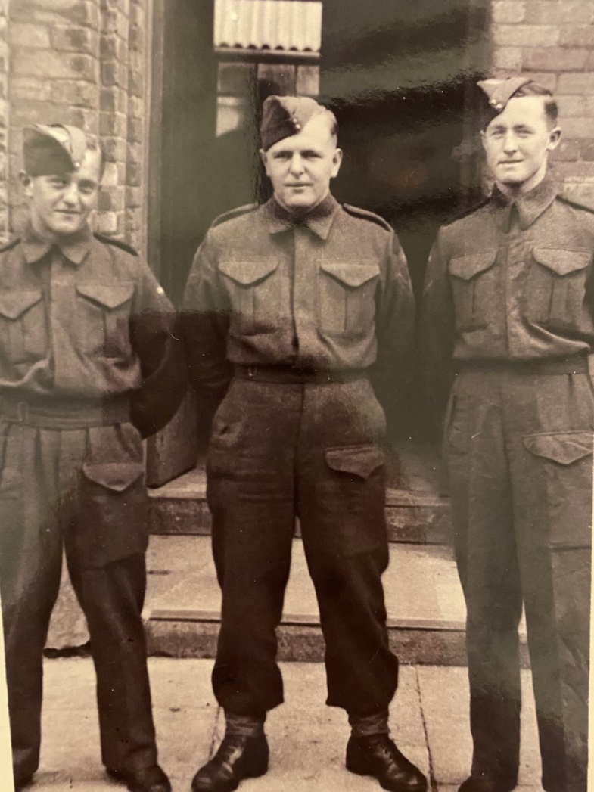
Hughie McCormack
(center)
Great Uncle to
Lily & Wade Dalton

Slide 5
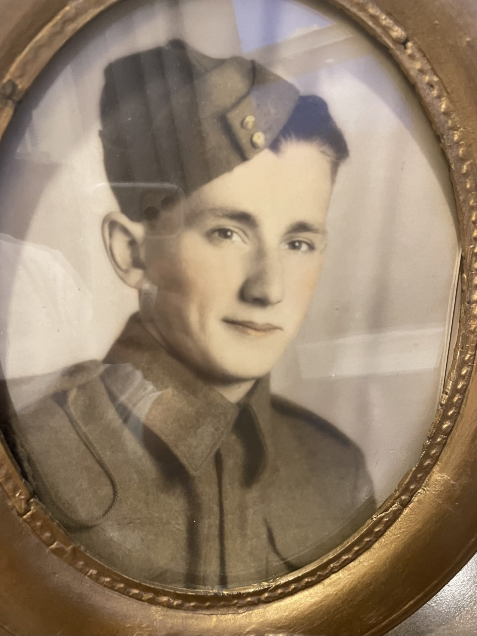
John Turnbull
Great Grandfather to
Charlie & Abby Connell

Slide 6
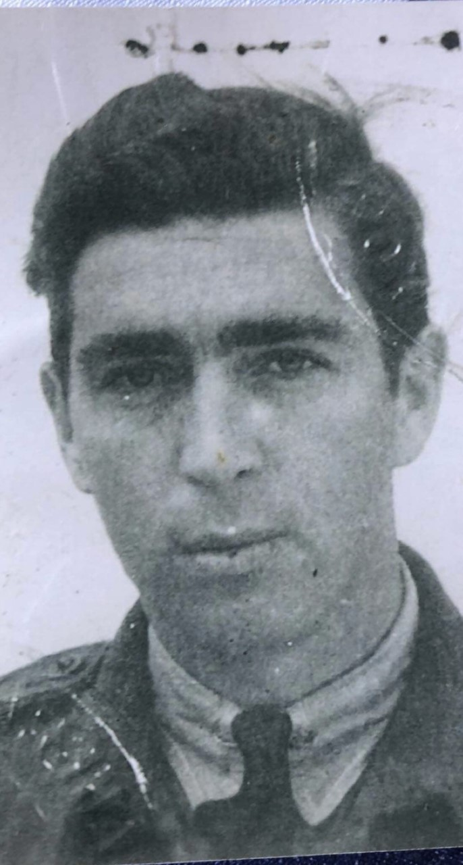
Peter J. Kingston
Great Grandfather to
Spencer Watling

Slide 7
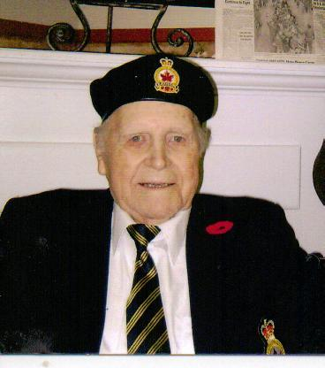
Earle MacDonald
Great Grandfather to
Charlie Lynch

Slide 8
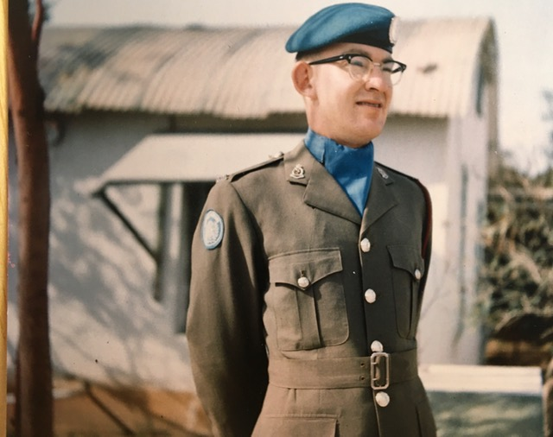
Noel Chambers
Grandfather to
Caleigh Chambers

Slide 9
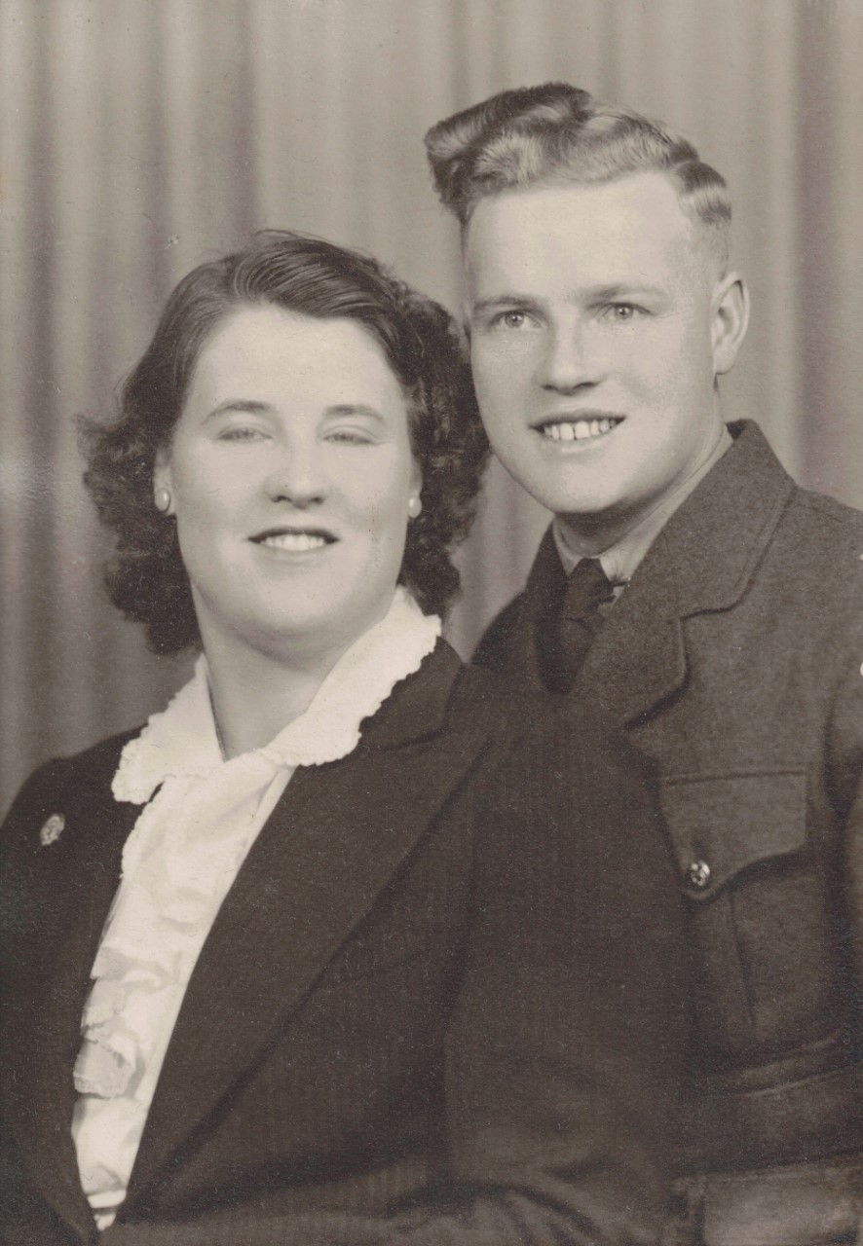
Moody Lewis
Great Grandfather to
Emma Nichols, Allison & Luke Maltby

Slide 10
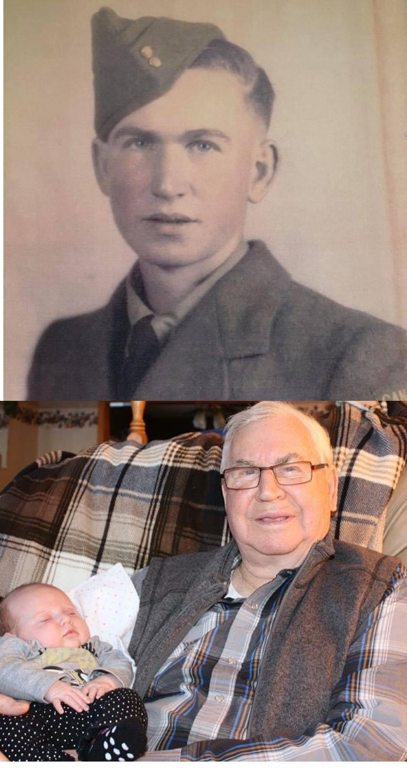
Wayne Russell
Grandfather to
Keira Somers

Slide 11
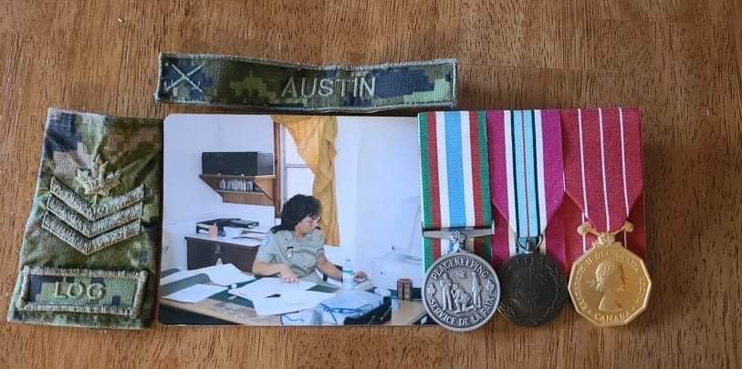
Sgt. Dorothy Austin
Great Aunt to
Grace, Walter & Charlie Scott

Slide 12
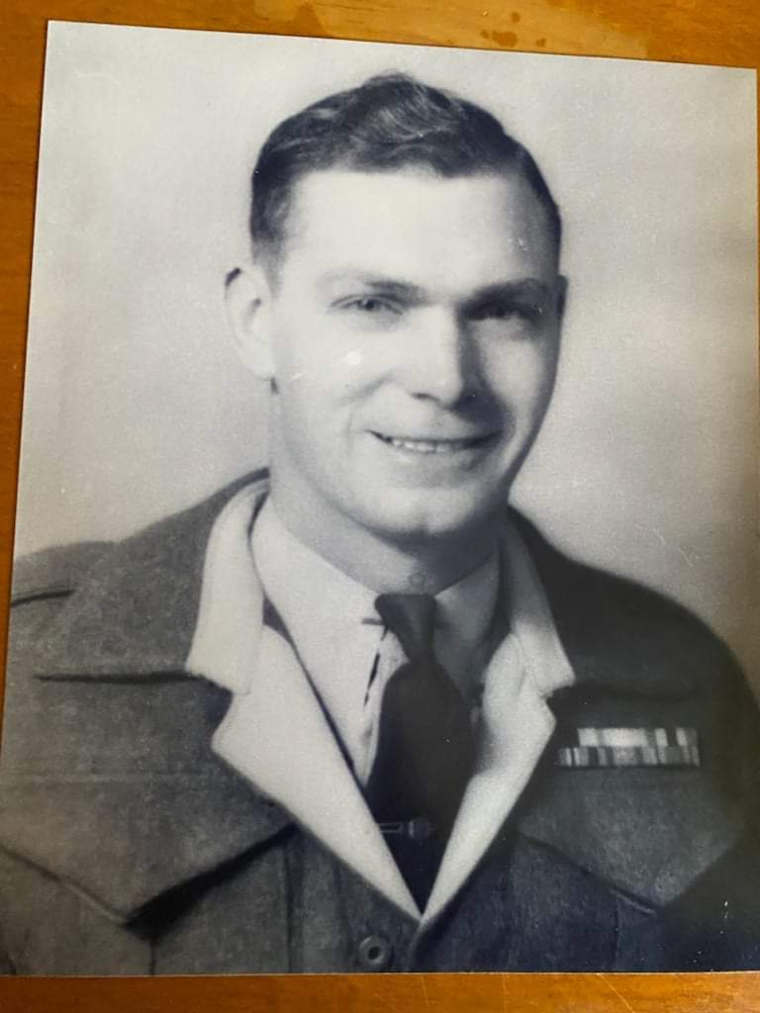
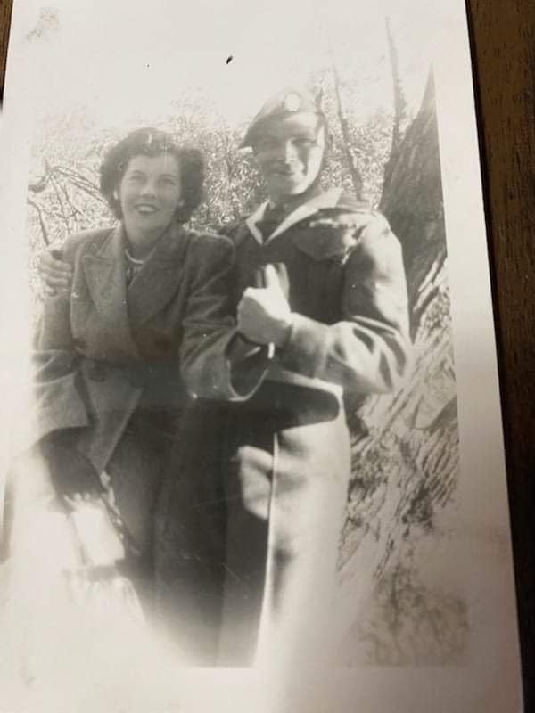
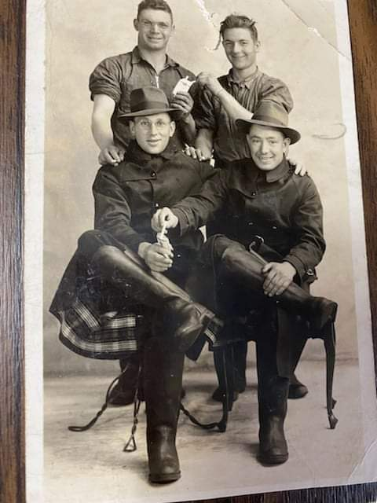
James Barter
Great Grandfather to
Aiyana & Silas Larry

Slide 13
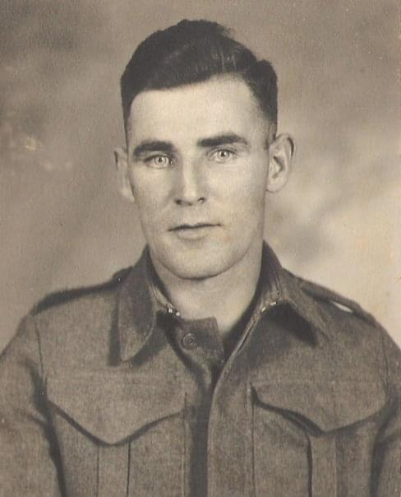
John McIntyre
Grandfather to
Barrett Girouard

Slide 14
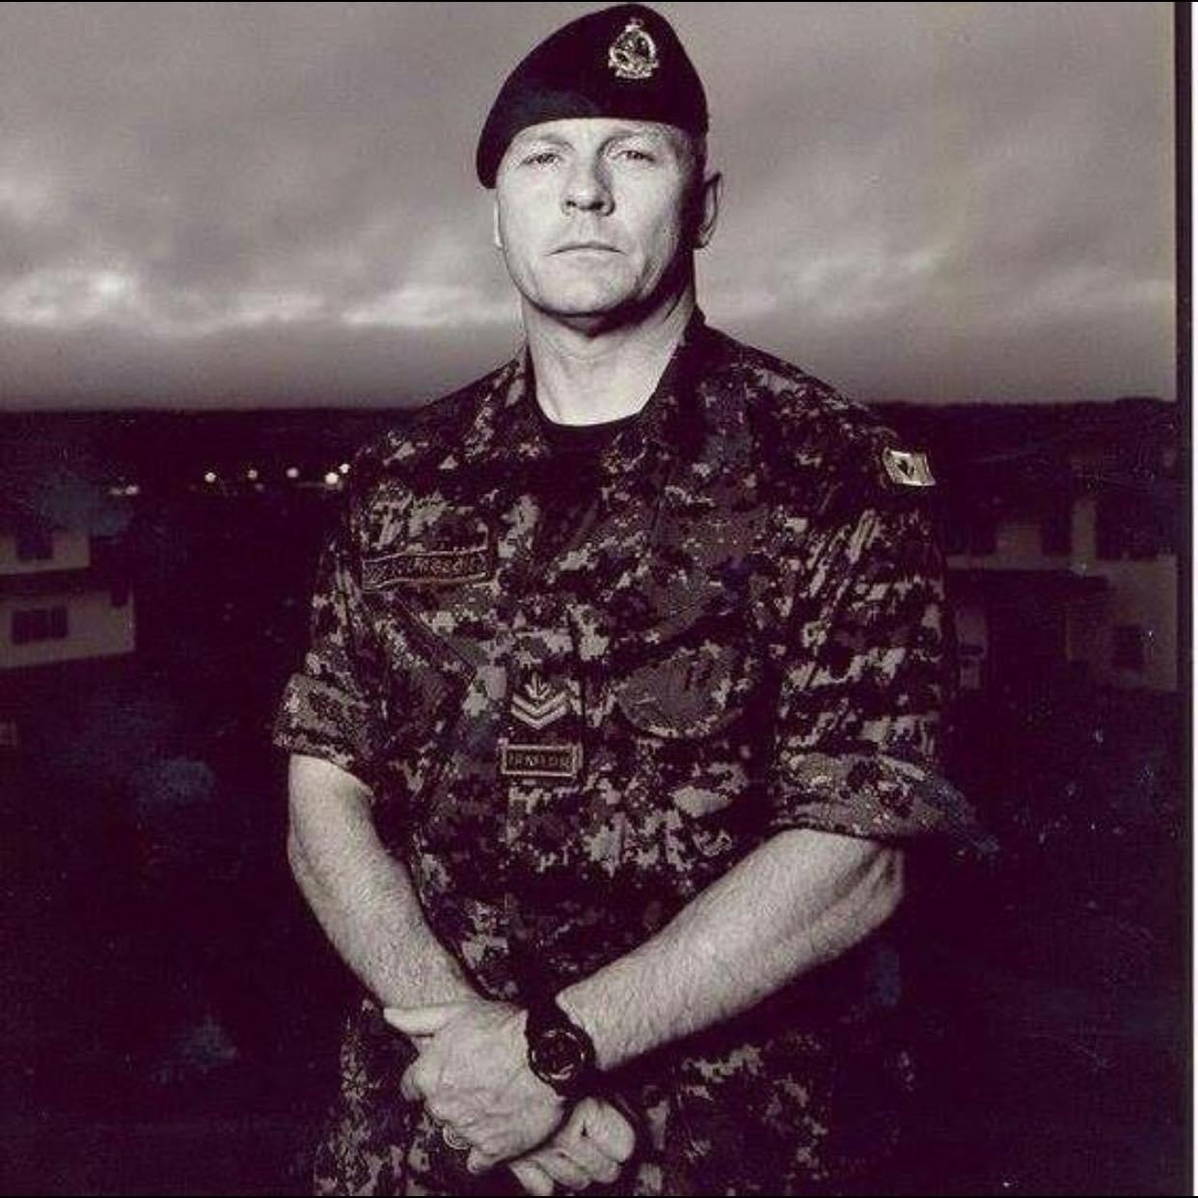
Duane Burgeois
Grandfather to
Leah Larter

Slide 15
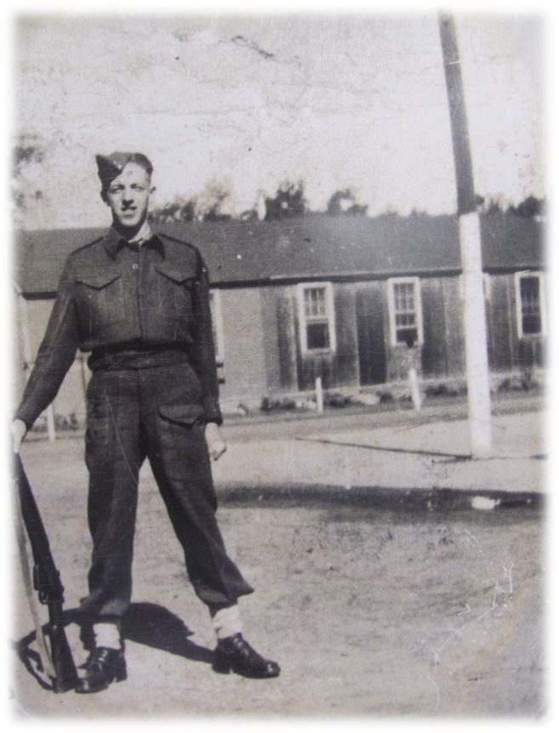
William Russell
Great Grandfather of Samantha Tweedie

Slide 16
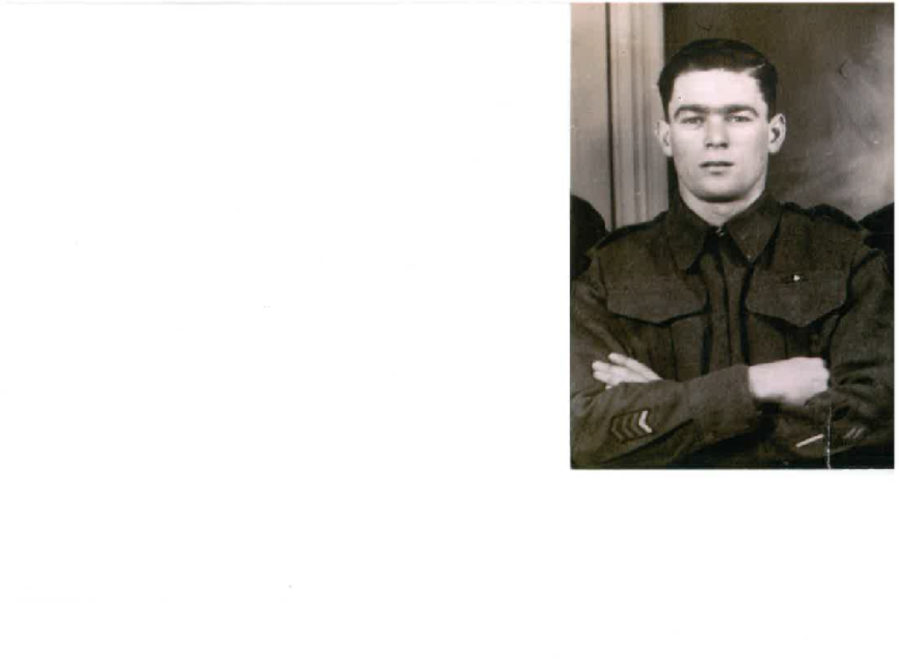
WILLIAM SAVAGE
Lauren & Elena’s Great - Great Grandfather

Slide 17
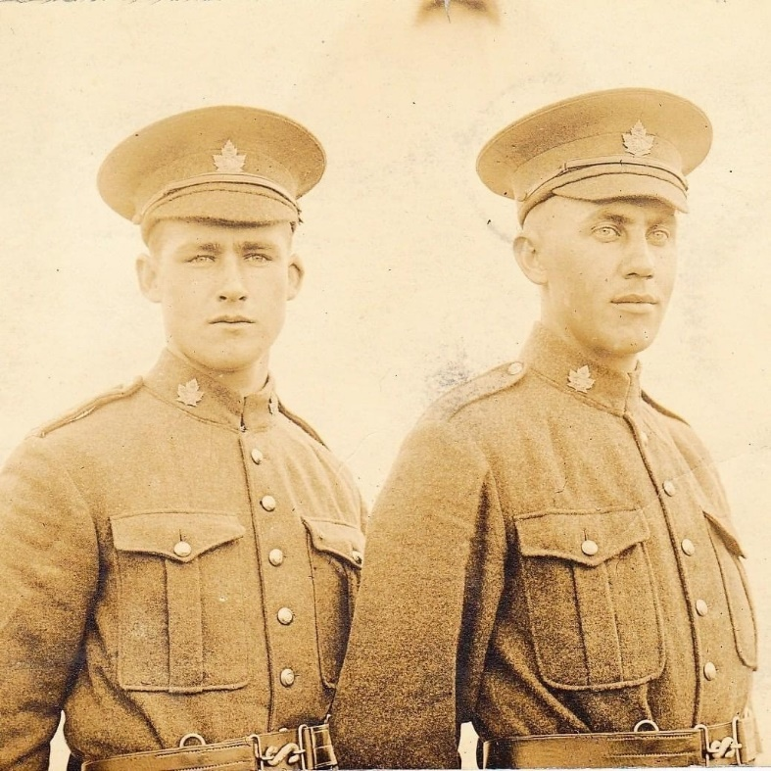
HENRY PERCY ANDERSON
(ON THE RIGHT)
Nash Lannan-McLeod’s Great Great grandfather

Slide 18
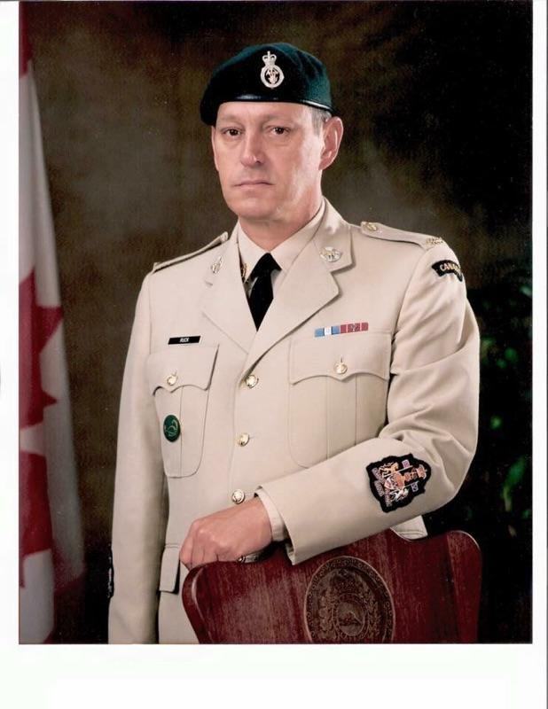
THEODORE RUCK
Jaida Gillespie’s Grandfather

Slide 19
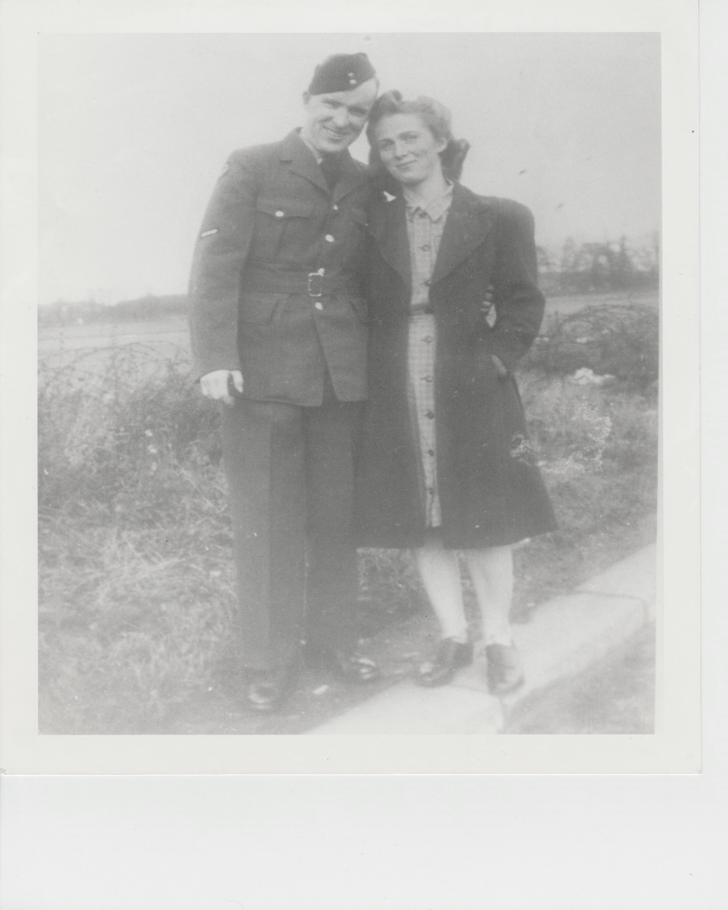
GEORGE & LILIAN DUNCAN
Logan & Lucas Mahabir’s
Great Great Grandparents

Slide 20
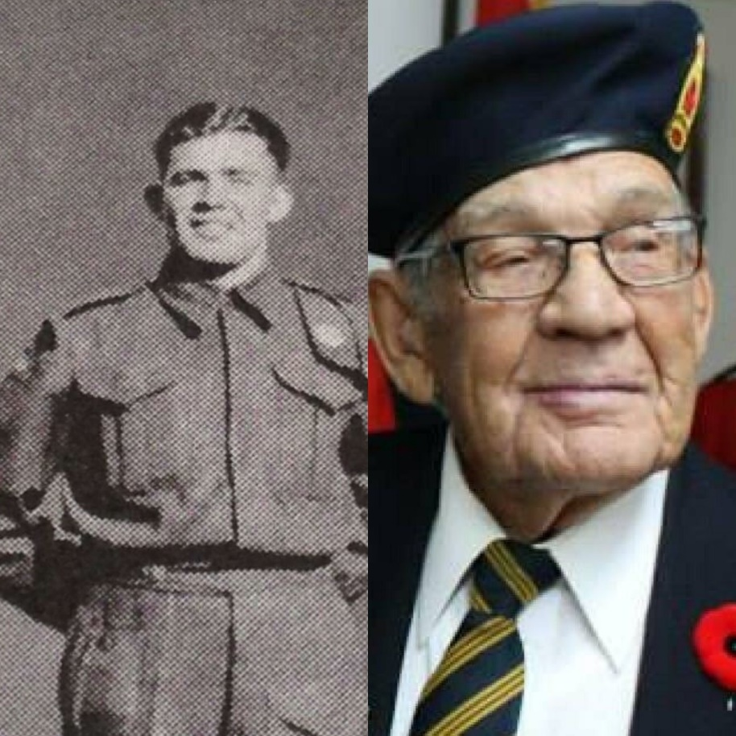
MARVIN HARDING WWII
Jackson Lavoie’s Great Grand Father

Slide 21
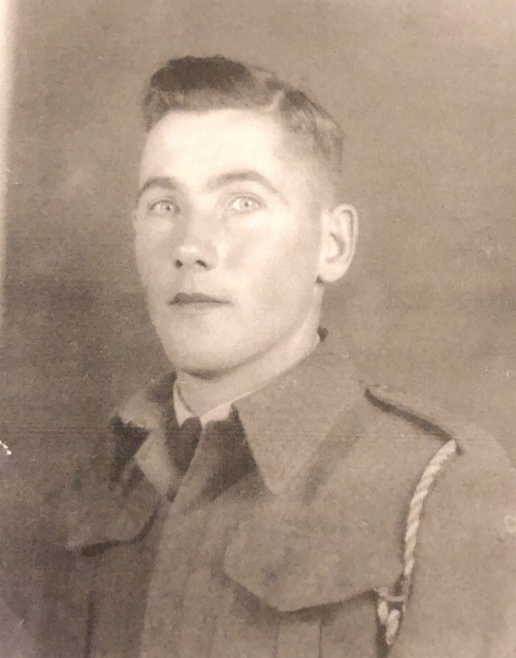
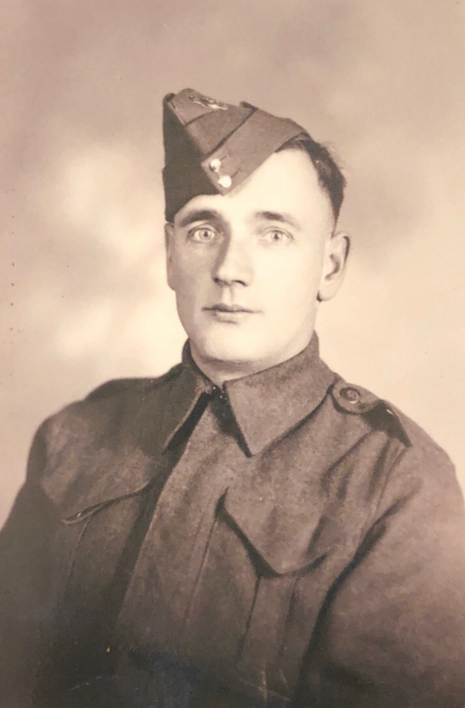
James Simpson &
Leonard MacCallum
Sky & Liv Stewart’s
Great Grand Fathers

Slide 22
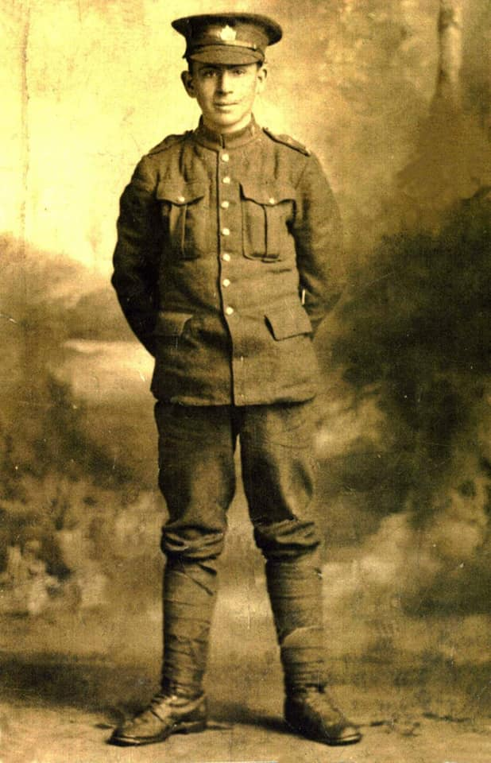
Aminah, Sam & Grace Gallant’s-- Great Great Uncle
Arthur Gallant

Slide 23
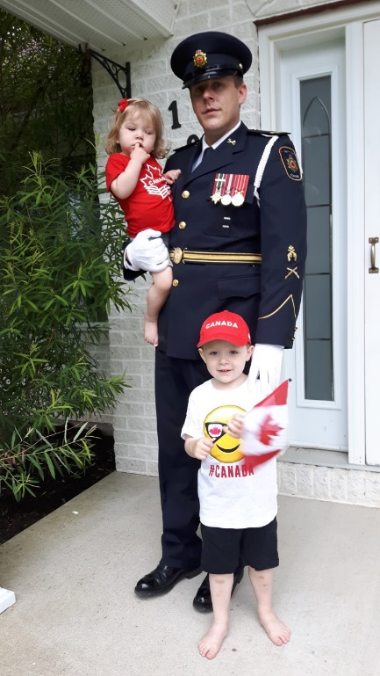
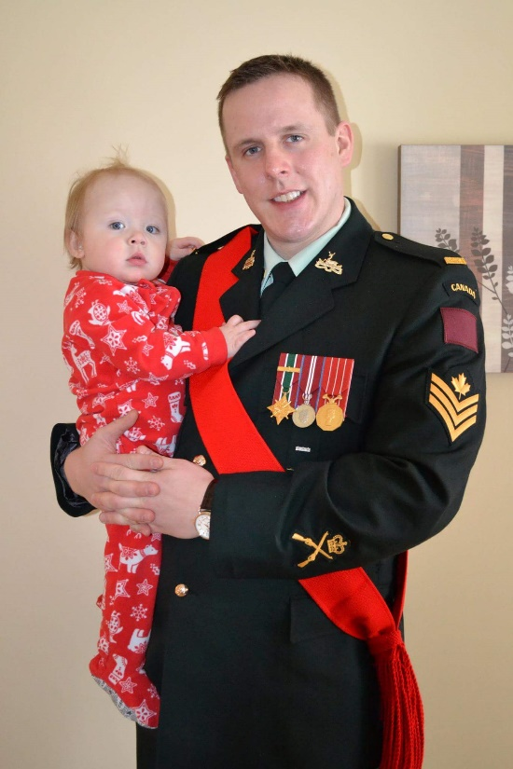
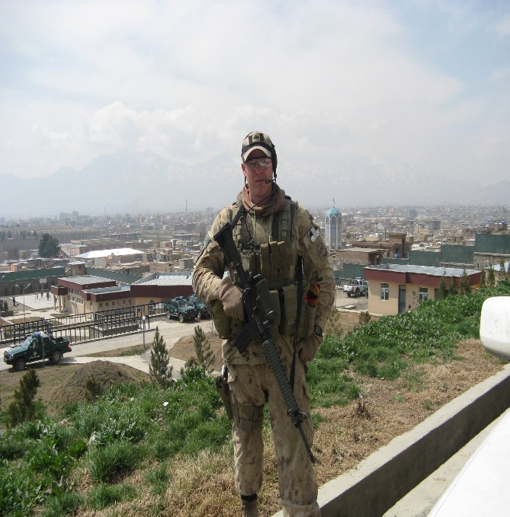
SERGEANT
CALEB DICKIE
Colten & Amelia’s Father

Slide 24
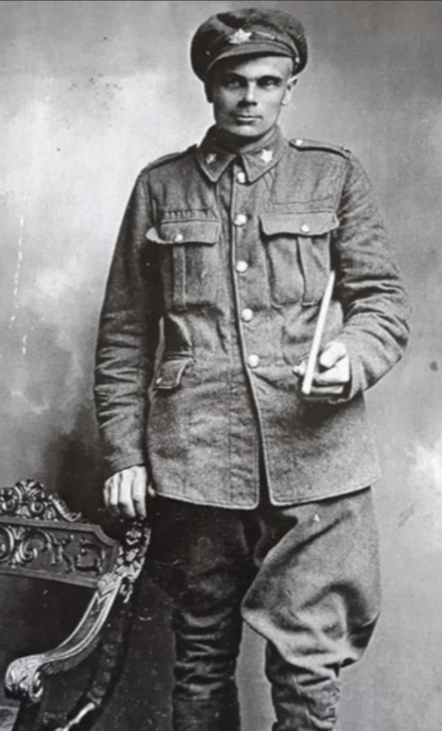
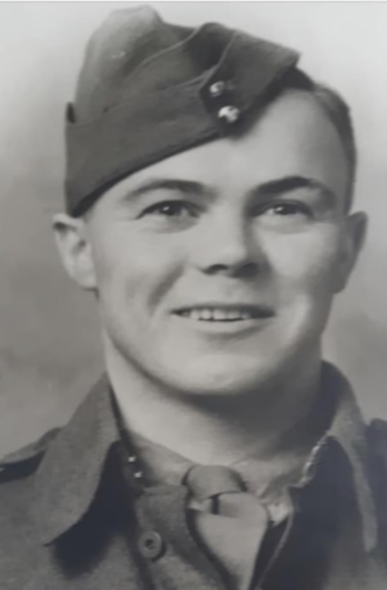
Great Great Grandfather William Savage (WWI) & son William Savage (WWII)
Emmily Mullin’s Great Great Grandfathers

Slide 25
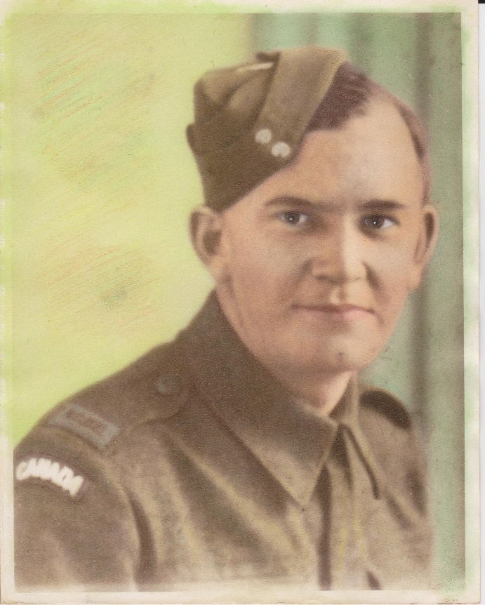
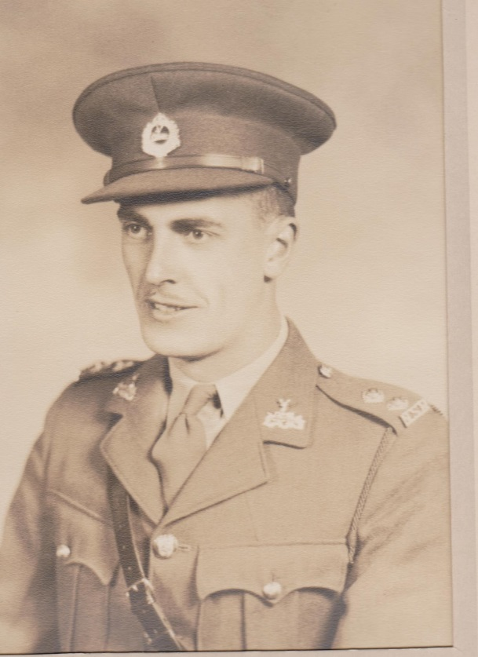
HUBERT BARNABY & BENEDICT DEWOLFE
Nicholas Treadwell’s
Great Great Grandfathers

Slide 26
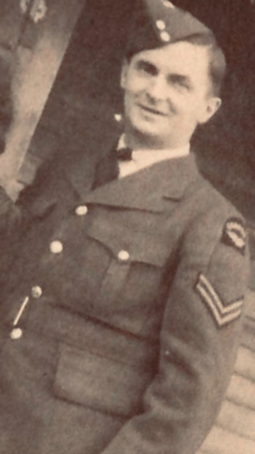
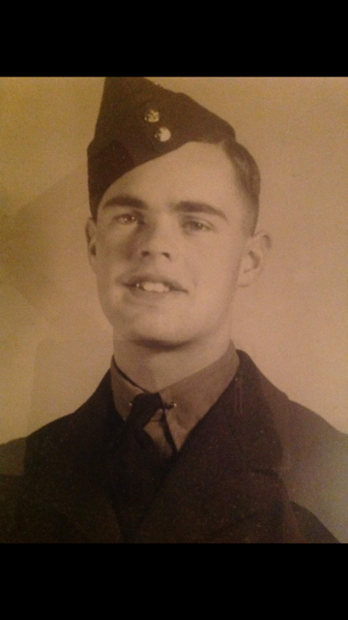
ROBERT & CAMPBELL WORRELL
Jack Worrell’s
Great Great Grandfathers

Slide 27
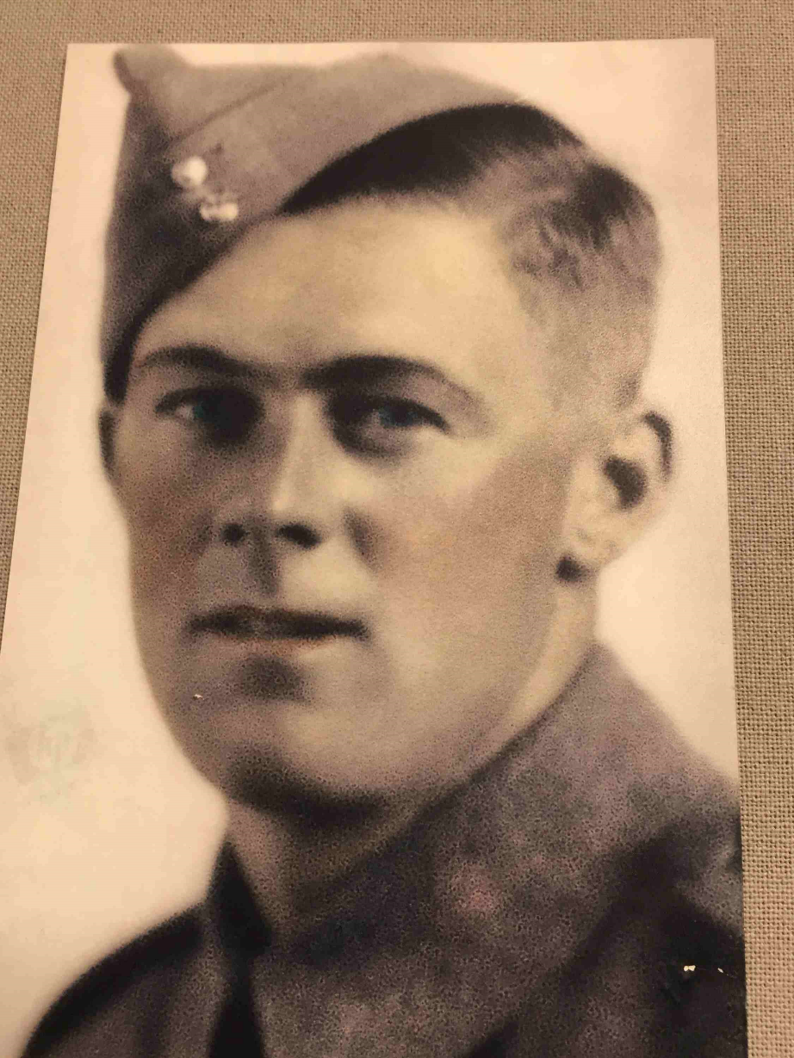
Byron Savage
Nealah Savage’s
Great Great
Grandfather

Slide 28
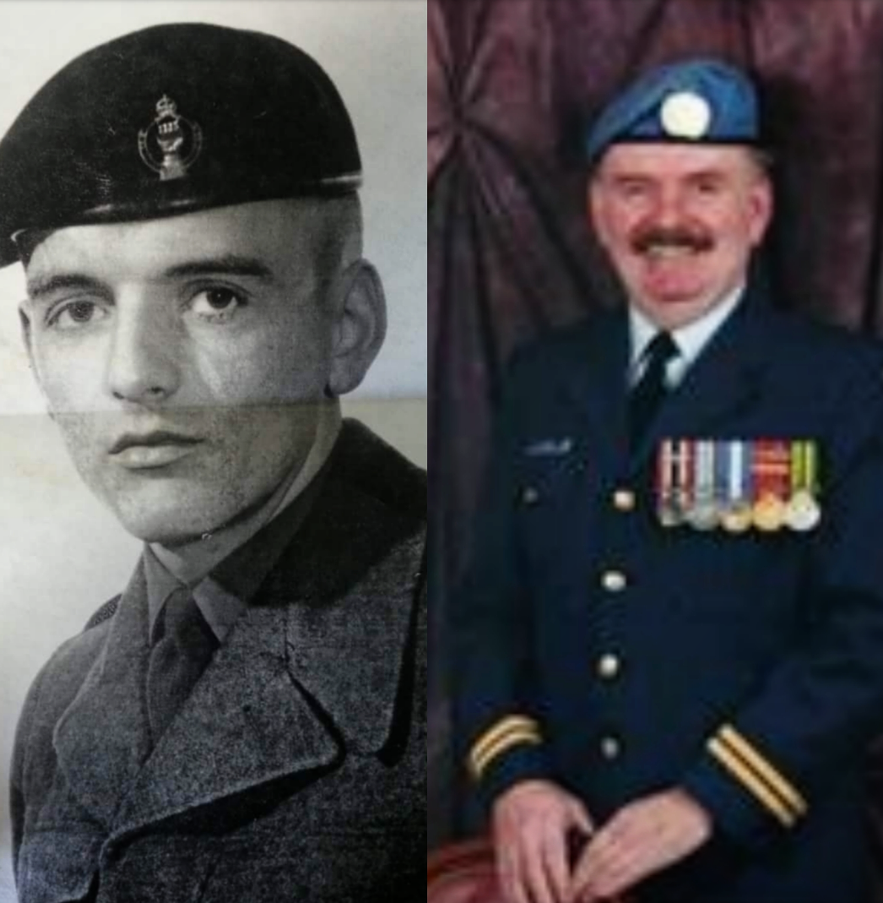
EARL WEIR
Lexen Guimond’s
Great Great
Grandfather

Slide 29
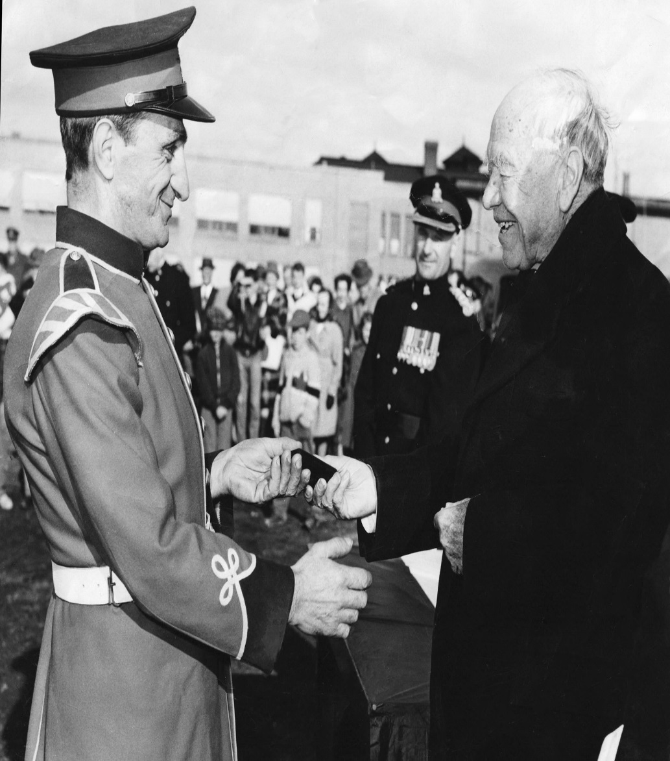
WILLIE FARRAH
Ella & Stone Breau’s
Great Great
Grandfather

Slide 30
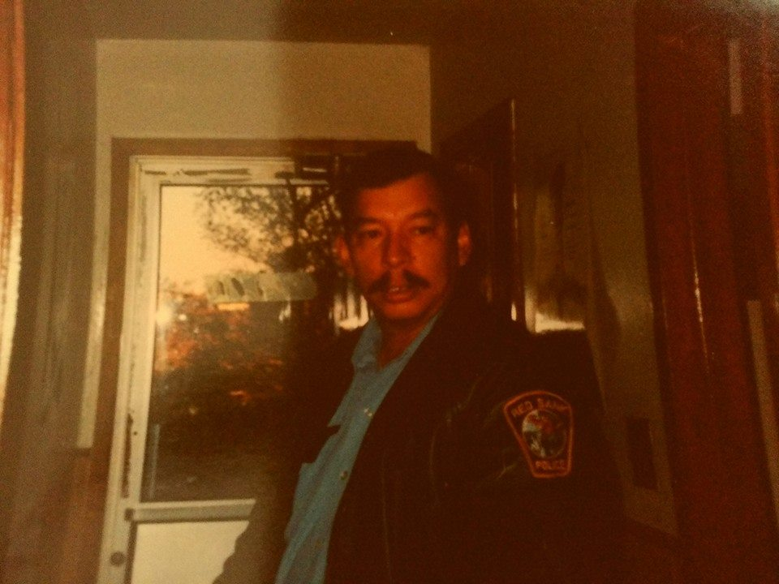
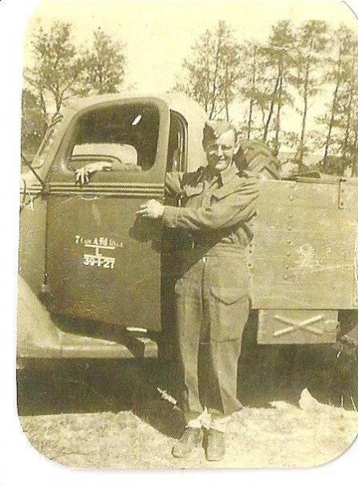
Wilfred LeGresley & Frank Sewell.
Sage Augustine Connell's Great Grand Fathers

Slide 31
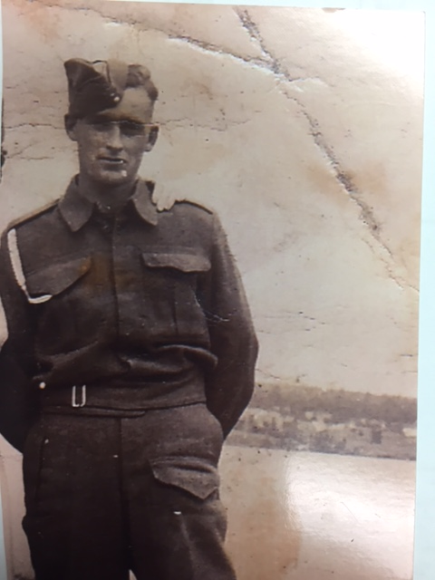
DEALY LANDRY
Great Grandfather to Gabriel Landry, Asher & Romi Kane

Slide 32
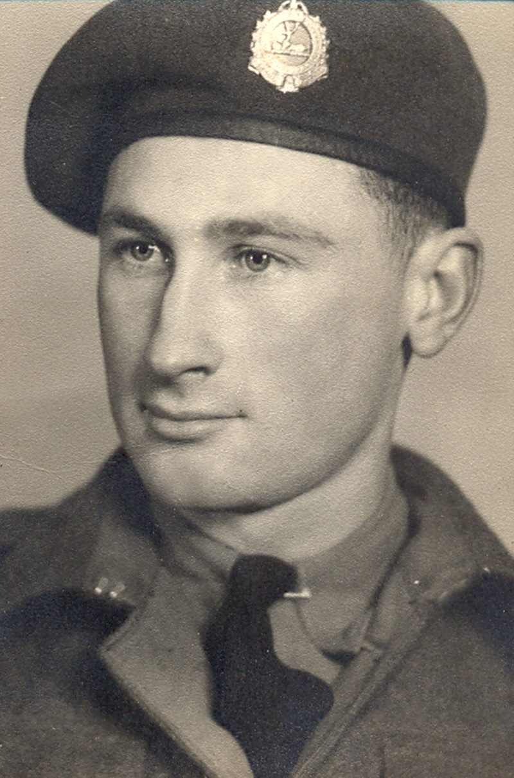
FREDERICK H.
PAYNE
Great grandfather to
Wynston, Tennyson, Huxley & Everett Foran

Slide 33
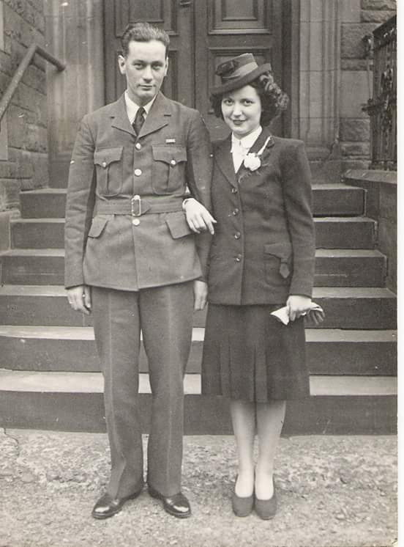
REG SAUNDERS
Great grandfather to
Luke and Charlotte
Saunders

Slide 34
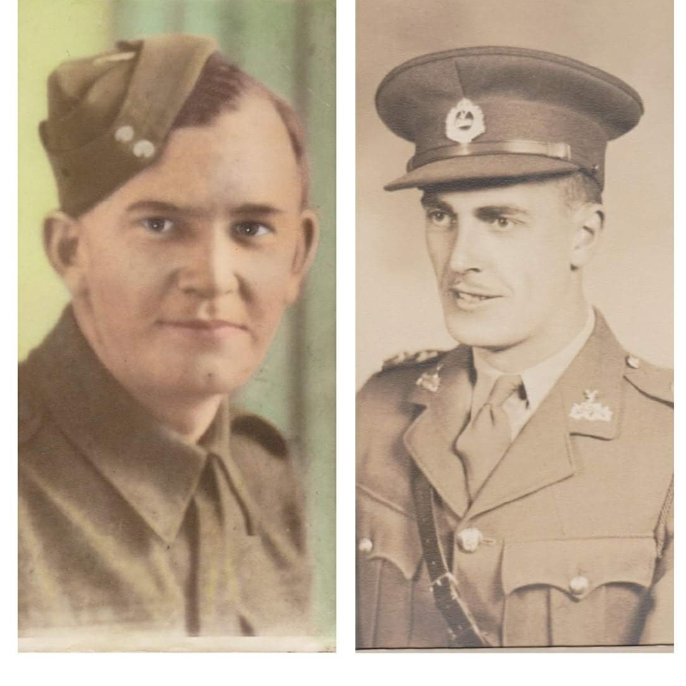
Hubert Barnaby
&
Benedict DeWolfe
Great Grandfathers to Nicholas Treadwell

Slide 35
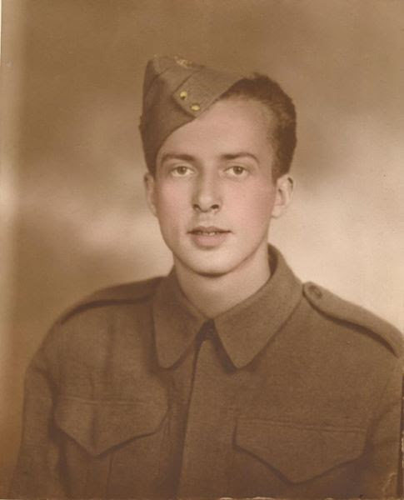
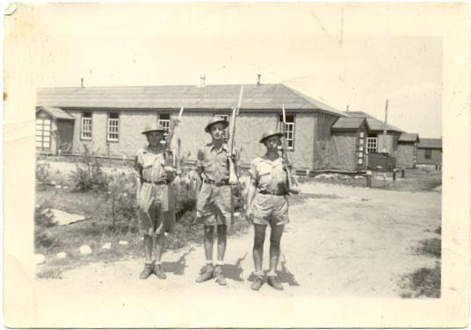
HAYWARD GRANT
Great- Great Grandfather to Molly Groundwater

Slide 36
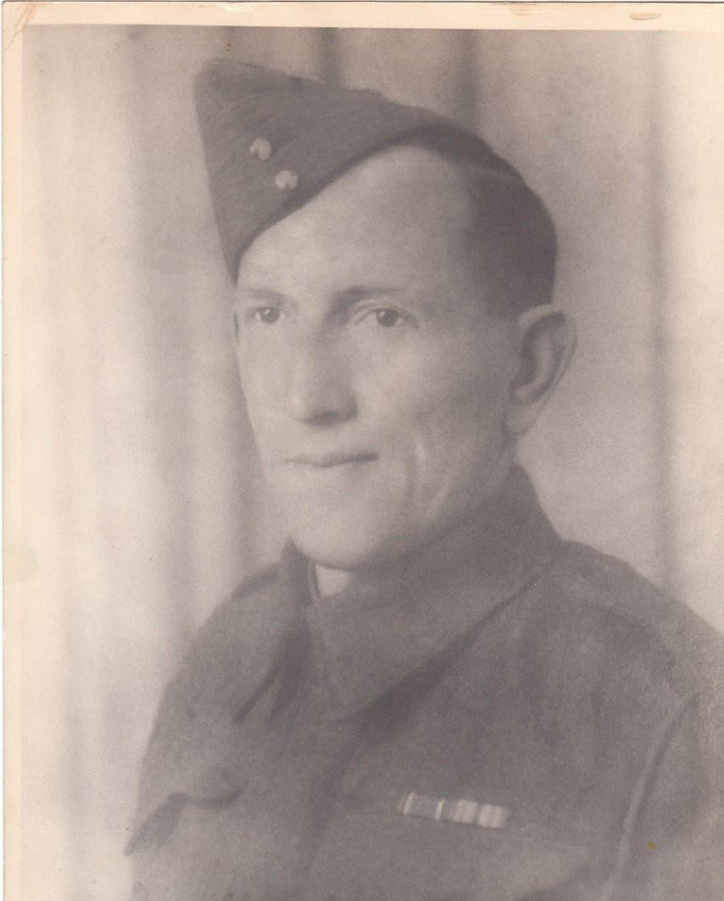
FREDERICK ARNOLD FOREST
Brady MacPherson's Great Great Grandfather

Slide 37
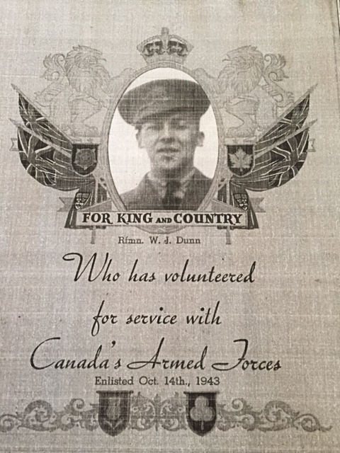
Rfmn. W.J. DUNN
Mrs. Dewolfe’s father

Slide 38
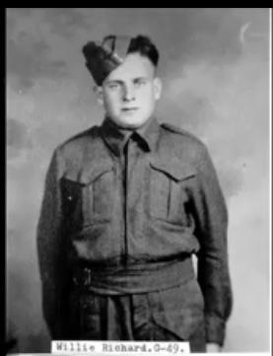
WILLIE RICHARD
Mme Lockerbie’s
Grandfather

Slide 39
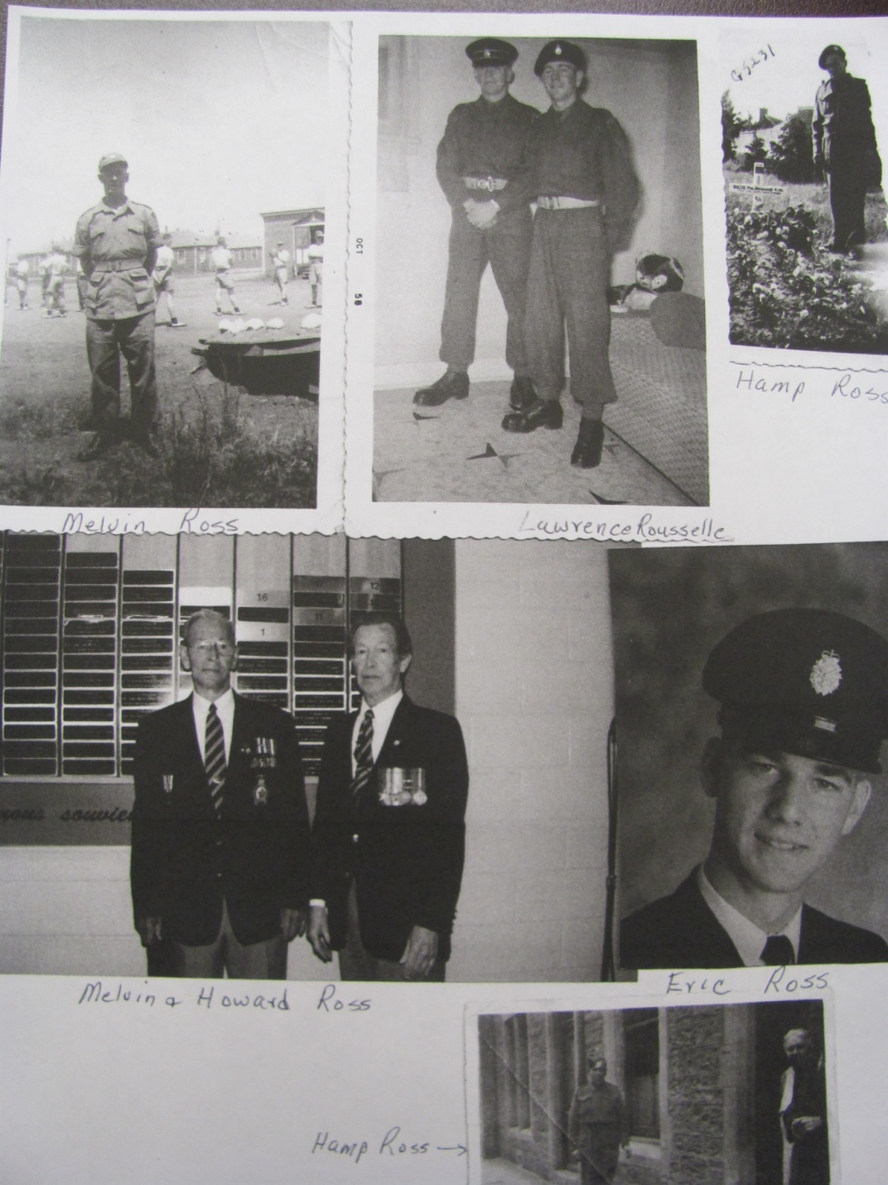
MEMBERS OF WALSH FAMILY
Related to Tyler
Anderson

Slide 40
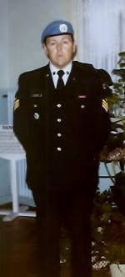
ALLAN MCKENZIE
Charlie, Jack & James Sullivan’s Grandfather

Slide 41
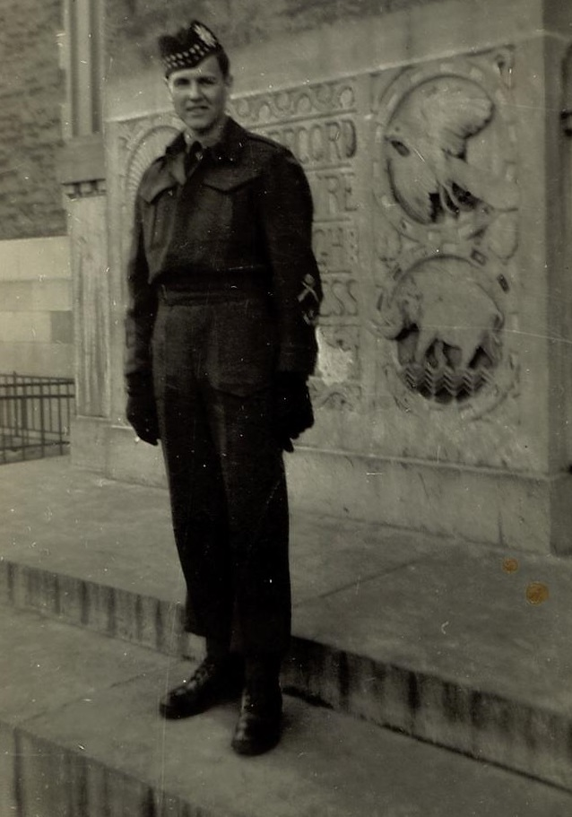
STERLING BELL
Great-Great Grandfather to Henry MacLean

Slide 42

JACK O’REILLY
Ms. O’Reilly’s Grandfather (on the right)

Slide 43

WILLIAM
BRANSFIELD
Great-grandfather of Ms. Bransfield
Great-great-grandfather Henry MacLean

Slide 44


CHARLES COOLEN
&
WILLIAM CLANCY
Kate, Max & Charlie Gallant’s Great Grandfathers

Slide 45



REID & BURTON WISHART
Ava Mitchell’s
Great Grandfathers

Slide 46

BILLY SAVAGE
Great Great Uncle to Nealah Savage & Charlie, Jack & James Sullivan
Great Grandfather to Lauren & Elena
Savage

Slide 47

ROBERT BRANSFIELD Sr.
Grandfather of Ms. Bransfield
Great-grandfather of
Henry MacLean

Slide 48

JEANNE O’REILLY
Ms. O’Reilly’s Grandmother (on the right)

Slide 49

Bryon Savage, Percy Savage, Billy Savage- Great Grandfathers
to Lauren, Elena & Nealah Savage
Great Great Uncle to Charlie
Jack & James Sullivan

Slide 50

GINNY CORKUM
Great Aunt to Roman Matchett

Slide 51

LOUIS HAROLD YOUNG
Great Grandfather to Adrienne &
Bentley Shaddick

Slide 52

WO Stuart Louis Young
Grandfather to Adrienne &
Bentley Shaddick

Slide 53

WILLIAM
STURGEON
William Sturgeon’s Great Grand Father

Slide 54


Clark Family
Mrs. Clark’s Father-In-Law

Slide 55

PATRICK DESMOND LYONS
Great Uncle to Quinn, Nora, Jacob, Rebecca, Matthew

Slide 56


Charles Arsenault &
Elmer Prosser
Conall & Luke McAllister’s Great Grandfathers

Slide 57

RAYMOND FLETCHER
Ms. Matheson’s
Grandfather

Slide 58

HOWARD WHITE
Great Grandfather to
Mason White

Slide 59


Holden Bowie &
Samuel Aube
Grandfathers to
Mrs. Allison

Slide 60


Jack Irving & brothers Andrew and Joseph
Great Grandfather to
Colin & Kale Murray

Slide 61

MELVIN ROSS
Great Grandfather to Tyler Anderson

Slide 62


RUBY SOMERS &
EARL BLAKELY
Great Great
Grandparents to
Sophie Burns

Slide 63

Monsignor RAYMOND HICKEY
Adrian Rosengren’s distant cousin

Slide 64

GREGORY JAMAEL
Great Grandfather to Aidan Forbes

Slide 65

WILFRED COMEAU
Great Great Uncle to Adrian Rosengren

Slide 66

FRANK MAHONEY
Great Grandfather to Maya McFarlane

Slide 67

RYAN MURPHY
Mrs. Gardiner’s Father

Slide 68


KEITH HUTT
Dylan & Ella’s Grandparents

Slide 69

CHARLES MCEVOY
Great Grandfather to Brianna & Liam Walsh

Slide 70

Yerxa Foran
Great Grandfather to Mrs Foran
Great Great Grandfather to London, Lleyton Foran
& Spencer McFarlane

Slide 71


WILFRED
ROBICHAUD
Great Grandfather to Lincoln Basque & Dallas and Delilah McEvoy

Slide 72


Byron Savage
Great Grandfather to London & Lleyton Savage

Slide 73


JAMES URQUHART & JOHN TURNBULL
Great Grandfathers to Charlotte Allison

Slide 74

HARRY DALEY
(Far Left)
Mrs. Yvonne Girouard’s Grandfather

Slide 75


KATHERINE BRANSFIELD
Henry McLean,Great-Great Grandmother

Slide 76

Patrick G Stewart
Samantha Tweedie’s Great Grandfather

Slide 77

FROM ALL OF US AT GRETNA GREEN SCHOOL
THANK YOU!

